Slide 1
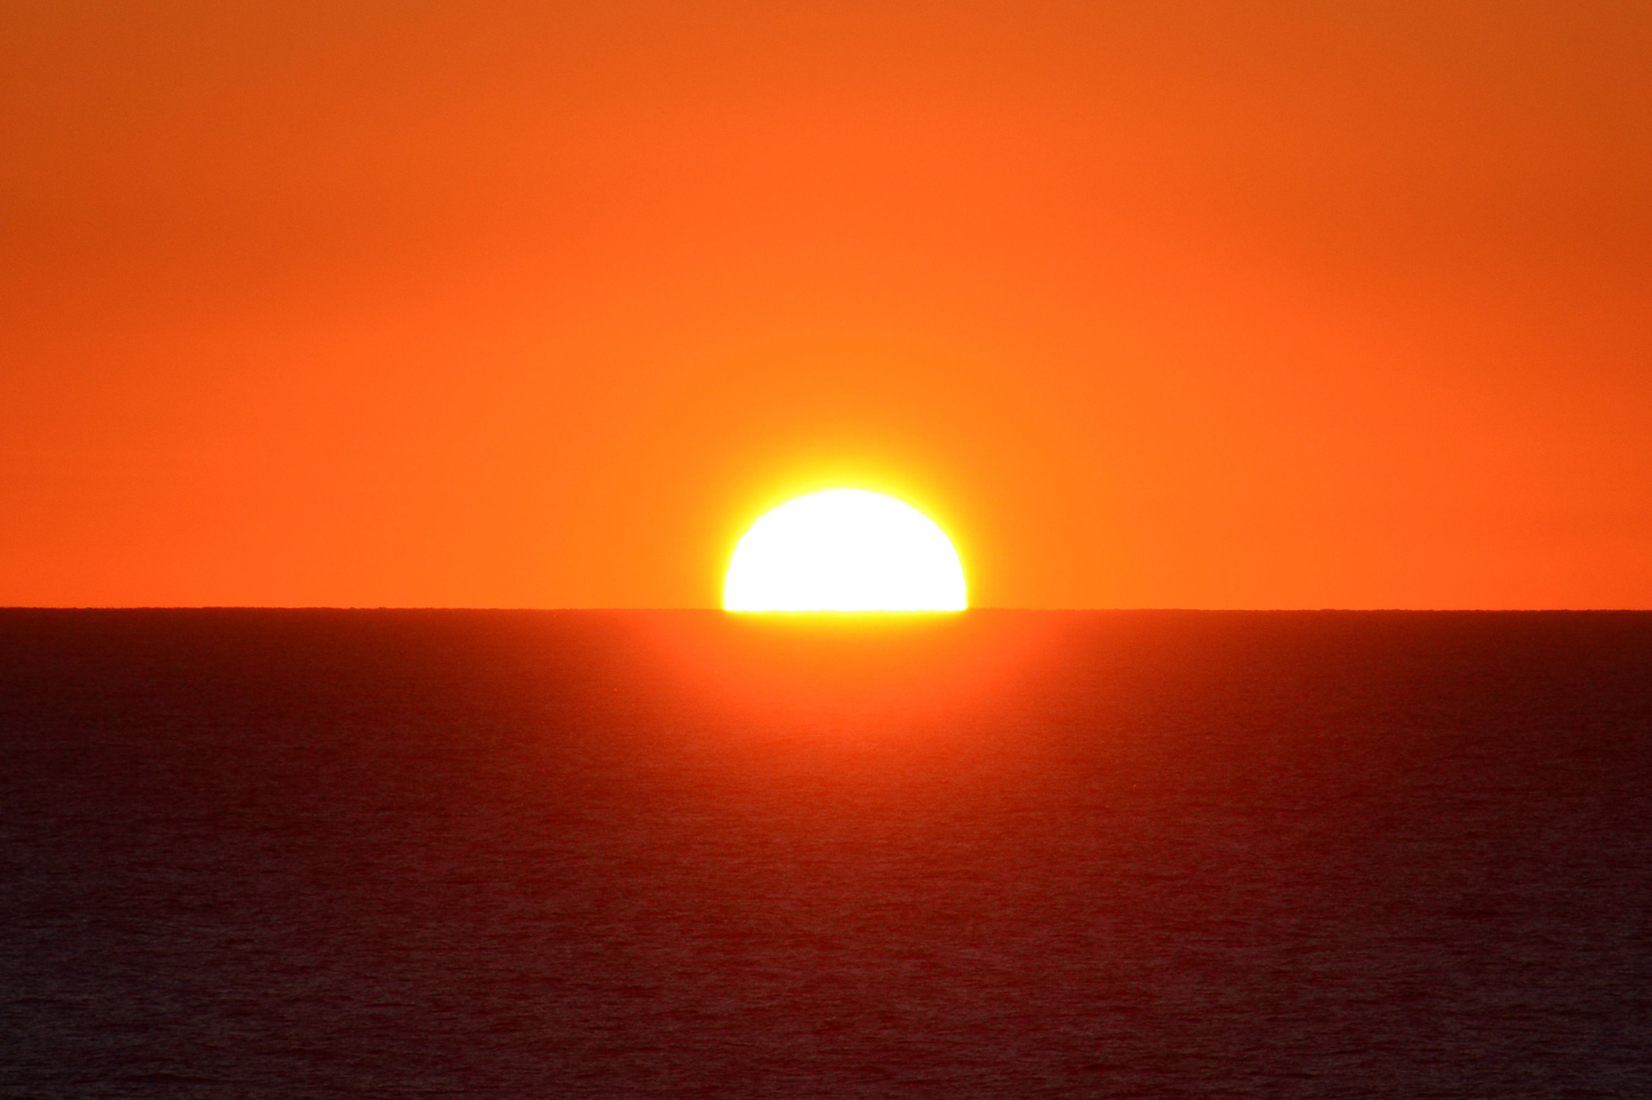
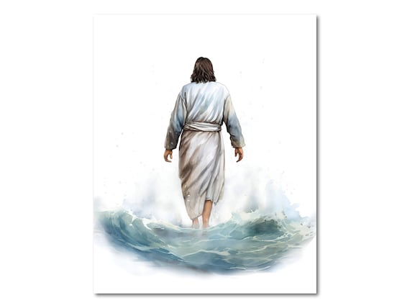
The Importance of the Sun/Son

Slide 2
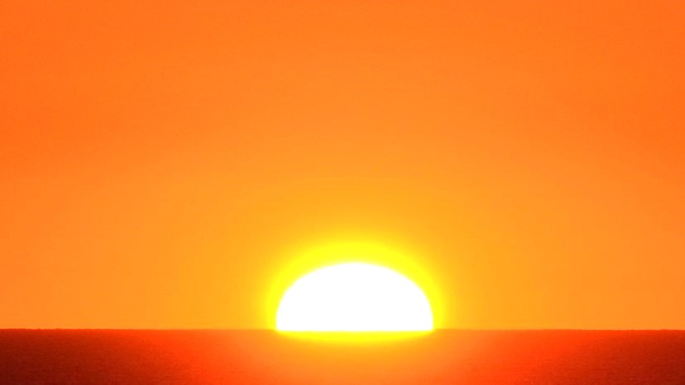
The Importance of the Sun

Slide 3
The Importance of the Sun
God made the Sun on the 4th Day of Creation

Slide 4
The Importance of the Sun
God made the Sun on the 4th Day of Creation
“Now when the sun was going down, a deep sleep fell upon Abram; and behold, horror and great darkness fell upon him.”
Genesis 15:12

Slide 5
The Importance of the Sun
It Radiates Light, Heat, or Solar Energy

Slide 6
The Importance of the Sun
It Radiates Light, Heat, or Solar Energy
Plants need sunlight to grow
Animals & humans need plants for food and the oxygen they produce
Without heat from the sun, the Earth would freeze

Slide 7
The Importance of the Sun
Why Else Do Humans Require Sunlight?

Slide 8
The Importance of the Sun
Why Else Do Humans Require Sunlight?
Human body has photoceptors (cells that respond to light), in the eyes and the skin that detect light, signals various pathways in the body, and are able to covert that light into energy.

Slide 9
The Importance of the Sun
Why Else Do Humans Require Sunlight?
The best-known benefit of the sun and sunlight is its ability to boost the body’s Vitamin D supply.
Most cases of lack of Vitamin D are from lack of sunlight
Vitamin D helps to promote stronger bones
Vitamin D helps prevent the onset of Diabetes

Slide 10
The Importance of the Sun
Why Else Do Humans Require Sunlight?
The sun and sunlight raise Serotonin levels improving our moods.

Slide 11
The Importance of the Sun
Why Else Do Humans Require Sunlight?
Sunlight exposure impacts how much Melatonin our brains produce which tells our brain to sleep when it
is dark.

Slide 12
The Importance of the Sun
Why Else Do Humans Require Sunlight?
The sun and sunlight encourages production of white blood cells balancing the immune system.

Slide 13
The Importance of the Sun
Why Else Do Humans Require Sunlight?
The ultraviolet radiation of the sun actually helps to heal certain type skin conditions.

Slide 14
The Importance of the Sun
Why Else Do Humans Require Sunlight?
Sunlight also kills bacteria.

Slide 15
The Importance of the Sun
Why Else Do Humans Require Sunlight?
“Then the Lord said to Moses, “Stretch out your hand toward heaven, that there may be darkness over the land of Egypt, darkness which may even be felt.”...
Exodus 10:21-23

Slide 16
The Importance of the Sun
Why Else Do Humans Require Sunlight?
…So Moses stretched out his hand toward heaven, and there was thick darkness in all the land of Egypt three days. They did not see one another; nor did anyone rise from his place for three days. But all the children of Israel had light in their dwellings.”
Exodus 10:21-23

Slide 17
The Importance of the Sun
Where Would We Be
Without The Sun?

Slide 18
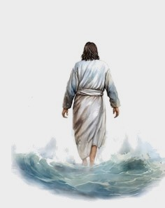
The Importance of the Son

Slide 19
The Importance of the Son
John 1:1-18

Slide 20
The Importance of the Son
“Then Jesus spoke to them again, saying,
“I am the light of the world. He who follows Me shall
not walk in darkness, but have the light of life.”
John 8:12

Slide 21
The Importance of the Son
“The city had no need of the sun or of the moon to shine in it, for the glory of God illuminated it. The Lamb is its light.”
Revelation 21:23

Slide 22
The Importance of the Son
“Then God made two great lights: the greater light to rule the day, and the lesser light to rule the night. He made the stars also. God set them in the firmament of the heavens to give light on the earth, and to rule over the day and over the night, and to divide the light from the darkness. And God saw that it was good.”
Genesis 1:16-18

Slide 23
The Importance of the Son
“And this is the condemnation, that the light has come into the world, and men loved darkness rather than light, because their deeds were evil. For everyone practicing evil hates the light and does not come to the light,
lest his deeds should be exposed.”
John 3:19-20

Slide 24
The Importance of the Son
“But if one walks in the night, he stumbles,
because the light is not in him.”
John 11:10

Slide 25
The Importance of the Son
“There are those who rebel against the light; They do not know its ways Nor abide in its paths. The murderer rises with the light; He kills the poor and needy;
And in the night he is like a thief…
Job 24:13-16

Slide 26
The Importance of the Son
…The eye of the adulterer waits for the twilight,
Saying, ‘No eye will see me’; And he disguises his face.
In the dark they break into houses Which they marked for themselves in the daytime; They do not know the light.”
Job 24:13-16

Slide 27
The Importance of the Son
“So it came between the camp of the Egyptians and the camp of Israel. Thus it was a cloud and darkness to the one, and it gave light by night to the other, so that the one did not come near the other all that night.”
Exodus 14:20

Slide 28
The Importance of the Son
He is our Savior and Redeemer

Slide 29
The Importance of the Son
He is our Savior and Redeemer
“Jesus said to her, “I am the resurrection and the life.
He who believes in Me, though he may die, he shall live. And whoever lives and believes in Me shall never die.
Do you believe this?”
John 11:25-26

Slide 30
The Importance of the Son
He is our Savior and Redeemer
“For God did not send His Son into the world to
condemn the world, but that the world
through Him might be saved?”
John 3:17

Slide 31
The Importance of the Son
He Is The Great Physician

Slide 32
The Importance of the Son
He Is The Great Physician
“When Jesus heard it, He said to them, “Those who are well have no need of a physician, but those who are sick. I did not come to call the righteous, but sinners, to repentance.”
Mark 2:17

Slide 33
The Importance of the Son
He Came to Save Sinners

Slide 34
The Importance of the Son
He Came to Save Sinners
“This is a faithful saying and worthy of all acceptance,
that Christ Jesus came into the world to save sinners,
of whom I am chief.”
1 Timothy 1:15

Slide 35
The Importance of the Son
He is Our Source of Life

Slide 36
The Importance of the Son
He is Our Source of Life
“I am the vine, you are the branches. He who abides in Me, and I in him, bears much fruit;
for without Me you can do nothing.”
John 15:5

Slide 37
The Importance of the Son
He Came to Share the “spirit” of the Word

Slide 38
The Importance of the Son
He Came to Share the “spirit” of the Word
“He who does not love Me does not keep My words;
and the word which you hear is not Mine
but the Father’s who sent Me.”
John 14:24

Slide 39
The Importance of the Son
He is the Great Example to Follow

Slide 40
The Importance of the Son
He is Now an Advocate For Us

Slide 41
The Importance of the Son
He is Now an Advocate For Us
“My little children, these things I write to you,
so that you may not sin. And if anyone sins,
we have an Advocate with the Father,
Jesus Christ the righteous.”
1 John 2:1

Slide 42
The Importance of the Son
As a High Priest He Intercedes For Us

Slide 43
The Importance of the Son
As a High Priest He Intercedes For Us
“Also there were many priests, because they were prevented by death from continuing. But He, because He continues forever, has an unchangeable priesthood. Therefore He is also able to save to the uttermost those who come to God through Him,
since He always lives to make intercession for them.”
Hebrews 7:23-25

Slide 44
The Importance of the Son
Where Would We Be
Without The Son of God?

Slide 45
The Importance of the Son
You may never know that Jesus is all you need,
until Jesus is all you have!

Slide 46
The Importance of the Sun/Son

Slide 47
The Importance of the Sun/Son
“Let not your heart be troubled; you believe in God, believe also in Me. In My Father’s house are many mansions; if it were not so, I would have told you. I go to prepare a place for you. And if I go and prepare a place for you,
I will come again and receive you to Myself;
that where I am, there you may be also
John 14:1-3

