Slide 1
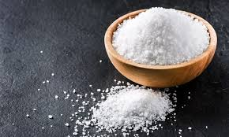
Salt of the Earth

Slide 2
Salt of the Earth
“You are the salt of the earth;
but if the salt loses its flavor,
how shall it be seasoned?
It is then good for nothing but
to be thrown out and
trampled underfoot by men.”
Matthew 5:13

Slide 3
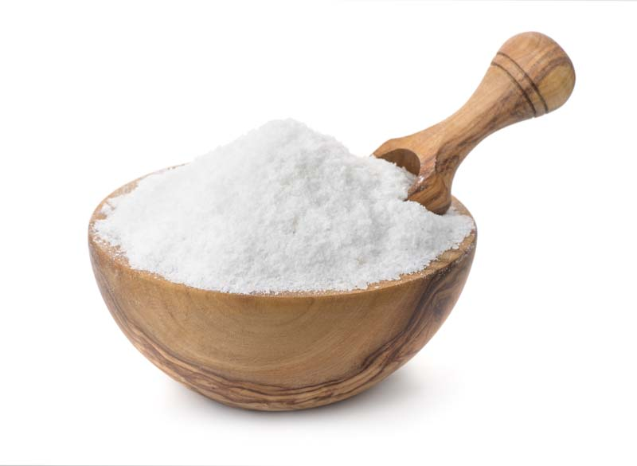
Salt Has Preserving Power
Salt of the Earth

Slide 4
Salt Has Preserving Power
“The wicked shall be turned into hell,
And all the nations that forget God.”
Psalm 9:17
Salt of the Earth

Slide 5
Salt Has Preserving Power
“Righteousness exalts a nation,
But sin is a reproach to any people.”
Proverbs 14:34
Salt of the Earth

Slide 6
Salt Has Preserving Power
“Behold, the eyes of the Lord God are on the sinful kingdom, And I will destroy it from the face of the earth; Yet I will not utterly destroy the house of Jacob,” Says the Lord.”
Amos 9:8
Salt of the Earth

Slide 7
Salt Has Irritating Power

Slide 8
Salt Has Irritating Power
“For the word of God is living and powerful, and sharper than any two-edged sword, piercing even to the division of soul and spirit, and of joints and marrow, and is a discerner of the thoughts and intents of the heart.”
Hebrews 4:12
Salt of the Earth

Slide 9
Salt Has Irritating Power
“Blessed are you when they revile and persecute you, and say all kinds of evil against you falsely for My sake. Rejoice and be exceedingly glad, for great is your reward in heaven, for so they persecuted the prophets who were before you.”
Matthew 5:11-12
Salt of the Earth

Slide 10
Salt Has Irritating Power
“Woe to you, scribes and Pharisees, hypocrites!
For you cleanse the outside of the cup and dish,
but inside they are full of extortion and self-indulgence.
Blind Pharisee, first cleanse the inside of the cup and dish,
that the outside of them may be clean also.”
Matthew 23:25-26
Salt of the Earth

Slide 11
Salt Has Irritating Power
“For Herod had laid hold of John and bound him,
and put him in prison for the sake of Herodias,
his brother Philip’s wife. Because John had said to him,
“It is not lawful for you to have her.”
Matthew 14:3-4
Salt of the Earth

Slide 12
Salt Has Irritating Power
“You stiff-necked and uncircumcised in heart and ears! You always resist the Holy Spirit; as your fathers did, so do you. Which of the prophets did your fathers not persecute? And they killed those who foretold the coming of the Just One, of whom you now have become the betrayers and murderers, who have received the law by the direction of angels and have not kept it.”
Acts 7:51-53
Salt of the Earth

Slide 13
Salt Has Thirsting Power
Salt of the Earth

Slide 14
Salt Has Thirsting Power
Christians, by their lives
and teachings, make others thirst for the word of God.
Salt of the Earth

Slide 15
Salt Has Flavoring Power
Salt of the Earth

Slide 16
Salt Has Flavoring Power
“Salt is good; but if the salt has lost its flavor, how shall it be seasoned?
It is neither fit for the land nor for the dunghill, but men throw it out.
He who has ears to hear, let him hear!”
Luke 14:34-35
Salt of the Earth

Slide 17
Salt Has Flavoring Power
“For everyone will be seasoned with fire, and every sacrifice will be seasoned with salt. Salt is good, but if the salt loses its flavor, how will you season it? Have salt in yourselves,
and have peace with one another.”
Mark 9:49-50
Salt of the Earth

Slide 18
Salt Has Flavoring Power
“Let your speech always be with grace, seasoned with salt, that you may know how you ought to answer each one.”
Colossians 4:6
Salt of the Earth

Slide 19
Salt Has Flavoring Power
“Pure and undefiled religion before God and the Father is this: to visit orphans and widows in their trouble, and to keep oneself unspotted from the world.”
James 1:27
Salt of the Earth

Slide 20
Salt Has Flavoring Power
“And on some have compassion, making a distinction; but others save with fear, pulling them out of the fire, hating even the garment defiled by the flesh.”
Jude 22-23
Salt of the Earth

Slide 21
Salt of the Earth

