Slide 2
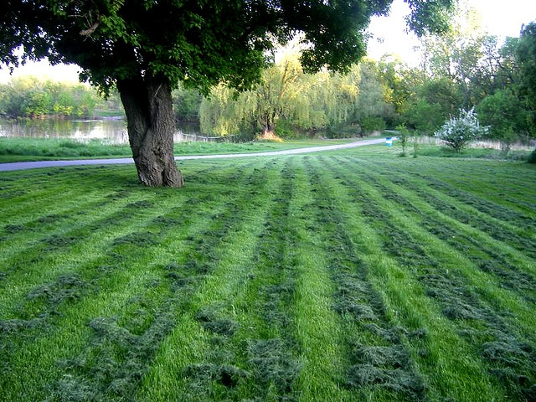

Slide 6
TOUGH LESSONS TO LEARN!

Slide 7
Motivation
Strong Will
Determination
Discipline
Focus
Desire
Passion
TOUGH LESSONS TO LEARN!

Slide 8
OUR PROMISE TO GOD

Slide 9
IF JESUS DID NOT QUIT, WHY SHOULD I?

Slide 10
IF JESUS DID NOT QUIT, WHY SHOULD I?
“Him, being delivered by the determined purpose and foreknowledge of God, you have taken by lawless hands, have crucified, and put to death;”
Acts 2:23

Slide 11
IF JESUS DID NOT QUIT, WHY SHOULD I?
“Let this mind be in you which was also in Christ Jesus, who, being in the form of God, did not consider it robbery to be equal with God, but made Himself of no reputation, taking the form of a bondservant, and coming in the likeness of men. And being found in appearance as a man, He humbled Himself and became obedient to the point of death, even the death of the cross.”
Philippians 2:5-8

Slide 12
IF JESUS DID NOT QUIT, WHY SHOULD I?
“For to this you were called, because Christ also suffered for us, leaving us an example, that you should follow His steps:”
1 Peter 2:21

Slide 13
IF JESUS DID NOT QUIT, WHY SHOULD I?
“But Jesus said to him, "No one, having put his hand to the plow, and looking back, is fit for the kingdom of God.”
Luke 9:62

Slide 14
IF JESUS DID NOT QUIT, WHY SHOULD I?
“But his wife looked back behind him, and she became a pillar of salt.”
Genesis 19:26

Slide 15
IF JESUS DID NOT QUIT, WHY SHOULD I?
“I came forth from the Father and have come into the world. Again, I leave the world and go to the Father.”
John 16:28

Slide 16
IF JESUS DID NOT QUIT, WHY SHOULD I?
“For God did not send His Son into the world to condemn the world, but that the world through Him might be saved.”
John 3:17

Slide 17
IF JESUS DID NOT QUIT, WHY SHOULD I?
“When Jesus heard it, He said to them,
"Those who are well have no need of a physician, but those who are sick. I did not come to call the righteous, but sinners, to repentance.”
Mark 2:17

Slide 18
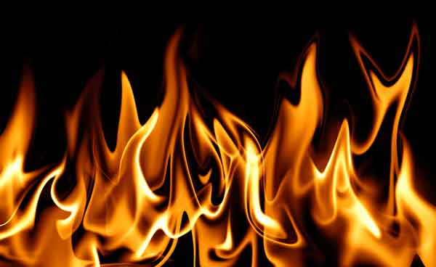
PASSION STRONGER THAN FEARS

Slide 19
PASSION STRONGER THAN FEARS
“Do you not know that those who run in a race all run, but one receives the prize?
Run in such a way that you may obtain it.”
1Corinthians 9:24

Slide 20
STRONG WILLED, DETERMINED, FOCUSED

Slide 21
STRONG WILLED, DETERMINED, FOCUSED
“I can do all things through
Christ who strengthens me.”
Philippians 4:13

Slide 22
STRONG WILLED, DETERMINED, FOCUSED
“Blessed is the man who endures temptation; for when he has been approved, he will receive the crown of life which the Lord has promised
to those who love Him.”
James 1:12

Slide 23
STRONG WILLED, DETERMINED, FOCUSED
“I have fought the good fight,
I have finished the race, I have kept the faith.”
2Timothy 4:7

Slide 24
STRONG WILLED, DETERMINED, FOCUSED
“I press toward the goal for the prize of the upward call of God in Christ Jesus.”
Philippians 3:14

Slide 26
I CAN DO ALL THINGS

