Slide 1
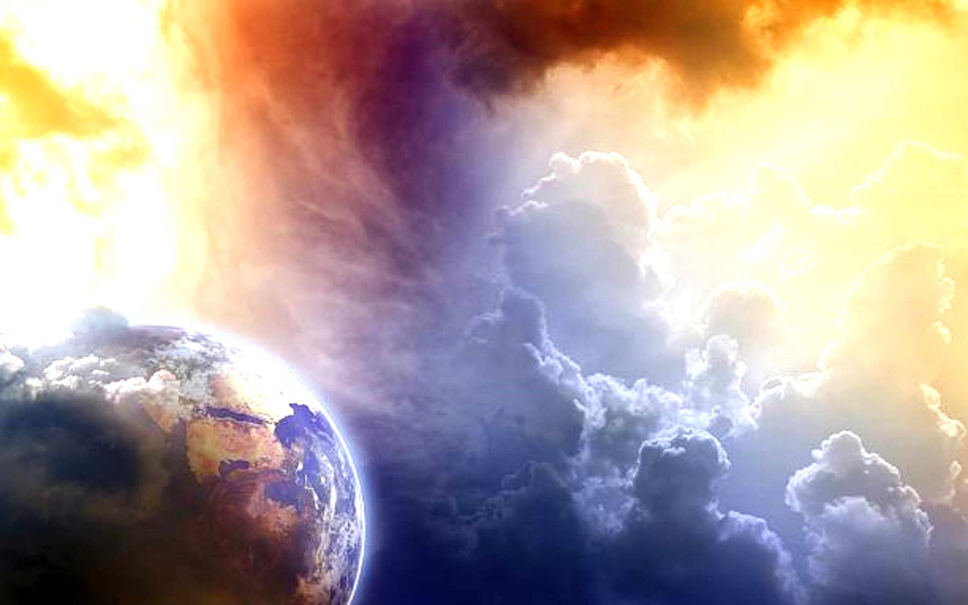
Boldness in the Day of Judgment

Slide 2
Christians should react “boldly”

Slide 3
Christians should react “boldly”
Not with self-confidence, but with Christ-confidence

Slide 4
Christians should react “boldly”
Not with self-confidence, but with Christ-confidence
“in whom we have boldness and access
with confidence through faith in Him.”
Ephesians 3:12

Slide 5
We Should Feel Assured of its REALITY
Boldness in the Day of Judgment

Slide 6
We Should Feel Assured of its REALITY
“Truly, these times of ignorance God overlooked, but now commands all men everywhere to repent,”
Acts 17:30
Boldness in the Day of Judgment

Slide 7
We Should Feel Assured of its REALITY
“because He has appointed a day on which He will judge the world in righteousness by the Man whom He has ordained. He has given assurance of this to all by raising Him from the dead.”
Acts 17:31
Boldness in the Day of Judgment

Slide 8
We Should Feel Assured of its REALITY
“And as it is appointed for men to die once,
but after this the judgment,”
Hebrews 9:27
Boldness in the Day of Judgment

Slide 9
We Should Feel Assured of its RESULTS
Boldness in the Day of Judgment

Slide 10
We Should Feel Assured of its RESULTS
“Love has been perfected among us in this:
that we may have boldness in the day of judgment; because as He is, so are we in this world.”
1 John 4:17
Boldness in the Day of Judgment

Slide 11
Not all who look for it, should “look forward” to it
Boldness in the Day of Judgment

Slide 12
Not all who look for it, should “look forward” to it
“For if we sin willfully after we have received the knowledge of the truth, there no longer remains a sacrifice for sins,”
Hebrews 10:26
Boldness in the Day of Judgment

Slide 13
Not all who look for it, should “look forward” to it
“but a certain fearful expectation of judgment, and fiery indignation which will devour the adversaries.”
Hebrews 10:27
Boldness in the Day of Judgment

Slide 14
Not all who look for it, should “look forward” to it
“Therefore, since all these things will be dissolved, what manner of persons ought you to be in holy conduct and godliness, looking for and hastening the coming of the day of God, because of which the heavens will be dissolved, being on fire, and the elements will melt with fervent heat?...
2 Peter 3:11-14
Boldness in the Day of Judgment

Slide 15
Not all who look for it, should “look forward” to it
…Nevertheless we, according to His promise, look for new heavens and a new earth in which righteousness dwells. Therefore, beloved, looking forward to these things, be diligent to be found by Him in peace, without spot and blameless;”
2 Peter 3:11-14
Boldness in the Day of Judgment

Slide 16
Not all who “look forward to it” should
Boldness in the Day of Judgment

Slide 17
Not all who “look forward to it” should
“False Assurance”
Boldness in the Day of Judgment

Slide 18
Not all who “look forward to it” should
“just as David also describes the blessedness of the man to whom God imputes righteousness apart from works:
“Blessed are those whose lawless deeds are forgiven,
And whose sins are covered; Blessed is the man to whom the Lord shall not impute sin.”
Romans 4:6-8
Boldness in the Day of Judgment

Slide 19
Not all who “look forward to it” should
“But if we walk in the light as He is in the light, we have fellowship with one another, and the blood of Jesus Christ His Son cleanses us from all sin.”
1 John 1:7
Boldness in the Day of Judgment

Slide 20
Not all who “look forward to it” should
“If we confess our sins, He is faithful and just to forgive us our sins and to cleanse us from all unrighteousness.”
1 John 1:9
Boldness in the Day of Judgment

Slide 21
Not all who “look forward to it” should
“Then Paul, looking earnestly at the council, said,
“Men and brethren, I have lived in all good conscience before God until this day.”
Acts 23:1
Boldness in the Day of Judgment

Slide 22
Not all who should “look forward to it” do
Boldness in the Day of Judgment

Slide 23
Not all who should “look forward to it” do
“Weak Faith”
Boldness in the Day of Judgment

Slide 24
Not all who should “look forward to it” do
“The Lord is not slack concerning His promise, as some count slackness, but is longsuffering toward us, not willing that any should perish but that all should come to repentance.”
2 Peter 3:9
Boldness in the Day of Judgment

Slide 25
Not all who should “look forward to it” do
“Then Peter said to them, “Repent, and let every one of you be baptized in the name of Jesus Christ
for the remission of sins; and you shall receive the gift of the Holy Spirit.”
Acts 2:38
Boldness in the Day of Judgment

Slide 26
Not all who should “look forward to it” do
“But if we walk in the light as He is in the light, we have fellowship with one another, and the blood of Jesus Christ His Son cleanses us from all sin.”
1 John 1:7
Boldness in the Day of Judgment

Slide 27
Not all who should “look forward to it” do
“If we confess our sins,
He is faithful and just to forgive us
our sins and to cleanse us from all unrighteousness.”
1 John 1:9
Boldness in the Day of Judgment

Slide 28
Not all who should “look forward to it” do
“Do not fear any of those things which you are about to suffer. Indeed, the devil is about to throw some of you into prison, that you may be tested, and you will have tribulation ten days. Be faithful until death, and I will give you the crown of life.”
Revelation 2:10
Boldness in the Day of Judgment

Slide 29
Not all who should “look forward to it” do
“For to me, to live is Christ, and to die is gain.”
Philippians 1:21
Boldness in the Day of Judgment

Slide 30
Not all who should “look forward to it” do
“Let us therefore come boldly to the throne of grace, that we may obtain mercy and find
grace to help in time of need.”
Hebrews 4:16
Boldness in the Day of Judgment

Slide 31
Not all who should “look forward to it” do
“Therefore let him who thinks he stands
take heed lest he fall.”
1 Corinthians 10:12
Boldness in the Day of Judgment

Slide 32
Not all who should “look forward to it” do
“No temptation has overtaken you except such as is common to man; but God is faithful, who will not allow you to be tempted beyond what you are able, but with the temptation will also make the way of escape, that you may be able to bear it.”
1 Corinthians 10:13
Boldness in the Day of Judgment

Slide 33
Not all who should “look forward to it” do
“But the Lord is faithful, who will establish you
and guard you from the evil one.”
2 Thessalonians 3:3
Boldness in the Day of Judgment

Slide 34
Not all who should “look forward to it” do
“And we have confidence in the Lord concerning you, both that you do and will do
the things we command you.”
2 Thessalonians 3:4
Boldness in the Day of Judgment

Slide 35
Not all who should “look forward to it” do
“For this reason I also suffer these things; nevertheless I am not ashamed, for I know whom I have believed and am persuaded that He is able to keep what I have committed to Him until that Day.”
2 Timothy 1:12
Boldness in the Day of Judgment

Slide 36
Not all who should “look forward to it” do
“Whoever commits sin also commits lawlessness,
and sin is lawlessness.”
1 John 3:4
Boldness in the Day of Judgment

Slide 37
Not all who should “look forward to it” do
“Therefore, as we have opportunity, let us do good to all, especially to those who are of the household of faith.”
Galatians 6:10
Boldness in the Day of Judgment

Slide 38
Not all who should “look forward to it” do
“Therefore, to him who knows to do good
and does not do it, to him it is sin.”
James 4:17
Boldness in the Day of Judgment

Slide 39
Not all who should “look forward to it” do
“But each one is tempted when he is
drawn away by his own desires and enticed.”
James 1:14
Boldness in the Day of Judgment

Slide 40
Not all who should “look forward to it” do
“Then, when desire has conceived, it gives birth to sin; and sin, when it is full-grown, brings forth death.”
James 1:15
Boldness in the Day of Judgment

Slide 41
Not all who should “look forward to it” do
“But if any man thinks he is behaving improperly toward his virgin, if she is past the flower of youth, and thus it must be, let him do what he wishes.
He does not sin; let them marry.”
1 Corinthians 7:36
Boldness in the Day of Judgment

Slide 42
Christians can approach the Day of Judgment with boldness

Slide 43
Christians can approach the
Day of Judgment
BOLDLY
If we obey Him
If we turn from sin to serve Him

