Slide 1
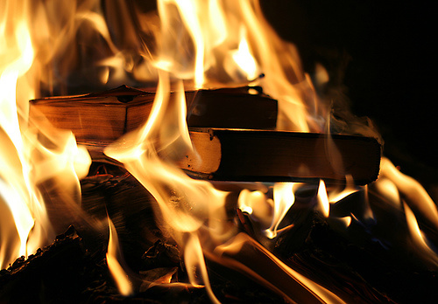
A Group Book Burning – Acts 19:19

Slide 2
A Group Book Burning
Special or Unusual Miracles

Slide 3
A Group Book Burning
Special or Unusual Miracles
“Now God worked unusual miracles by the hands of Paul, so that even handkerchiefs or aprons were brought from his body to the sick, and the diseases left them and the evil spirits went out of them.”
Acts 19:11-12

Slide 4
A Group Book Burning
Special or Unusual Miracles
“Yes, you yourselves know that these hands have provided for my necessities,
and for those who were with me.”
Acts 20:34

Slide 5
A Group Book Burning
Takeaway # 1
We can help those that others cannot, with the word of God!

Slide 6
A Group Book Burning
The Seven Sons of Sceva
Acts 19: 13-20

Slide 7
A Group Book Burning
The Seven Sons of Sceva
“And if I cast out demons by Beelzebub, by whom do your sons cast them out? Therefore they shall be your judges.”
Matthew 12:27

Slide 8
A Group Book Burning
The Seven Sons of Sceva
“Then some of the itinerant Jewish exorcists took it upon themselves to call the name of the Lord Jesus over those who had evil spirits, saying, “We exorcise you by the Jesus whom Paul preaches.”
Acts 19:13

Slide 9
A Group Book Burning
The Seven Sons of Sceva
“And the evil spirit answered and said,
“Jesus I know, and Paul I know; but who are you?”
Acts 19:15

Slide 10
A Group Book Burning
The Seven Sons of Sceva
“Then the man in whom the evil spirit was leaped on them, overpowered them, and prevailed against them, so that they fled out of that house naked and wounded.”
Acts 19:16

Slide 11
A Group Book Burning
The Seven Sons of Sceva
“This became known both to all Jews and Greeks dwelling in Ephesus; and fear fell on them all,
and the name of the Lord Jesus was magnified.”
Acts 19:17

Slide 12
A Group Book Burning
Takeaway # 2
Be right with God – do not follow after fads, doctrines, etc.

Slide 13
A Group Book Burning
Many Good Choices and Results

Slide 14
A Group Book Burning
Many Good Choices and Results
“And many who had believed came confessing and telling their deeds. Also, many of those who had practiced magic brought their books together and burned them in the sight of all. And they counted up the value of them, and it totaled fifty thousand pieces of silver.”
Acts 19:18-19

Slide 15
A Group Book Burning
Many Good Choices and Results
“that if you confess with your mouth the Lord Jesus and believe in your heart that God has raised Him from the dead, you will be saved. For with the heart one believes unto righteousness, and with the mouth confession is made unto salvation. For the Scripture says,
“Whoever believes on Him will not be put to shame.”
Romans 10:9-11

Slide 16
A Group Book Burning
Many Good Choices and Results
“If we confess our sins, He is faithful and just to forgive us our sins and to cleanse us from all unrighteousness.”
1 John 1:9

Slide 17
A Group Book Burning
Many Good Choices and Results
“Abstain from every form of evil.”
1 Thessalonians 5:22

Slide 18
A Group Book Burning
Many Good Choices and Results
“So the word of the Lord grew mightily and prevailed.”
Acts 19:20

Slide 19
A Group Book Burning
Many Good Choices and Results
“So the word of the Lord grew mightily and prevailed.”
Acts 19:20
With overpowering force and strength which nothing could resist.

Slide 20
A Group Book Burning
Takeaway # 3
Make the Right Choice
No Matter the Cost!

Slide 21
A Group Book Burning
Takeaways…
# 1 – We can help those who others cannot – with the word of God!
# 2 – Be right with God – do not follow fads, doctrines, etc.!
# 3 – Make the right choices no matter
the cost!

Slide 22
A Group Book Burning – Acts 19:19

