Slide 1
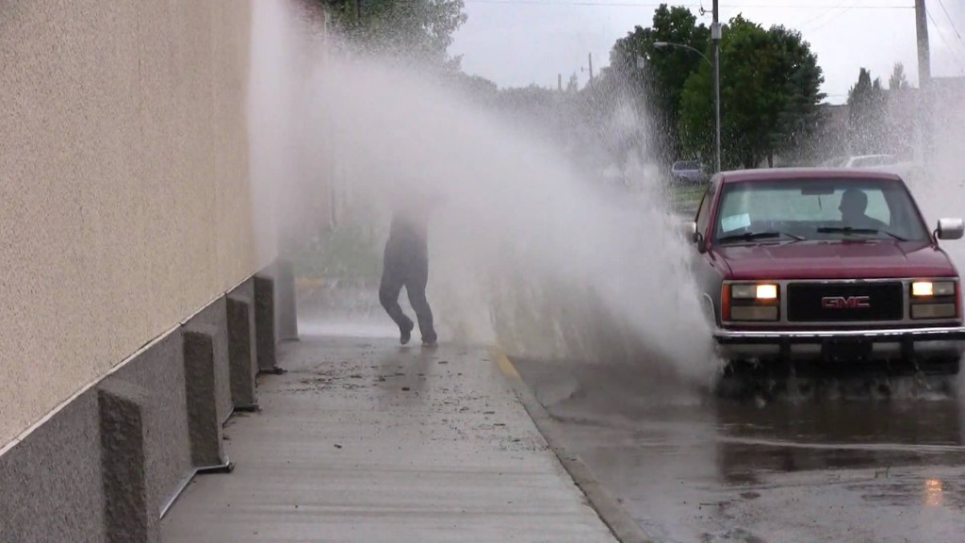
When the Moment Strikes

Slide 2
What Causes A
Good or Bad Day?
When the Moment Strikes

Slide 3
What Causes A
Good or Bad Day?
“Keep your heart with all diligence, For out of it spring the issues of life.”
Proverbs 4:23
When the Moment Strikes

Slide 4
What Causes A
Good or Bad Day?
Most times it is in our hands…
When the Moment Strikes

Slide 5
What Causes A
Good or Bad Day?
Most times it is in our hands…
Our responses, reactions, and attitudes
When the Moment Strikes

Slide 6
What Causes A
Good or Bad Day?
Most times it is in our hands…
Our responses, reactions, and attitudes
“He who has knowledge spares his words, And a man of understanding Is of a calm spirit.”
Proverbs 17:27
When the Moment Strikes

Slide 7
What Causes A
Good or Bad Day?
Most times it is in our hands…
Our responses, reactions, and attitudes
Expectations / Disappointments
When the Moment Strikes

Slide 8
What Causes A
Good or Bad Day?
Most times it is in our hands…
Our responses, reactions, and attitudes
Expectations / Disappointments
“My soul, wait silently for God alone,
For my expectation is from Him.”
Psalm 62:5
When the Moment Strikes

Slide 9
You Are Not Alone!

Slide 10
You Are Not Alone!
“The eyes of the Lord are on the righteous,
And His ears are open to their cry.”
Psalm 34:15

Slide 11
You Are Not Alone!
God has made sure that we do not have to go it alone

Slide 12
You Are Not Alone!
God has made sure that we do not have to go it alone
God has made sure we have everything we need

Slide 13
You Are Not Alone!
God has made sure that we do not have to go it alone
God has made sure we have everything we need
Watchful eye – 1Pet. 3:12

Slide 14
You Are Not Alone!
God has made sure that we do not have to go it alone
God has made sure we have everything we need
Watchful eye – 1Pet. 3:12
Armor – Eph. 6:11-18

Slide 15
You Are Not Alone!
God has made sure that we do not have to go it alone
God has made sure we have everything we need
Watchful eye – 1Pet. 3:12
Armor – Eph. 6:11-18
A way out of every temptation – 1Cor. 10:13

Slide 16
You Are Not Alone!
God has made sure that we do not have to go it alone
God has made sure we have everything we need
Watchful eye – 1Pet. 3:12
Armor – Eph. 6:11-18
A way out of every temptation – 1Cor. 10:13
A congregation full of “live” people

Slide 17
Grab Hold and Do Not Let Go!

Slide 18
Grab Hold and Do Not Let Go!
As individuals we must grab hold to these resources and don’t let go!

Slide 19
Grab Hold and Do Not Let Go!
As individuals we must grab hold to these resources and don’t let go!
“Finally, brethren, farewell. Become complete. Be of good comfort, be of one mind, live in peace; and the God of love and peace will be with you.”
2 Corinthians 13:11

Slide 20
Grab Hold and Do Not Let Go!
As individuals we must grab hold to these resources and don’t let go!
“Blessed be the God and Father of our Lord Jesus Christ, the Father of mercies and God of all comfort, who comforts us in all our tribulation, that we may be able to comfort those who are in any trouble, with the comfort with which we ourselves are comforted by God.”
2 Corinthians 1:3-4

Slide 21
Grab Hold and Do Not Let Go!
As individuals we must grab hold to these resources and don’t let go!
“Now we exhort you, brethren, warn those who are unruly, comfort the fainthearted, uphold the weak, be patient with all.”
1 Thessalonians 5:14

Slide 22
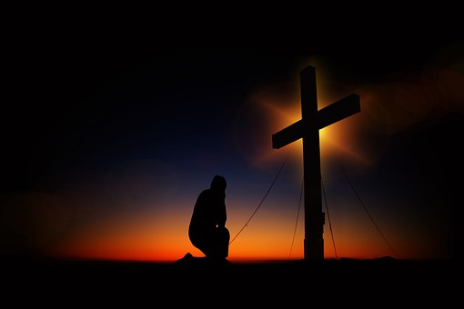
We Are All Important to God,
and To One Another

Slide 23
“that their hearts may be encouraged, being knit together in love, and attaining to all riches of the full assurance of understanding, to the knowledge of the mystery of God, both of the Father and of Christ.”
Colossians 2:2
We Are All Important to God,
and To One Another

Slide 24
Make it your priority grab hold, and don’t let go of what is necessary to secure your soul

