Slide 1
What Should I Bring to Worship Service?
Psalm 100

Slide 2
Introduction
People bring all kinds of things with them
Snacks, candy, toys (loud ones) to entertain the kids
Some people read books during the sermon
Some us the sermon time or collection time to fully balance their checkbooks
Some have even been seen using nail clippers to trim the fingers and toes
Not everything should be brought to worship

Slide 3
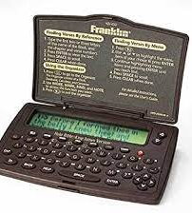
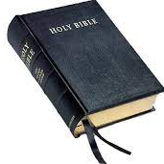
God’s Word
It allows you to examine what the preaching is saying (Acts 17:11)
It shows that the Bible is important to you (Josh 1:8)
It sets a positive example for your neighbors, fellow Christians, and children (Mt 5:14-16)
It allows you to participate in Bible study and possibly service (2 Tim 3:16-17)
It allows you to highlight certain passages that will be helpful in future studies (2 Tim 2:15)

Slide 4
Psalm 100

Slide 5
Psalm 100: 1-2 Bring the Proper Spirit
Shouting addresses the idea of the kind of enthusiasm we bring to worship
“The joyful noise is…the equivalent in worship to the homage-shout or fanfare to a king.” (Kidner)
“exult, triumph, leap for joy.” (Clarke)
Notes:
Ps 95:1 “95 Oh come, let us sing to the Lord! Let us shout joyfully to the Rock of our salvation.
Ps 98:4 “⁴ Shout joyfully to the Lord, all the earth; Break forth in song, rejoice, and sing praises.

Slide 6
Psalm 100: 1-2 Bring the Proper Spirit
Singing speaks to the contemplative frame of mind we should cultivate in our worship
This word again speaks to “The ringing cry, the shout of joy”
Our hearts should be so filled with the wonder of who He is and what He has done for us that we allow His praises to burst forth from our inner being
Notes:
Sermon Notebook
Ps 40:1-3 I waited patiently for the Lord; And He inclined to me, And heard my cry. ² He also brought me up out of a horrible pit, Out of the miry clay, And set my feet upon a rock, And established my steps. ³ He has put a new song in my mouth— Praise to our God; Many will see it and fear, And will trust in the Lord.

Slide 7
Psalm 100: 1-2 Bring the Proper Spirit
Cheerful Serving Spirit
A primitive root; to work (in any sense); by implication to serve, till, (causatively) enslave, etc.: - X be, keep in bondage,
Refers to doing whatever the master tells the slave to do (and to do it with gladness according to this passage)
That word “gladness” is an interesting word. It carries with the meaning of being “wide-eyed with a big grin”. It brings to mind the unvarnished joy of a child. When something happens that they like, it affects the whole body! The mouth flies open, the eyes get wide, the face lights up, the heart lifts and the soul rejoices. Such should be the delight for us old sinners as we come to serve the Lord our God Who has redeemed us from death and Hell by His precious blood!
Notes:
1 Cor 16:20 ²⁰ For you were bought at a price; therefore glorify God in your body ^{[a]}and in your spirit, which are God’s.
Sermon Noteboolk
Serve the Lord with gladness - That is, In your worship, and in all your acts of obedience. Let there be joy in this service. Let it not be with the fear of slaves; not as a matter of compulsion and force; not with reluctance, moroseness, or gloom. Let it be a cheerful, happy service; let it be freely rendered, let it be an occasion of joy to the soul. The service of God is a source of the highest joy that man knows. (Barnes)

Slide 8
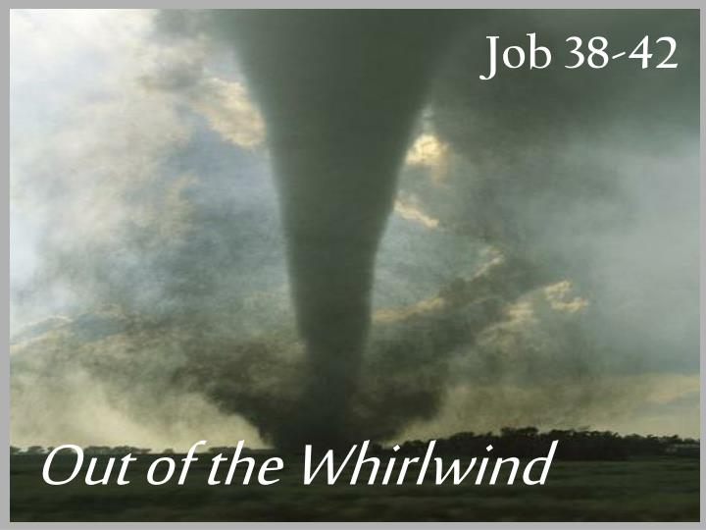
Ps 100:3 Bring a Proper Perspective
Know the person of God (Ezek 34:24-34)
We are told to “know” that the Lord is God. This word means “to make a distinction” We are to know that He and He alone is God (sermon notebook)
Know that the Lord — Hebrews Jehovah, he is God — The only living and true God; a being infinitely perfect, self-existent, and self- sufficient; and the fountain of all being; the first cause and last end of all things (Benson)
Notes:
Job 42:1-2 42 Then Job answered the Lord and said:
² “I know that You can do everything, And that no purpose of Yours can be withheld from You.

Slide 9
Ps 100:3 Bring a Proper Perspective
Know the person of God (Ezek 34:24-34)
If you ever get it nailed down in your soul that He is the God and that He is superior to every other person, thing or activity in your life, then you will have no problem serving Him as you should!
The reason some people have trouble giving, getting to church, or just plain serving God as they should is that they have a different God than the God of the Bible. Who is your God today?
Notes:
Sermon notebook
Creator: JoyImage | Credit: Getty Images/iStockphoto
Copyright: KUO CHUN HUNG

Slide 10
Ps 100:3 Bring a Proper Perspective
Know the Purpose of God
We are who and what we are because He made us
We need to realize this morning that God saved us for a purpose.
He didn't just redeem us to keep us out of Hell.
He didn't redeem us so that we could feel good from time to time.
He didn't do it so that we could look down on our long, religious noses at our lost neighbors and feel superior.
He saved us so that we might serve Him, Ep 2:8-10
Notes:
Sermon notenook
Eph 2:8-10 ⁸ For by grace you have been saved through faith, and that not of yourselves; it is the gift of God, ⁹ not of works, lest anyone should boast. ¹⁰ For we are His workmanship, created in Christ Jesus for good works, which God prepared beforehand that we should walk in them.
1 Cor 10:31 ³¹ Therefore, whether you eat or drink, or whatever you do, do all to the glory of God.
Eccl 12:13 fear God and keep His commandments….whole duty of man

Slide 11
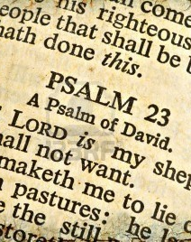
Ps 100:3 Bring a Proper Perspective
Know the Promise of God: We are, “The sheep of His pasture”
As the shepherd owns the flock, so God is our owner; as the shepherd guards his flock and provides for it, so God guards us and provides for us (Barnes)
This statement simply reminds us that we belong to Him and just as a shepherd looks after the welfare of his so, so our Lord looks after us with infinite care (Sermon Notebook)

Slide 12
Notes:
What are you bringing with you when you come to worship our Lord?

