Slide 1
Dead to Sin, Alive to God
Romans 6:1-14

Slide 2
A Rhetorical Question
Rom 6:1 6 What shall we say then? Shall we continue in sin that grace may abound?
Understanding Paul’s rhetorical questions is important to properly understanding this section of Romans
Paul is not saying, “Since we have grace, can we go out and commit many sins?” This is not the question Paul is answering
“Are we to continue in sin?” Or to state the question another way, “Are we to remain in sin?”

Slide 3
A Rhetorical Question
Rom 6:1 6 What shall we say then? Shall we continue in sin that grace may abound?
ep-ee-men’-o: From G1909 and G3306; to stay over, that is, remain (figuratively persevere): - abide (in), continue (in), tarry.
Sin is spoken of as coming into the world (5:12) and as ruling like a king (5:21)
Paul is continuing that usage and is asking if we can remain in the place of sin
Paul is questioning if we should remain under the power and reign of sin
Notes:
Brent Kerchevill West Palm Beach Church of Christ

Slide 4
A Rhetorical Question
Rom 6:1 6 What shall we say then? Shall we continue in sin that grace may abound?
This question closely relates to Paul’s teaching in Romans 5
Once Adam sinned, we live in a world full of sin, death, and corruption. But Christ has come bringing super-abounding grace. So we do not have to live in the country of sin
The Christian now lives in the country of grace and justification

Slide 5
A Rhetorical Question
Rom 6:1 6 What shall we say then? Shall we continue in sin that grace may abound?
Sin reigned in Adam, according to Romans 5. Paul is asking Christians, “Shall we remain under sin’s rule?” “Should we continue living under its power?”
Paul is not asking if we should go on sinning because we have the grace of Christ
Rather, since we have the grace of Christ, can we still live under the rule and power of sin? Can we still live in the country of sin and act like the citizens of that ruling power?

Slide 6
A Strong Response
Rom 6:2 ² Certainly not! How shall we who died to sin live any longer in it?
Certainly not! For Paul, the idea that anyone might continue in sin that grace may abound is unthinkable. Certainly not is a strong phrase. It might also be translated, “Perish the thought!” Or, “Away with the notion!”
Notes:
Enduringword.com

Slide 7
A Strong Response
Rom 6:2 ² Certainly not! How shall we who died to sin live any longer in it?
We died to sin, so how can we continue to live in it? It is like asking someone who has been released from prison why he would want to continue occupying a cell—or asking an emancipated slave why he would want to continue submitting to an abusive master—or asking a lottery winner why she would want to continue living in an old shack. Once a person has been liberated from an unhappy situation, it makes no sense for that person to continue in that situation. We have been liberated from sin—have “died to sin”—so it makes no sense for us to continue living in it.
Notes:
Enduringword.com

Slide 8
Important Things to know
Rom 6:3-5 ³ Or do you not know that as many of us as were baptized into Christ Jesus were baptized into His death? ⁴ Therefore we were buried with Him through baptism into death, that just as Christ was raised from the dead by the glory of the Father, even so we also should walk in newness of life. ⁵ For if we have been united together in the likeness of His death, certainy lwe also shall be in the likeness of His
Entering the water = death/burial
Rising from the water = raised to a new life

Slide 9
Important Things to know
Rom 6:6-7 ⁶ knowing this, that our old man was crucified with Him, that the body of sin might be done away with, that we should no longer be slaves of sin. ⁷ For he who has died has been freed from sin.
Our old self is crucified with Christ (already dead)
We have been freed from sin

Slide 10
Important Things to know
Rom 6:8-10 “⁸ Now if we died with Christ, we believe that we shall also live with Him, ⁹ knowing that Christ, having been raised from the dead, dies no more. Death no longer has dominion over Him. ¹⁰ For the death that He died, He died to sin once for all; but the life that He lives, He lives to God.
Christ was raised from the dead and dies no more…death no longer has dominion over Him
In Christ we have overcome the death of sin and will rise one day to die no more

Slide 11
Actions to Take
Rom 611-12 “¹¹ Likewise you also, reckon yourselves to be dead indeed to sin, but alive to God in Christ Jesus our Lord. ¹² Therefore do not let sin reign in your mortal body, that you should obey it in its lusts.
log-id'-zom-ahee: to take an inventory, that is, estimate (literally or figuratively): - conclude, (ac-) count (of), + despise, esteem, impute, lay, number, reason, reckon, suppose, think (on)
Dead unto sin and alive unto God… do not let sin reign in your mortal body

Slide 12
Actions to Take
Rom 6:13-14 ¹³ And do not present your members as ]instruments of unrighteousness to sin, but present yourselves to God as being alive from the dead, and your members as instruments of righteousness to God. ¹⁴ For sin shall not have dominion over you, for you are not under law but under grace.
par-is'-tay-mee, par-is-tan’-o: surrender or give away to someone
mel’-os: a limb or part of the body
We are to present ourselves instruments of righteousness to God and not instruments of unrighteousness to sin

Slide 14
The Power of the Gospel
God’s Righteousness is revealed in his plan of salvation.
In 3:21–8:39, the apostle Paul explains what the power of the gospel achieves.
Forgiveness (3:21–4:25)
Peace (5:1–21)
Freedom from the power of sin (6:1–23)
Freedom from the condemnation of the law (6:1–23)
New life in the Spirit (8:1–39)

Slide 15
The Power of the Gospel
Forgiveness
Forgiveness of sin through the ministry of Jesus is a revelation of God’s righteousness and of the power of the gospel.
All the images the apostle used before—commercial, religious, and legal—point to this essential benefit.
Forgiveness (3:21–4:25)
Peace (5:1–21)
Freedom from the power of sin (6:1–23)
Freedom from the condemnation of the law (6:1–23)
New life in the Spirit (8:1–39)

Slide 16
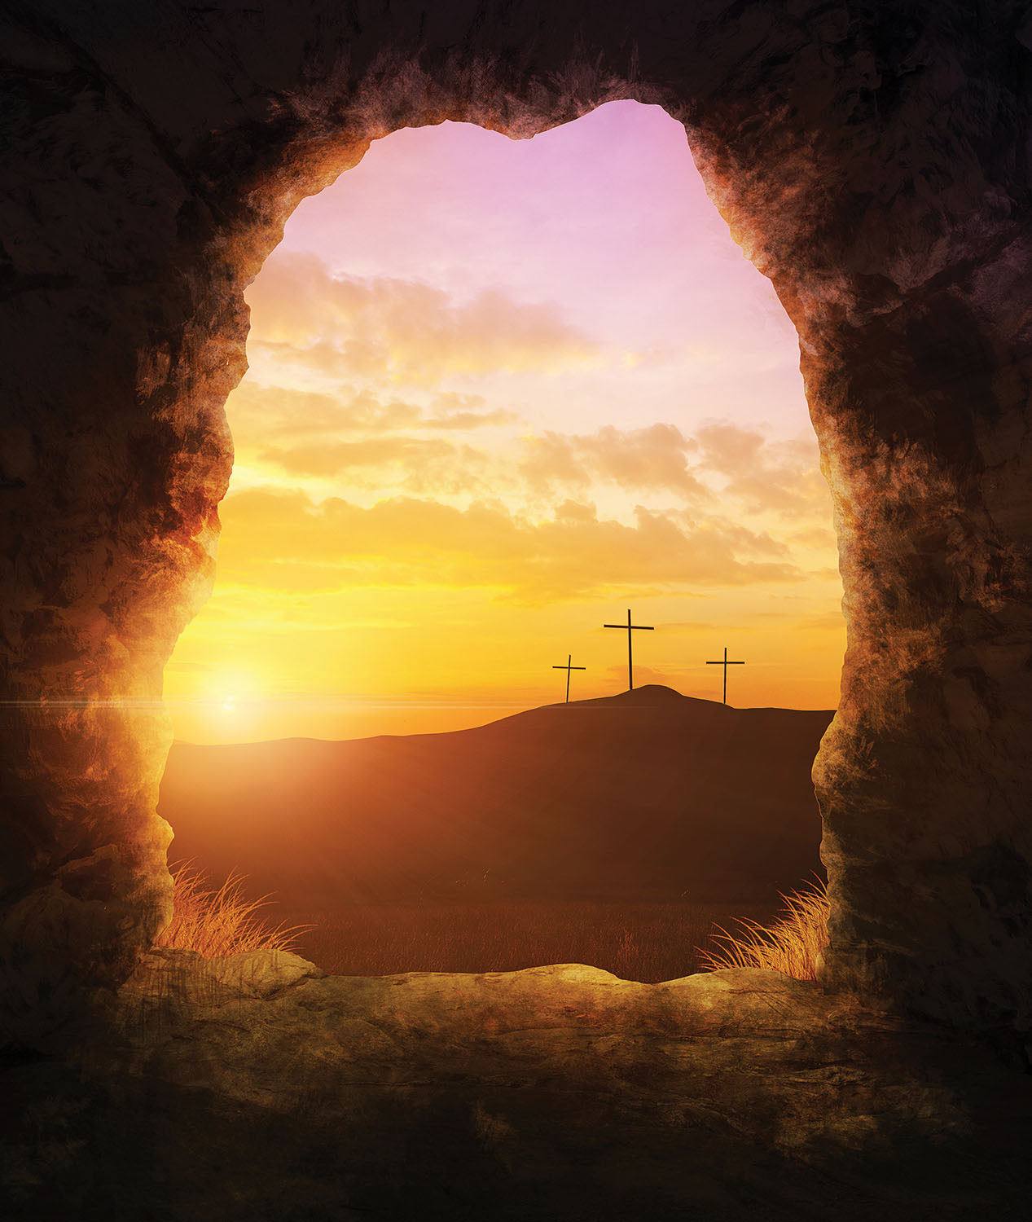
The Power of the Gospel
Forgiveness
The benefits of the gospel are not something people earn or deserve.
Rather, they come from God’s grace, as a gift, and are appropriated by faith.

Slide 17
The Power of the Gospel
Forgiveness
Sin:
Offends God’s holiness and justice,
breaks any possibility of a relationship with humanity,
and brings death and destruction.
The first step in God’s amazing grace is to forgive people who do not deserve forgiveness.

Slide 18
The Power of the Gospel
Peace
Because of God’s gracious forgiveness, humanity can start a new relationship with God.
The enmity that sin causes between God and humans is now overcome.
Forgiveness (3:21–4:25)
Peace (5:1–21)
Freedom from the power of sin (6:1–23)
Freedom from the condemnation of the law (6:1–23)
New life in the Spirit (8:1–39)

Slide 19
The Power of the Gospel
“But God demonstrates his own love for us in this: While we were still sinners, Christ died for us.” —Romans 5:8

Slide 20
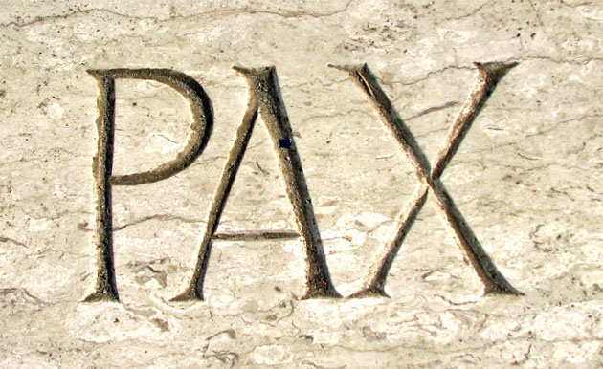
The Power of the Gospel
Peace
The Roman audience understood the concept well because of the Pax Romana—the peace within the Roman Empire that allowed for consistent commerce, growth of cities, and peaceful travel.
Pax, Latin for “Peace”

Slide 21
The Power of the Gospel
Peace
The peace that Christ brings:
Is just the beginning of a new life.
Includes perseverance, character, and hope.
Brings a new freedom that believers must learn to experience.

Slide 22
The Power of the Gospel
Peace
There is nothing people can do to earn or merit or influence God’s decision to save us.
Salvation is an undeserved gift from God.
God’s offer of salvation to all people is free!

Slide 23
The Power of the Gospel
Peace
However, this teaching raises the problem of “cheap grace”—antinomianism.
Paul gives an answer to that problem in Romans, chapters 6 and 7.
Cheap grace and legalism are two sides of the same coin:
Both represent the inability to understand or accept the wondrous grace of God.
Legalism: The teaching that we must obey the Law to be saved.

Slide 24
The Power of the Gospel
Freedom from the Power of Sin
Believers are free from the power of sin.
This does not mean that Christians do not sin at all.
Rather, because of Christ’s death, sin no longer controls us; we can choose not to sin.
Forgiveness (3:21–4:25)
Peace (5:1–21)
Freedom from the power of sin (6:1–23)
Freedom from the condemnation of the law (6:1–23)
New life in the Spirit (8:1–39)

Slide 25
The Power of the Gospel
Freedom from the Power of Sin
Returning to his image of slavery, Paul affirms that we are no longer slaves to sin.
We “have become slaves to righteousness” (6:18).
We are free to do what is right in a world where wickedness and injustice abounds.

Slide 26
The Power of the Gospel
Rom. 6: | Dead to Sin | Alive in Christ
13 | Instruments of unrighteousness to sin | Instruments of righteousness to God
14–15 | Not under the law | Under grace
16 | Sin unto death | Obedience unto righteousness
18 | Free from sin | Enslaved to righteousness
19 | Slave to impurity unto wickedness | Slave to righteousness unto holiness
20 | Slaves to sin | Slaves to God
21–22 | End is death | End is eternal life
22 | Free from sin | Slaves to God
23 | Wages of sin is death | Gift of God is eternal life
(Adapted from James D. G. Dunn, WBC Vol. 38A, Romans 1–8 )

Slide 27
The Power of the Gospel
Freedom from the condemnation of the law
The law condemns us because of our sin.
The law cannot remove the stain of sin nor transform our hearts so we can become free from the slavery to sin.
But God has delivered us “through Jesus Christ our Lord!” (7:25).
Forgiveness (3:21–4:25)
Peace (5:1–21)
Freedom from the power of sin (6:1–23)
Freedom from the condemnation of the law (6:1–23)
New life in the Spirit (8:1–39)

Slide 28
The Power of the Gospel
New Life in the Spirit
“The law of the Spirit who gives life has set you free from the law of sin and death” (8:2).
In Romans 8, Paul neatly brings the arguments from the previous chapters to a closing—and a glorious closing it is!
Forgiveness (3:21–4:25)
Peace (5:1–21)
Freedom from the power of sin (6:1–23)
Freedom from the condemnation of the law (6:1–23)
New life in the Spirit (8:1–39)

Slide 29
The Power of the Gospel
New Life in the Spirit
God’s solution to the greatest human problem is found in Christ’s death and resurrection.
“We were therefore buried with him through baptism into death in order that, just as Christ was raised from the dead through the glory of the Father, we too may live a new life.”—Romans 6:4

Slide 30
The Power of the Gospel
New Life in the Spirit
How do we see the benefits of Christ’s death and resurrection in the life of believers? The answer is found in chapter 8.
“For those who are led by the Spirit of God are the children of God” (8:14).
God gives us new life in the spirit!

Slide 31
The Power of the Gospel
New Life in the Spirit
This salvation that the Spirit makes active in the believers has consequences beyond the individual. It has cosmic consequences!
The entire universe groans for God’s deliverance, just as believers groan for God’s deliverance and the Spirit groans as he intercedes for us (8:22, 23, 26).

Slide 32
The Power of the Gospel
New Life in the Spirit
Even in this context of suffering in life, Paul offers encouragement and comfort by reminding us that we, as believers, are safe in God’s loving hands.

Slide 33
The Power of the Gospel
New Life in the Spirit
Because of what Christ did on the cross and the presence of the Spirit in our lives, we can proclaim along with the Paul:
“In all these things [trouble, hardship, persecution, famine, nakedness, danger, sword (8:35)] we are more than conquerors through him who loved us” (8:37).
Menu

Slide 34
God’s Righteous Plan for Israel and Gentiles
Romans 9:1–11:36
Menu

Slide 35
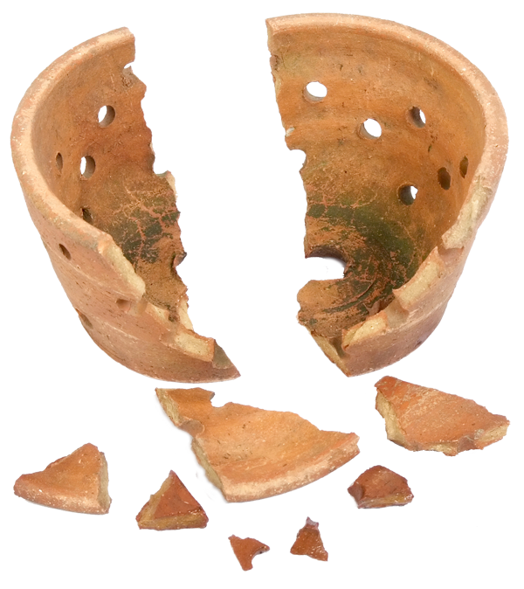
God’s Righteous Plan
Divisions
Paul now deals with a vital and practical problem in the church:
Divisions between the Roman Gentiles and Jewish Christians.
Divisions within the body oppose the very gospel that Paul describes.

Slide 36
God’s Righteous Plan
Paul refutes questions about Israel’s place in God’s plans:
Did God’s plans fail?
Is God still faithful to his promises to Israel?
Are Gentile Christians above the Jews now?
If God’s faithfulness to Israel changed, could his faithfulness to believers, as expressed in 8:31–39, also change?
Are we truly safe in his hands?

Slide 37
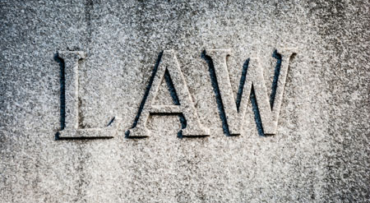
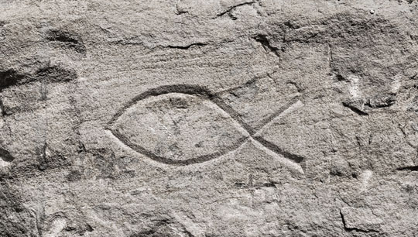
God’s Righteous Plan
For most of his ministry, Paul dealt with the problem of Jewish Christians wanting Gentiles to follow Jewish laws.
In his letter to the Romans, Paul deals with the opposite problem: Gentile Christians who seem to regard Jews as inferior.

Slide 38
God’s Righteous Plan
Paul’s appeal to believers is a personal one, as an apostle of the Lord and as a Jew.
In the previous section, Paul used examples from the life of Abraham and Adam to connect more directly with the Gentile experience.
In chapters 9–11, Paul argues using many Old Testament quotations and allusions.

Slide 39
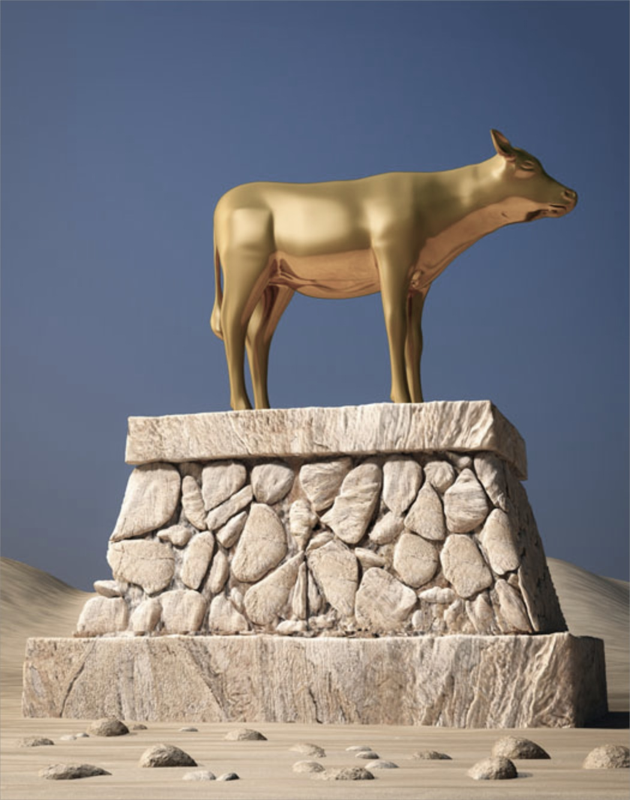
God’s Righteous Plan
Paul begins with alluding to Moses’ own appeal on behalf of God’s people in the aftermath of the golden calf catastrophe (Ex. 32:32):
“For I could wish that I myself were cursed and cut off from Christ for the sake of my people, those of my own race” (Rom. 9:3).

Slide 40
God’s Righteous Plan
He presents a three-part salvation plan:
God rejects Israel for the sake of the Gentiles (11:11–12).
The Gentiles will be saved “until the full number of the Gentiles has come in” (11:25).
Then “all Israel will be saved” (11:26).

Slide 41
God’s Righteous Plan
Paul’s conclusions
Rejection of Israel is temporary and has a vital purpose.
“But if their transgression means riches for the world, and their loss means riches for the Gentiles, how much greater riches will their full inclusion bring!” (11:12).

Slide 42
God’s Righteous Plan
Paul’s conclusions
Gentiles should not feel superior to the Jews.
Salvation is not by works, so no one can boast about it.
Gentiles’ attitude toward Jews should be one of humility and hope.

Slide 43
God’s Righteous Plan
The beautiful doxology at the end of the section suggests this attitude of humility (11:33–36).
“Oh, the depth of the riches of the wisdom and knowledge of God! How unsearchable his judgments, and his paths beyond tracing out!”—Romans 11:33
Menu

Slide 44
The Power of the Gospel in the Life of Believers
Romans 12:1–15:13
Menu

Slide 45
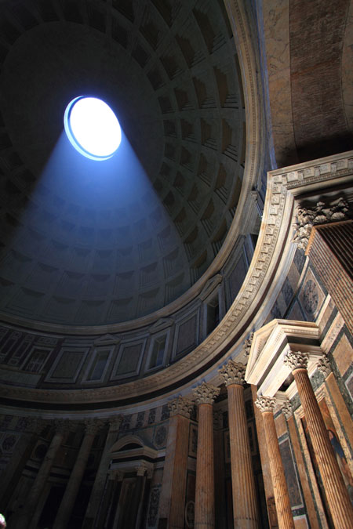
The Gospel in the Life of Believers
So far, the apostle Paul has covered much doctrinal ground in this most impressive letter. He has explained:
The basis for his gospel.
The role of Israel in the history of salvation.

Slide 46
The Gospel in the Life of Believers
He now turns to the consequences of all he has taught.
The power of the gospel has concrete and decisive effects in the lives of believers.

Slide 47
The Gospel in the Life of Believers
Romans 12:1–15:13
The basis for Christian living apart from the Mosaic law (12:1–2)
The body of Christ as the social expression of God’s people (12:3–8)
Love as the fundamental moral rule in human relationships (12:9–21)
Christians and the powers that be (13:1–7)
Love of neighbor as the fulfillment of the law in human relationships (13:8–10)
Christ as the pattern of Christian living (13:11–14)
The basis for social interaction apart from the Mosaic law (14:1–15:13)

Slide 48
The Gospel in the Life of Believers
Transformative
The power of the gospel is creative and transformative; the consequences are equally radical.
In light of all he has written, Paul now appeals to his readers to become living sacrifices.
“Therefore, I urge you, brothers and sisters, in view of God’s mercy, to offer your bodies as a living sacrifice, holy and pleasing to God—this is your true and proper worship.”—Romans 12:1

Slide 49
The Gospel in the Life of Believers
Law of Love
The concept captures what he has hinted at before:
If we are not bound to the law, which requires daily sacrifices,
we are now bound to the law of love, which requires that we offer our whole selves to God.
“Let no debt remain outstanding, except the continuing debt to love one another, for whoever loves others has fulfilled the law” (13:8).
Our entire lives should be an act of worship to God!

Slide 50
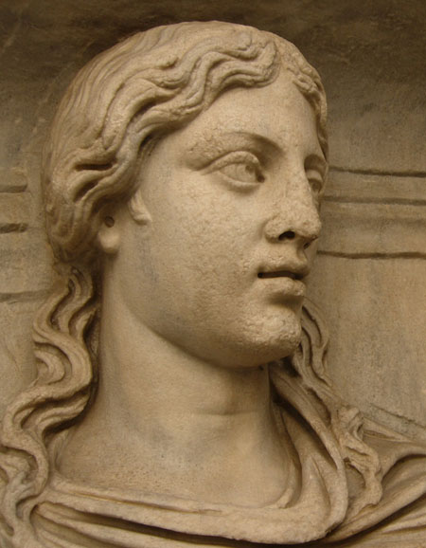
The Gospel in the Life of Believers
Renewed
Paul uses another radical concept: Our minds must be transformed and renewed.
If we were once slaves of sin, we are now slaves of righteousness.
We need a radical change in worldview!

Slide 51
The Gospel in the Life of Believers
New Creation
This transformation begins with being made into a new creation, with the surrender of our bodies and our minds.
Transformation is possible, and it can occur in this life. This is good news indeed!

Slide 52
The Gospel in the Life of Believers
This table shows the connections between this section and the beginning of the letter. It reveals the way God is solving the problem of human sin and its effects.
1:24 | Degrading of their bodies | 12:1 | Offer your bodies
1:25 | Worshiped created things | 12:1 | Proper worship
1:28 | A depraved mind | 12:2 | Renewing of your mind
2:18 | Know his will and approve | 12:2 | Test and approve what God’s will is
(Adapted from James D. G. Dunn, WBC Vol. 38A, Romans 1–8 )

Slide 53
The Gospel in the Life of Believers
Paul provides several examples of how a renewed mind deals with difficult ethical and moral issues.
He does not give us a comprehensive list. Rather, he expects his readers to understand his examples and apply his insights to all areas of life.
He expects us to exercise our moral muscles to develop renewed discernment. We can do that because now “we can test and approve what God’s will is” (12:2).

Slide 54
The Gospel in the Life of Believers
“Love must be sincere. Hate what is evil; cling to what is good. Be devoted to one another in love. Honor one another above yourselves. Never be lacking in zeal, but keep your spiritual fervor, serving the Lord. Be joyful in hope, patient in affliction, faithful in prayer. Share with the Lord’s people who are in need. Practice hospitality.”—Romans 12:9–13
Menu

Slide 55
Conclusion
Romans 15:14–16:27
Menu

Slide 56
Conclusion
Paul begins the conclusion of his letter with encouragement for the Roman Christians:
“I myself am convinced, my brothers and sisters, that you yourselves are full of goodness, filled with knowledge and competent to instruct one another. Yet I have written you quite boldly on some points to remind you of them again, because of the grace God gave me to be a minister of Christ Jesus to the Gentiles.”—Romans 15:14–16

Slide 57
Conclusion
After sending extended greetings to many people in Rome, he offers a final exhortation:
“I urge you, brothers and sisters, to watch out for those who cause divisions and put obstacles in your way that are contrary to the teaching you have learned.” —Romans 16:17
Menu

Slide 58
Application Questions
for reflection and discussion
Menu

Slide 59
Application Questions
Romans 1:16–17
What is the power of the gospel?
How does it accomplish God’s purposes in the lives of people?
How have you seen that power at work in your own life?

Slide 60
Application Questions
Romans 1:21–32
What are the dangers of valuing God’s creation more than the Creator himself?
In what ways have you struggled with this?

Slide 61
Application Questions
Romans 3:20
How should our inability to “be declared righteous in God’s sight by the works of the law” affect our attitudes toward God?
How about our attitudes toward others?

Slide 62
Application Questions
Romans 10:1–4; 11:1, 25–26
How should Paul’s arguments regarding the Jews give us reassurance about our own salvation?

Slide 63
Application Questions
Romans 10:9–15
What is our role in spreading the gospel, and why?
What are some different ways we can fulfill that?

Slide 64
Application Questions
Romans 12:1–2
Practically speaking, what does it mean to be “a living sacrifice” (12:1)?
How does it enable us to know God’s “good and pleasing and perfect” will—and actually do it?

Slide 65
Application Questions
Romans 12:3–8
How does a sacrificial attitude help us relate better to those who are built differently from us?

Slide 66
Application Questions
Romans 15:14
What is your reaction to Paul’s statement that your “brothers and sisters … are full of goodness”?
How would (or does) believing Paul’s statement change the way you approach and work together with your “brothers and sisters”?
Menu

Slide 67
Romans PowerPoint®
All rights reserved. No part of this publication may be reproduced, stored in a retrieval system or transmitted in any form or by any means—for example, electronic, photocopy, recording—without prior written permission of the publisher.
Image Credits: Some images used under license from Shutterstock.com
Author: Benjamin Galan, MTS, ThM
Tables adapted from James D. G. Dunn, WBC Vol. 38A, Romans 1–8
Trademarks: Any trademarked symbols included in this teaching presentation belong to the organizations identified. Rose Publishing is a Christian organization and not affiliated with any of the organizations with trademarked symbols. The symbols and photos used in this presentation fall under the U.S.A. Copyright Law, Title 17, Section 107.
All Scripture quotations, unless otherwise indicated, are taken from the Holy Bible, New International Version®, NIV®. Copyright ©1973, 1978, 1984, 2011 by Biblica, Inc.™ Used by permission of Zondervan. All rights reserved worldwide. www.zondervan.com The “NIV” and “New International Version” are trademarks registered in the United States Patent and Trademark Office by Biblica, Inc.™
© 2015 Bristol Works, Inc.
Rose Publishing, Inc.
4733 Torrance Blvd., #259 Torrance, California 90505 U.S.A. All rights reserved. Email: info@rose-publishing.com
www.rose-publishing.com

Slide 68
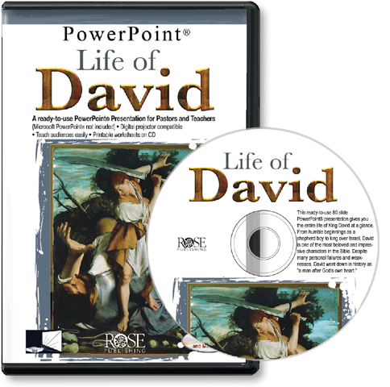
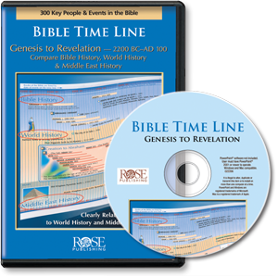
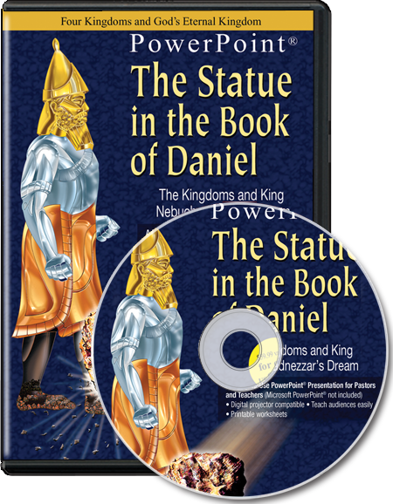
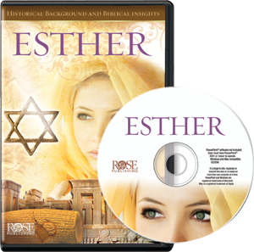
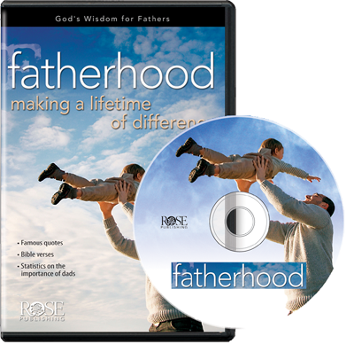
More than 60 PowerPoint® Presentations from Rose Publishing
www.rose-publishing.com

