Slide 2
God is Right to Judge the Gentiles
Romans 1:18–32

Slide 3
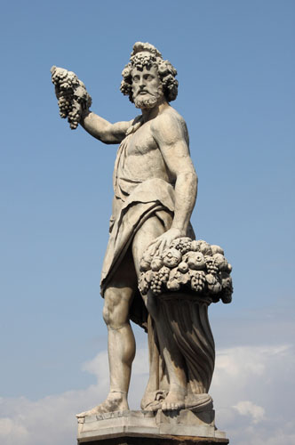
God is Right to Judge the Gentiles
The Gentiles are Guilty
Paul deals with the sinfulness and perversions found in the Gentile world (1:18–32).
The apostle Paul did not list all possible sins, or even the worst of them, that one could find in the Gentile world.
Bacchus, Roman god of wine and revelry

Slide 4
God is Right to Judge the Gentiles
The Gentiles are Guilty
If the Roman Christians had any feeling of ethnic superiority over the Jewish Christians, Paul’s reasoning erased it.
Paul’s evidence is conclusive: the Gentile world is in need of salvation.
Bacchus, Roman god of wine and revelry

Slide 5
The Reason for the Wrath of God (1:18-23)
Ungodliness and Unrighteousness of men (vs 18)
Ungodliness is a lack of reverence toward God and disregards who He is resulting in unrighteousness
Unrighteousness is literally “wickedness”…sin against God results in acts that are not right with God
Note God’s wrath is against “All” sin w/o exception
Bacchus, Roman god of wine and revelry
Notes:
From G3713; properly desire (as a reaching forth or excitement of the mind), that is, (by analogy) violent passion (ire, or [justifiable] abhorrence); by implication punishment: - anger, indignation, vengeance, wrath.
in this place, the word denotes the "divine displeasure" or "indignation" against sin; the divine purpose to "inflict punishment. It is the opposition of the divine character against sin;" and the determination of the divine mind to express that opposition in a proper way, by excluding the offender from the favors which he bestows on the righteous

Slide 6
The Reason for the Wrath of God (1:18-23)
Men suppressing the truth in unrighteousness (vs 19)
Suppress has to do with the idea of “Holding down”
Men knew the truth but tried to hold it down to keep from being convicted by it
The results of this will be seen in upcoming verses
Bacchus, Roman god of wine and revelry

Slide 7
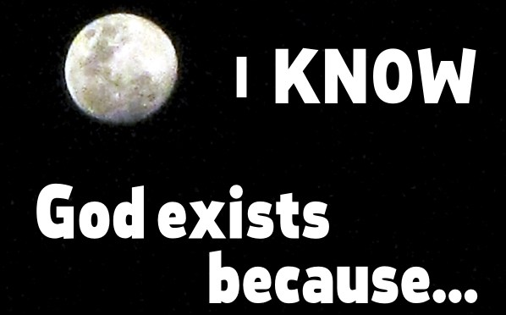
The Reason for the Wrath of God (1:18-23)
God’s Attributes are Clearly Seen (vs 20)
Since the creation of the world His attributes are clearly seen
Paul seems to be implying that only someone with “eternal power” could create the world
Such a creator must also be divine and not merely human

Slide 8
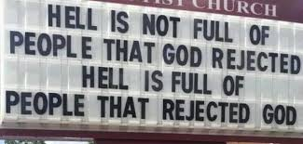
The Reason for the Wrath of God (1:18-23)
Man’s Rejection of God (vs 21-23)
Did not glorify God
Not thankful
Futile in thinking
Hearts darkened
Puffed up with pride
Glorified the creation rather than the creator

Slide 9
God’s Response: He Gave Them Up (1:24-28)
God Gave Them Up To…
Uncleanness (vs 24-25)
Degenerate craving, sexual aberration
The Greek word is used for decaying matter such as dead bodies in the grave…there is a chemical process that results in corruption

Slide 10
God’s Response: He Gave Them Up (1:24-28)
God Gave Them Up To…
Vile Passions (vs 24-25)
Vile implies: dishonor, disgrace, and shame
Women exchanged the natural use for what is against nature…turning from men to women (this is unnatural)
Men left what was natural and burned in their lust for men committing what is shameful
Men received the penalty of their error

Slide 11
God’s Response: He Gave Them Up (1:24-28)
God Gave Them Over To…
Debased Mind
The Greek word for debased implies an “unapproved” or “rejected” mind
A mind not approved in the eyes of God
Minds that could not think moral thoughts
We must remember that rebellion against God is not only seen in our actions, but our thinking as well

Slide 12
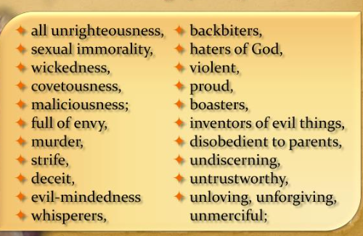
Those Things Which are not Fitting (1:28c-31)
Notes:
Make not of vs 32 that not only those who practice but also those who approve are them are worthy of death
Chart created by Don McClain West 65th street Church of Christ Little Rock Arkansas

Slide 13
Notes:
Make not of vs 32 that not only those who practice but also those who approve are them are worthy of death

