Slide 1
Make your Declaration
“I live in Dependence on God”

Slide 2
Depend Defined (Webster)
To be contingent
Whatever a little child does is contingent on his parents
A little child cannot prepare his own food or take himself to the doctor if sick or hurt
A little child depends on his parents for everything
Christians are expected to turn their lives over to God and depend on Him
Their lives are to be “contingent” on His will
Mt 18:3-4; Jam 4:15
Notes:
Mt 18:3-4 “³ And said, Verily I say unto you, Except ye be converted, and become as little children, ye shall not enter into the kingdom of heaven.
⁴ Whosoever therefore shall humble himself as this little child, the same is greatest in the kingdom of heaven.
Jam 4:15 “¹⁵ For that ye ought to say, If the Lord will, we shall live, and do this, or that.

Slide 3
Depend Defined (Webster)
To be pending or undecided
Christians are not to make decisions based on their own will but rather God’s
Christians do not know what will happen tomorrow or if there will even be a tomorrow
From our perspective everything is “pending”
Mk 13:31-32; Jam 4:14
Notes:
Mk 13:31-32 “³¹ Heaven and earth shall pass away: but my words shall not pass away.
³² But of that day and that hour knoweth no man, no, not the angels which are in heaven, neither the Son, but the Father.”
Jam 4:13-14 “¹³ Go to now, ye that say, To day or to morrow we will go into such a city, and continue there a year, and buy and sell, and get gain:
¹⁴ Whereas ye know not what shall be on the morrow. For what is your life? It is even a vapour, that appeareth for a little time, and then vanisheth away.”

Slide 4
Depend Defined (Webster)
To place reliance or trust
We do not depend on people we do not trust
Our dependence on God is linked to our trust in Him
Is linked to faith
The more faith and trust we have in God, the more dependent we will be on Him
Notes:
Mk 13:31-32 “³¹ Heaven and earth shall pass away: but my words shall not pass away.
³² But of that day and that hour knoweth no man, no, not the angels which are in heaven, neither the Son, but the Father.”
Jam 4:13-14 “¹³ Go to now, ye that say, To day or to morrow we will go into such a city, and continue there a year, and buy and sell, and get gain:
¹⁴ Whereas ye know not what shall be on the morrow. For what is your life? It is even a vapour, that appeareth for a little time, and then vanisheth away.”

Slide 5
Dependent on God
Physical needs
Neh 9:20-21 “²⁰ You also gave Your good Spirit to instruct them, And did not withhold Your manna from their mouth, And gave them water for their thirst. ²¹ Forty years You sustained them in the wilderness; They lacked nothing; Their clothes did not wear out And their feet did not swell.

Slide 6
Dependent on God
Notes:
Mt 6:25 “²⁵ “Therefore I say to you, do not worry about your life, what you will eat or what you will drink; nor about your body, what you will put on. Is not life more than food and the body more than clothing?

Slide 7
Dependent on God
2 Tim 3:16-17 “All scripture is given by inspiration of God, and is profitable for doctrine, for reproof, for correction, for instruction in righteousness: ¹⁷ That the man of God may be perfect, thoroughly furnished unto all good works.”

Slide 8
Dependent on God
1 Pet 2:2 “As newborn babes, desire the sincere milk of the word, that ye may grow thereby:”

Slide 9
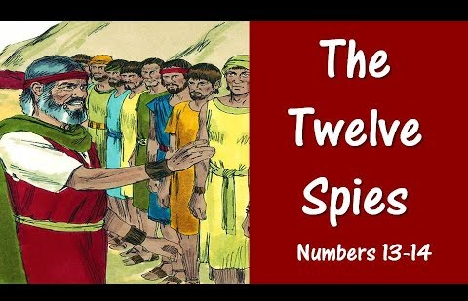
Example of Failure to Depend on God
Report of 10 of the 12
We are not able to go up against the people for they are stronger
It is a land that devours its inhabitants
The people are all of great stature
We were like grasshoppers in the sight of the people
Let us return to Egypt

Slide 10
Example of Failure to Depend on God
The Report of Joshua and Caleb
Let us go at once and take the land as we are well able to overcome it
If the Lord delights in us then He will bring us into this land and give it to us
Do not rebel against the Lord or fear the people…the Lord is with us

Slide 11
Example of Failure to Depend on God
The Lord’s Response (Josh 14:28-39)
This generation died in the wilderness except Joshua and Caleb
Their sons would be shepherds in the wilderness for 40 years until all those over the age of 40 passed
The 10 spies who brought the evil report died by the plague before the Lord

Slide 12
Example of Failure to Depend on God
Those who boast in their riches and wealth cannot redeem their brother
Leaving wealth to others with the expectation it will exist forever…is futile…man does not exist forever
Men will praise those who do well for themselves but these will still all one day die

Slide 14
Am I ready to make a declaration that I am going to live my life “in dependence on God?”

