Slide 1
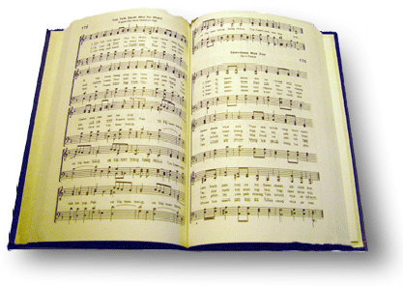
At the cross
Song #157

Slide 2
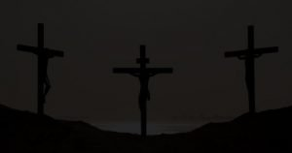
Well might the sun in darkness hide, and shut his glories in
Lk 23:44-45 “⁴⁴ Now it was about the sixth hour, and there was darkness over all the earth until the ninth hour.
⁴⁵ Then the sun was darkened, and the veil of the temple was torn in two.

Slide 3
Well might the sun in darkness hide, and shut his glories in
Jn 17:1-3 “17 Jesus spoke these words, lifted up His eyes to heaven, and said: “Father, the hour has come. Glorify Your Son, that Your Son also may glorify You,
² as You have given Him authority over all flesh, that He should give eternal life to as many as You have given Him.
³ And this is eternal life, that they may know You, the only true God, and Jesus Christ whom You have sent.
Notes:
Jn 1”14 “¹⁴ And the Word became flesh and dwelt among us, and we beheld His glory, the glory as of the only begotten of the Father, full of grace and truth.”

Slide 4
Well might the sun in darkness hide, and shut his glories in
Jn 17:4-5 “⁴ I have glorified You on the earth. I have finished the work which You have given Me to do.
⁵ And now, O Father, glorify Me together with Yourself, with the glory which I had with You before the world was.

Slide 5
Well might the sun in darkness hide, and shut his glories in
2 Cor 4:4-6 “⁴ whose minds the god of this age has blinded, who do not believe, lest the light of the gospel of the glory of Christ, who is the image of God, should shine on them.
⁵ For we do not preach ourselves, but Christ Jesus the Lord, and ourselves your bondservants for Jesus’ sake.
⁶ For it is the God who commanded light to shine out of darkness, who has shone in our hearts to give the light of the knowledge of the glory of God in the face of Jesus Christ.

Slide 6
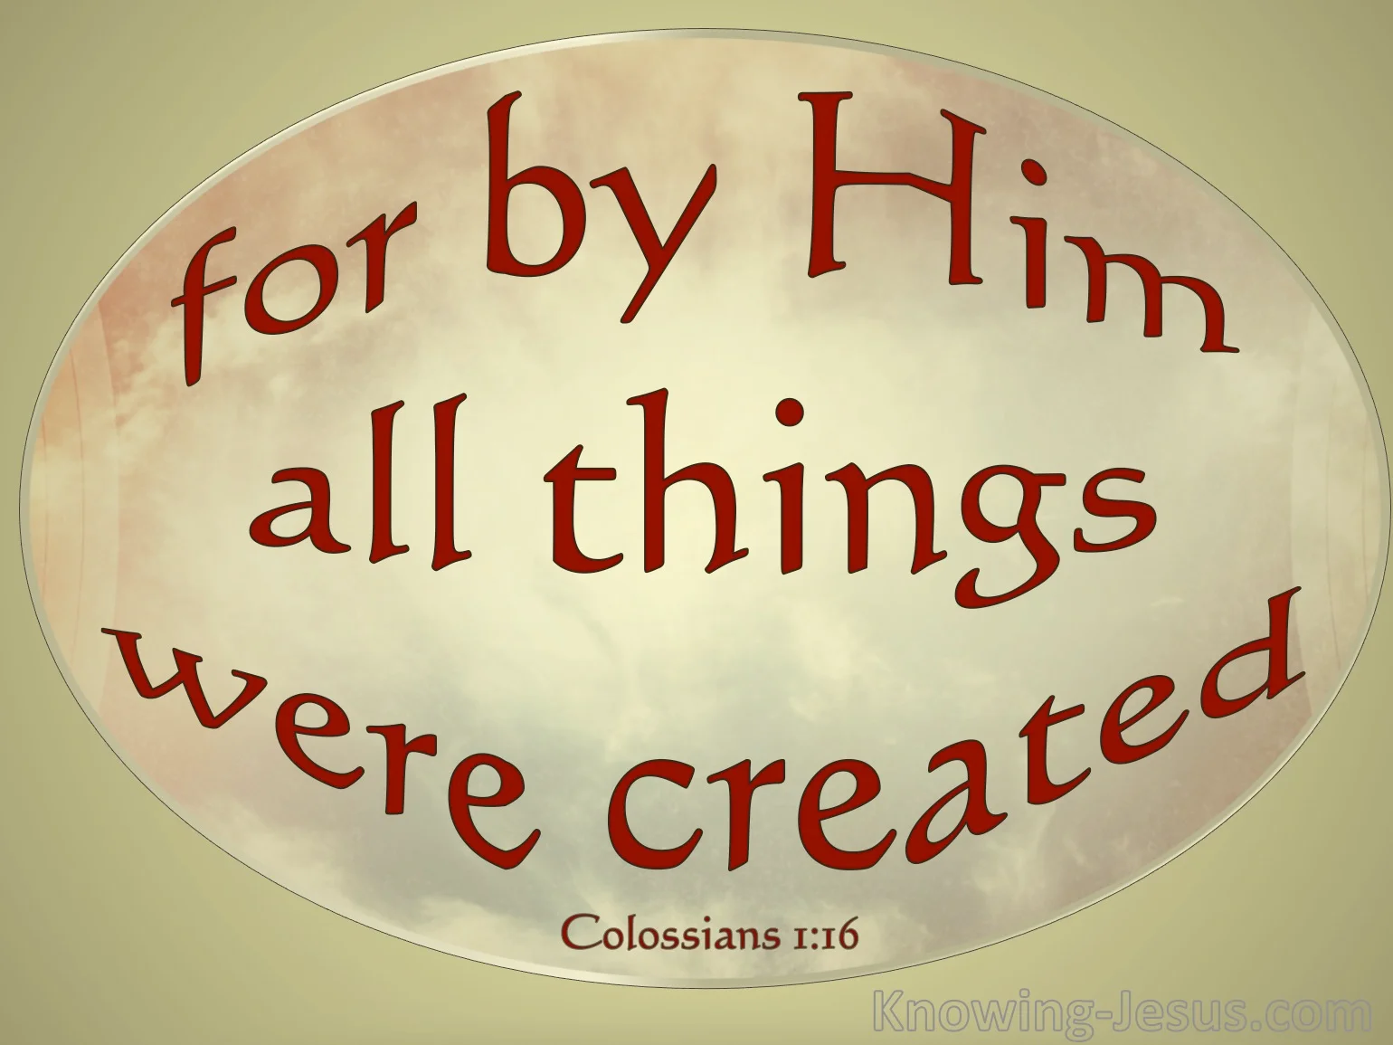
When christ the mighty maker, died for man the creature’s sin
Col 1:16-17 “¹⁶ For by Him all things were created that are in heaven and that are on earth, visible and invisible, whether thrones or dominions or principalities or powers. All things were created through Him and for Him.
¹⁷ And He is before all things, and in Him all things consist.
Notes:
Jn 1:1-3 “1 In the beginning was the Word, and the Word was with God, and the Word was God. ² He was in the beginning with God. ³ All things were made through Him, and without Him nothing was made that was made.”

Slide 7
When christ the mighty maker, died for man the creature’s sin
Rom 5:6-8 “⁶ For when we were still without strength, in due time Christ died for the ungodly.
⁷ For scarcely for a righteous man will one die; yet perhaps for a good man someone would even dare to die.
⁸ But God demonstrates His own love toward us, in that while we were still sinners, Christ died for us.

Slide 8
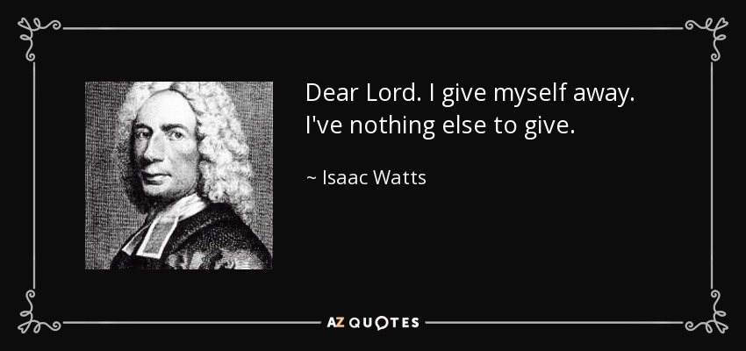
But drops of can can ne-er repay the debt of love I owe; here, Lord, I give myself away, tis all that I can do
Rom 12:1 “12 I beseech you therefore, brethren, by the mercies of God, that you present your bodies a living sacrifice, holy, acceptable to God, which is your reasonable service.

Slide 9
But drops of can can ne-er repay the debt of love I owe; here, Lord, I give myself away, tis all that I can do
Gal 2:20 “²⁰ I have been crucified with Christ; it is no longer I who live, but Christ lives in me; and the life which I now live in the flesh I live by faith in the Son of God, who loved me and gave Himself for me.

