Slide 1
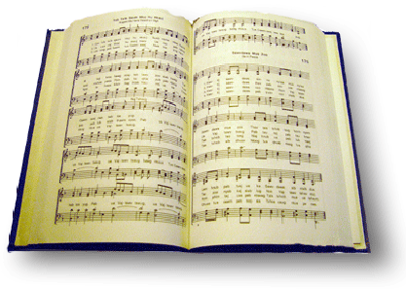
The solid rock
Song #378

Slide 2
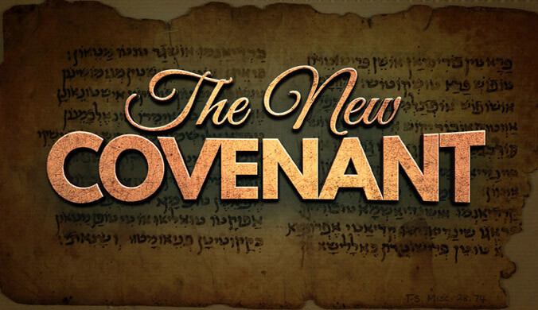
His oath, His covenant, his blood, support me in the whelming flood
Jer 31:31-34 “³¹ “Behold, the days are coming, says the Lord, when I will make a new covenant with the house of Israel and with the house of Judah—
³² not according to the covenant that I made with their fathers in the day that I took them by the hand to lead them out of the land of Egypt, My covenant which they broke, though I was a husband to them, says the Lord.
³³ But this is the covenant that I will make with the house of Israel after those days, says the Lord: I will put My law in their minds, and write it on their hearts; and I will be their God, and they shall be My people.
³⁴ No more shall every man teach his neighbor, and every man his brother, saying, ‘Know the Lord,’ for they all shall know Me, from the least of them to the greatest of them, says the Lord. For I will forgive their iniquity, and their sin I will remember no more.”

Slide 3
His oath, His covenant, his blood, support me in the whelming flood
Mt 26:26-28 “²⁶ And as they were eating, Jesus took bread, blessed and broke it, and gave it to the disciples and said, “Take, eat; this is My body.”
²⁷ Then He took the cup, and gave thanks, and gave it to them, saying, “Drink from it, all of you.
²⁸ For this is My blood of the new covenant, which is shed for many for the remission of sins

Slide 4
His oath, His covenant, his blood, support me in the whelming flood
Heb 7:22 “²² by so much more Jesus has become a surety of a better covenant.
Heb 8:6 “⁶ But now He has obtained a more excellent ministry, inasmuch as He is also Mediator of a better covenant, which was established on better promises.
Heb 9:15 “¹⁵ And for this reason He is the Mediator of the new covenant, by means of death, for the redemption of the transgressions under the first covenant, that those who are called may receive the promise of the eternal inheritance.

Slide 5
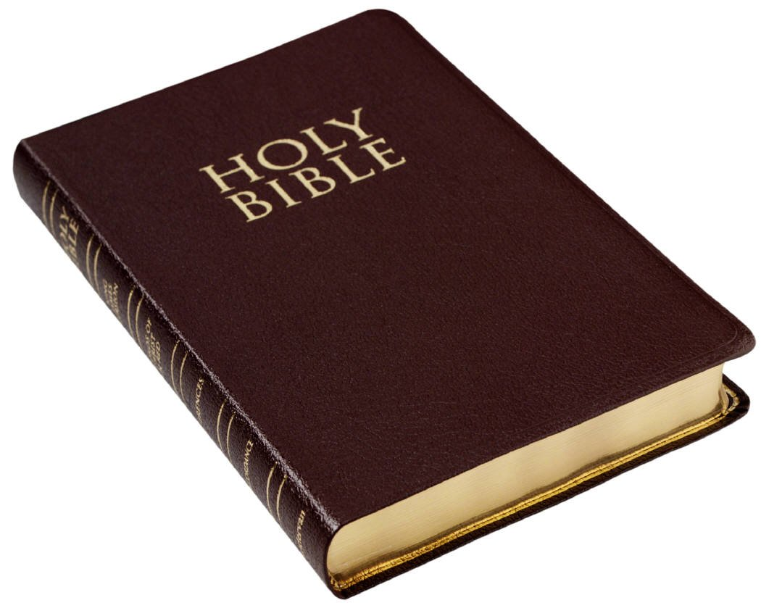
When all around my soul gives way, he then is all my hope and stay
Job 1:13-22

Slide 6
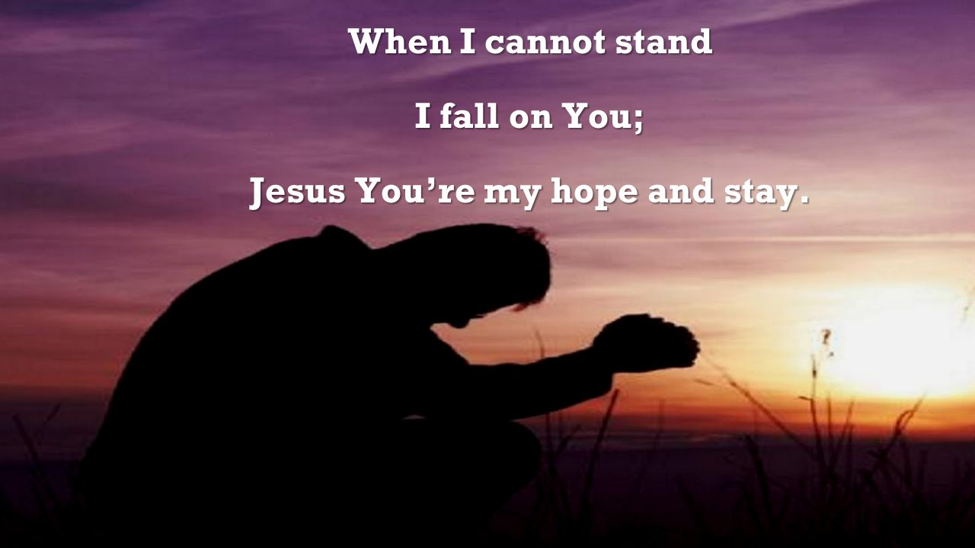
When all around my soul gives way, he then is all my hope and stay
Isaiah 10:20 “²⁰ And it shall come to pass in that day, that the remnant of Israel, and such as are escaped of the house of Jacob, shall no more again stay upon him that smote them; but shall stay upon the Lord, the Holy One of Israel, in truth.
Notes:
In Isaiah 10:20 in the KJV the word stay is used. It means, To rest; to rely; to confide in; to trust.

Slide 7
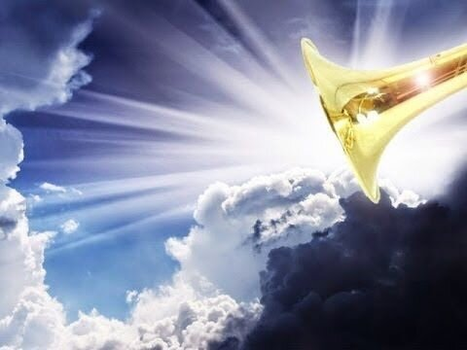
When he shall come with trumpet sound, o may I then in him be found
Mt 24:30-31 “³⁰ Then the sign of the Son of Man will appear in heaven, and then all the tribes of the earth will mourn, and they will see the Son of Man coming on the clouds of heaven with power and great glory. ³¹ And He will send His angels with a great sound of a trumpet, and they will gather together His elect from the four winds, from one end of heaven to the other.
1 Cor 15:52 “⁵² in a moment, in the twinkling of an eye, at the last trumpet. For the trumpet will sound, and the dead will be raised incorruptible, and we shall be changed..

Slide 8
When he shall come with trumpet sound, o may I then in him be found
1 thes 4:15-18 “¹⁵ For this we say to you by the word of the Lord, that we who are alive and remain until the coming of the Lord will by no means precede those who are asleep.
¹⁶ For the Lord Himself will descend from heaven with a shout, with the voice of an archangel, and with the trumpet of God. And the dead in Christ will rise first.
¹⁷ Then we who are alive and remain shall be caught up together with them in the clouds to meet the Lord in the air. And thus we shall always be with the Lord.
¹⁸ Therefore comfort one another with these words.

Slide 9
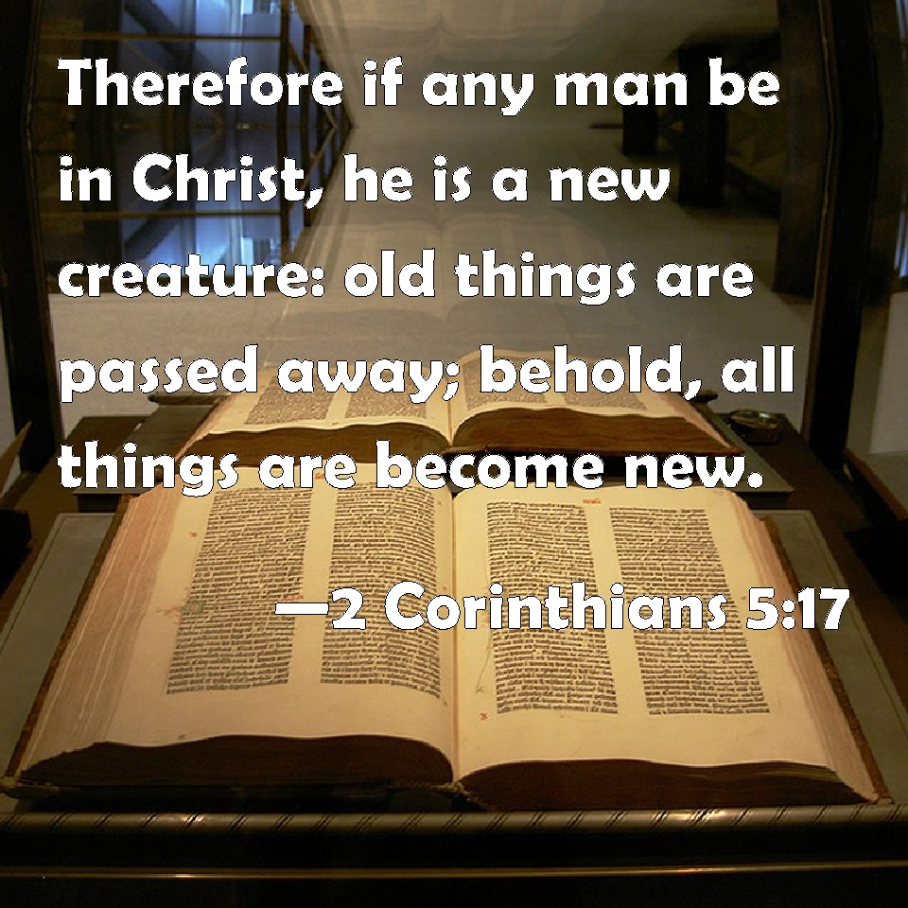
When he shall come with trumpet sound, o may I then in him be found
Phil 3:8-11 “⁸ Yet indeed I also count all things loss for the excellence of the knowledge of Christ Jesus my Lord, for whom I have suffered the loss of all things, and count them as rubbish, that I may gain Christ
⁹ and be found in Him, not having my own righteousness, which is from the law, but that which is through faith in Christ, the righteousness which is from God by faith;
¹⁰ that I may know Him and the power of His resurrection, and the fellowship of His sufferings, being conformed to His death,
¹¹ if, by any means, I may attain to the resurrection from the dead.
Notes:
Rom 8:1 “8 There is therefore now no condemnation to those who are in Christ Jesus, who^{[a]} do not walk according to the flesh, but according to the Spirit.

Slide 10
Dressed in his righteousness alone, faultless to stand before the throne
Rom 3:20-26 “²⁰ Therefore by the deeds of the law no flesh will be justified in His sight, for by the law is the knowledge of sin.
²¹ But now the righteousness of God apart from the law is revealed, being witnessed by the Law and the Prophets,
²² even the righteousness of God, through faith in Jesus Christ, to all and on all who believe. For there is no difference;
²³ for all have sinned and fall short of the glory of God,.

Slide 11
Dressed in his righteousness alone, faultless to stand before the throne
²⁴ being justified freely by His grace through the redemption that is in Christ Jesus,
²⁵ whom God set forth as a propitiation by His blood, through faith, to demonstrate His righteousness, because in His forbearance God had passed over the sins that were previously committed,
²⁶ to demonstrate at the present time His righteousness, that He might be just and the justifier of the one who has faith in Jesus

Slide 12
Dressed in his righteousness alone, faultless to stand before the throne
⁴ But when the kindness and the love of God our Savior toward man appeared,
⁵ not by works of righteousness which we have done, but according to His mercy He saved us, through the washing of regeneration and renewing of the Holy Spirit,
⁶ whom He poured out on us abundantly through Jesus Christ our Savior,
⁷ that having been justified by His grace we should become heirs according to the hope of eternal life.
Notes:
Tit 3:4-7

