Slide 1
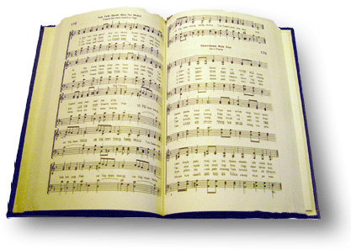
The solid rock
Song #378

Slide 2
My hope is built on nothing less than Jesus’ blood and righteousness
Tit 2:11-14 “¹¹ For the grace of God that brings salvation has appeared to all men,
¹² teaching us that, denying ungodliness and worldly lusts, we should live soberly, righteously, and godly in the present age,
¹³ looking for the blessed hope and glorious appearing of our great God and Savior Jesus Christ,
¹⁴ who gave Himself for us, that He might redeem us from every lawless deed and purify for Himself His own special people, zealous for good works.

Slide 3
My hope is built on nothing less than Jesus’ blood and righteousness
Notes:
¹³ But I do not want you to be ignorant, brethren, concerning those who have fallen ^{[b]}asleep, lest you sorrow as others who have no hope. ¹⁴ For if we believe that Jesus died and rose again, even so God will bring with Him those who ^{[c]}sleep in Jesus.
¹⁵ For this we say to you by the word of the Lord, that we who are alive and remain until the coming of the Lord will by no means precede those who are ^{[d]}asleep. ¹⁶ For the Lord Himself will descend from heaven with a shout, with the voice of an archangel, and with the trumpet of God. And the dead in Christ will rise first. ¹⁷ Then we who are alive and remain shall be caught up together with them in the clouds to meet the Lord in the air. And thus we shall always be with the Lord. ¹⁸ Therefore comfort one another with these words.

Slide 4
My hope is built on nothing less than Jesus’ blood and righteousness
Rom 5:6-9 “⁶ For when we were still without strength, in due time Christ died for the ungodly.
⁷ For scarcely for a righteous man will one die; yet perhaps for a good man someone would even dare to die.
⁸ But God demonstrates His own love toward us, in that while we were still sinners, Christ died for us.
⁹ Much more then, having now been justified by His blood, we shall be saved from wrath through Him.

Slide 5
My hope is built on nothing less than Jesus’ blood and righteousness
Eph 1:7 “⁷ In Him we have redemption through His blood, the forgiveness of sins, according to the riches of His grace
1 jn 1:7 “⁷ But if we walk in the light as He is in the light, we have fellowship with one another, and the blood of Jesus Christ His Son cleanses us from all sin.

Slide 6
My hope is built on nothing less than Jesus’ blood and righteousness
Heb 4:15 “¹⁵ For we do not have a High Priest who cannot sympathize with our weaknesses, but was in all points tempted as we are, yet without sin.
Heb 9:14-15 “¹⁴ how much more shall the blood of Christ, who through the eternal Spirit offered Himself without spot to God, cleanse your conscience from dead works to serve the living God?
¹⁵ And for this reason He is the Mediator of the new covenant, by means of death, for the redemption of the transgressions under the first covenant, that those who are called may receive the promise of the eternal inheritance.
Notes:
Reference Is 53…1 Pet 1:18-19 a lamb without blemish or defect

Slide 7
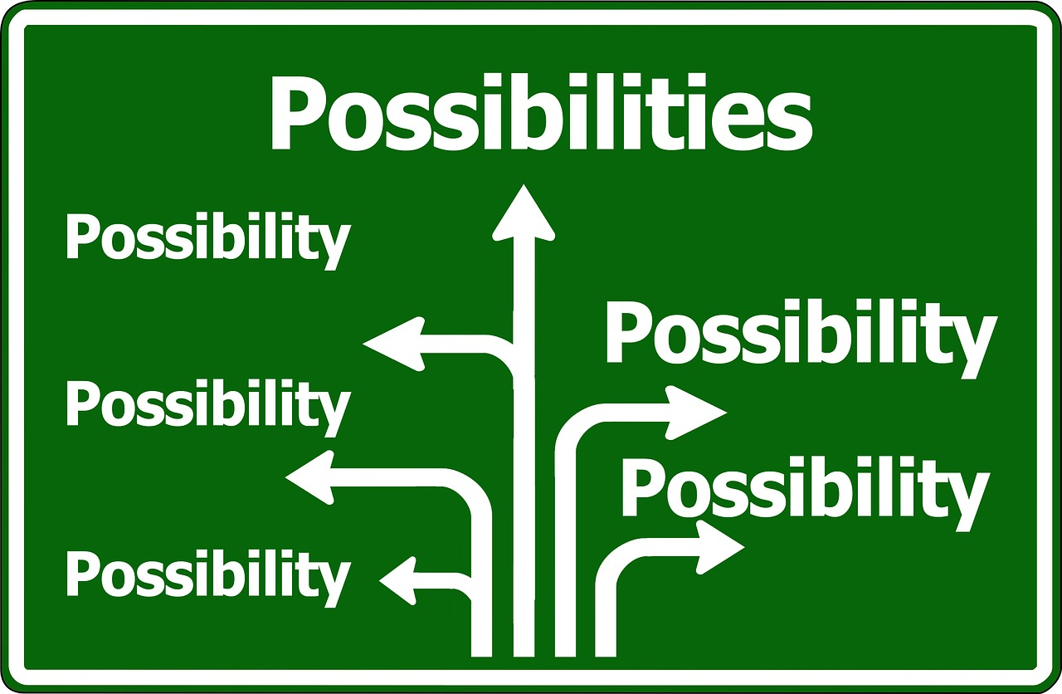
I dare not trust the sweetest frame, but wholly lean on Jesus’ name
A frame as in a structure that gives shelter and security (meaning: I will not trust in the sweetest and most secure shelter on earth but instead trust wholly in Jesus’ name)
A frame as in a body (meaning: I will not trust in myself or any other person, but wholly trust in Jesus’ name)
A frame as in a frame of mind (meaning: I will not trust in any other idea or truth, but wholly trust in Jesus’ name)

Slide 8
I dare not trust the sweetest frame, but wholly lean on Jesus’ name
Finance
Family
Success
Our own righteousness
Notes:
In the first stanza, hardly a clearer statement of total dependence on Christ could be made. Mote recognizes that our hope for eternal life depends completely upon Jesus’ righteousness, not on some sweet earthly frame. Nothing in this hymn ever hints that any work on our part can add to Christ’s work in order to secure our eternal salvation. ‘ (http://www.faithalone.org/journal/1998i/Ward.html)
The forbidden fruit in Genesis…The framing of how the land looked that Lot chose…

Slide 9
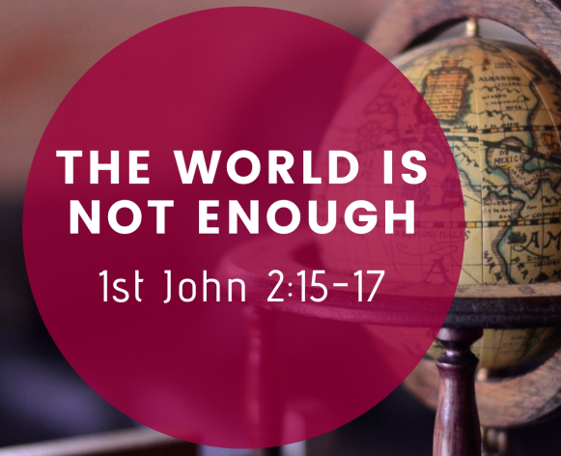
I dare not trust the sweetest frame, but wholly lean on Jesus’ name
¹⁵ Do not love the world or the things in the world. If anyone loves the world, the love of the Father is not in him.
¹⁶ For all that is in the world—the lust of the flesh, the lust of the eyes, and the pride of life—is not of the Father but is of the world.
¹⁷ And the world is passing away, and the lust of it; but he who does the will of God abides forever

Slide 10
I dare not trust the sweetest frame, but wholly lean on Jesus’ name
.Jn 20:31 “³¹ but these are written that you may believe that Jesus is the Christ, the Son of God, and that believing you may have life in His name.
Acts 4:12 “¹² Nor is there salvation in any other, for there is no other name under heaven given among men by which we must be saved.”
Acts 10:43 “⁴³ To Him all the prophets witness that, through His name, whoever believes in Him will receive remission^{[a]} of sins.”

Slide 11
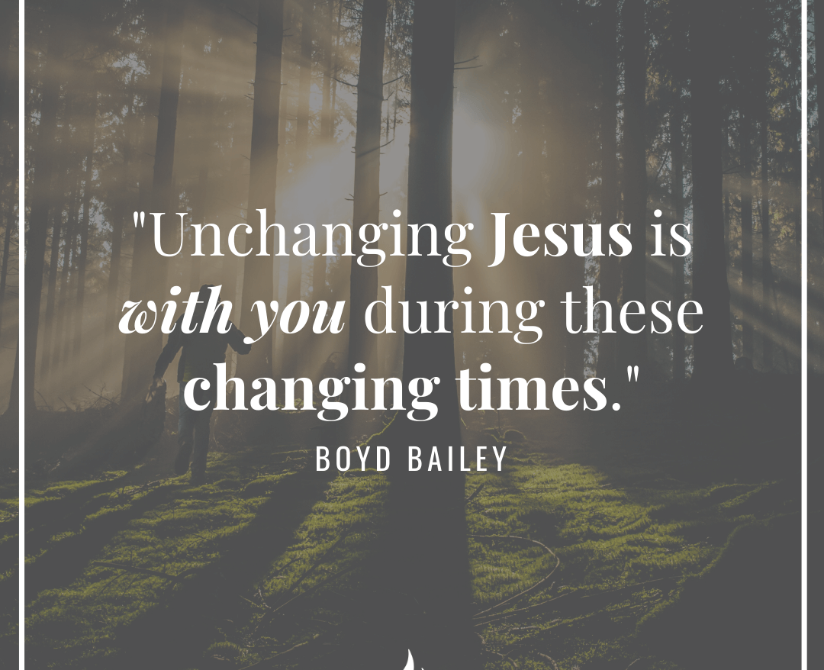
When darkness veils his lovely face, I rest on his unchanging grace
Jn 1:14 “¹⁴ And the Word became flesh and dwelt among us, and we beheld His glory, the glory as of the only begotten of the Father, full of grace and truth.
Heb 13:8 “⁸ Jesus Christ is the same yesterday, today, and forever.
Jam 1:17 :¹⁷ Every good gift and every perfect gift is from above, and comes down from the Father of lights, with whom there is no variation or shadow of turning.
Notes:
Eph 2:8-9 “⁸ For by grace you have been saved through faith, and that not of yourselves; it is the gift of God, ⁹ not of works, lest anyone should boast.

Slide 12
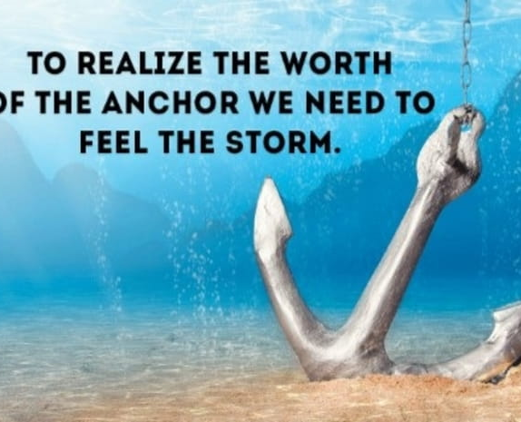
In every high and stormy gale, my anchor holds within the veil
Jn 1:14 “¹⁴ And the Word became flesh and dwelt among us, and we beheld His glory, the glory as of the only begotten of the Father, full of grace and truth.
Heb 13:8 “⁸ Jesus Christ is the same yesterday, today, and forever.
Jam 1:17 :¹⁷ Every good gift and every perfect gift is from above, and comes down from the Father of lights, with whom there is no variation or shadow of turning.

Slide 13
In every high and stormy gale, my anchor holds within the veil
Heb 6:19-20 “¹⁹ This hope we have as an anchor of the soul, both sure and steadfast, and which enters the Presence behind the veil,
²⁰ where the forerunner has entered for us, even Jesus, having become High Priest forever according to the order of Melchizedek.
Notes:
The “veil” in question refers to the curtain in the Jerusalem Temple that separated the Holy Place from the Holy of Holies where the Ark of the Covenant resided, representing the throne of God. Further, the writer of Hebrews uses this Temple imagery to point out that Christ has superseded the old covenant and its rituals and now ministers for us not in the earthly Temple, which is but a “copy and a shadow of the heavenly things” (Heb 8:5), but in the “greater and more perfect tabernacle” (Heb 9:11), that is, heaven itself.
When all about us are waves and wind that threaten to shipwreck our lives, what we need is an anchor. An anchor that’s chained to an immovable hope. And an anchor that’s fastened around us. An anchor that holds us fast when storms rage all about us. We need what the author of Hebrews tells us we have: “We have this as a sure and steadfast anchor of the soul, a hope that enters in the inner place behind the curtain, where Jesus has gone as a forerunner on our behalf,” (6:19-20). There is no “Jesus and….” There is only Jesus, and he is more than enough.

Slide 14
In every high and stormy gale, my anchor holds within the veil
Heb 6:19-20 “¹⁹ This hope we have as an anchor of the soul, both sure and steadfast, and which enters the Presence behind the veil,
²⁰ where the forerunner has entered for us, even Jesus, having become High Priest forever according to the order of Melchizedek.
Notes:
When all about us are waves and wind that threaten to shipwreck our lives, what we need is an anchor. An anchor that’s chained to an immovable hope. And an anchor that’s fastened around us. An anchor that holds us fast when storms rage all about us. We need what the author of Hebrews tells us we have: “We have this as a sure and steadfast anchor of the soul, a hope that enters in the inner place behind the curtain, where Jesus has gone as a forerunner on our behalf,” (6:19-20). There is no “Jesus and….” There is only Jesus, and he is more than enough. “In every high and storm gale, my anchor holds within the veil.” Nothing can separate us from the love of Christ because nothing can un-anchor him from us, or us from him. No storms of sin, no gales of guilt, no floods of fear. We may be tossed about, but our anchor holds. We will struggle, we will doubt, but thanks be to God we are not the anchor. Christ is. Our hope is built on nothing less than Jesus’ blood and righteousness. Not our own fidelity. Not our own piety. Not our own anything. There is no “Jesus and….” There is only Jesus, and he is more than enough.

