Slide 2
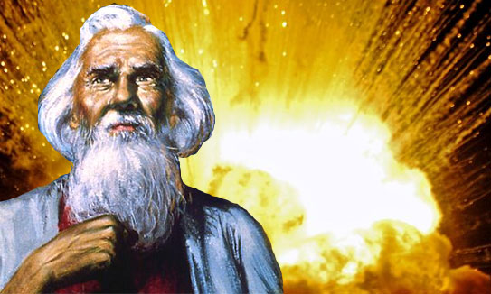
THOSE WHO LOVE GOD

Slide 3
“Know today that I do not speak with your children,…”
Deuteronomy 11:2

Slide 4
THOSE WHO LOVE GOD
Moses
Abel - (Gen 4:1-5)
Noah - (Gen. 6:1-8)
Abraham - (Gen. 22:1-13)
Peter, John, Stephen, and Paul

Slide 5
“THOSE WHO LOVE GOD”
HOW IS THEIR LOVE FOR GOD DEMONSTRATED?

Slide 6
“THOSE WHO LOVE GOD”
HOW IS THEIR LOVE FOR GOD DEMONSTRATED?
THEY ARE “ALL IN”!

Slide 7
“THOSE WHO LOVE GOD”
HOW IS THEIR LOVE FOR GOD DEMONSTRATED?
With all their heart!
The heart is the center of the inner part of the individual

Slide 8
“THOSE WHO LOVE GOD”
HOW IS THEIR LOVE FOR GOD DEMONSTRATED?
With all their soul!
Tells us that this is to be the persons “life principal” or “breath of life”

Slide 9
“THOSE WHO LOVE GOD”
HOW IS THEIR LOVE FOR GOD DEMONSTRATED?
With all their strength!
Every ability of man and all his energy should stand behind his relationship with God

Slide 10
“THOSE WHO LOVE GOD”
HOW IS THEIR LOVE FOR GOD DEMONSTRATED?
With all their mind!
Understanding, intelligence, disposition, thought, imagination, purpose and plan

Slide 11
HEART – SOUL – STRENGTH - MIND
The elements of a person described by four terms depicts the emotion, consciousness, drive, and intelligence or cognitive abilities

Slide 12
“THOSE WHO LOVE GOD”
HOW IS THEIR LOVE FOR GOD DEMONSTRATED?
SHOW HIM RESPECT

Slide 13
“THOSE WHO LOVE GOD”
HOW IS THEIR LOVE FOR GOD DEMONSTRATED?
DO WHAT IS ASKED

Slide 14
“THOSE WHO LOVE GOD”
HOW IS THEIR LOVE FOR GOD DEMONSTRATED?
HAVE GREAT FAITH

Slide 15
How do you see yourself in comparison to those mentioned in this lesson?

