Slide 1
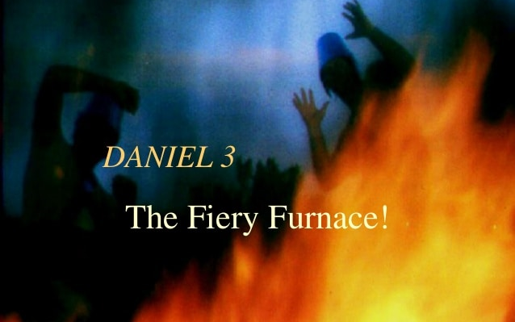

Slide 2
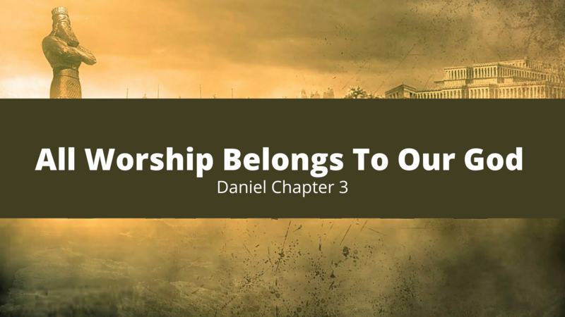
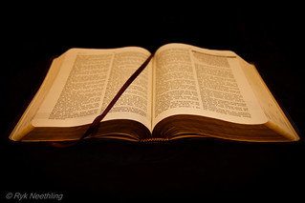
King Nebuchadnezzar erects a statue and calls for the leaders
Vs 1-3

Slide 3
The command and warning to the people
Vs 4-6

Slide 4
The obedience of the people
Vs 7

Slide 5
The accusation against Daniel’s friends
Vs 8-12

Slide 6
The reaction and actions of the king
Vs 13-15

Slide 7
The response of Daniel’s friends
Vs 16-18

Slide 8
The reaction and actions of the king
Vs 19-20

Slide 9
Daniel’s friends taken and thrown into the furnace
Vs 21-23

Slide 10
The king looks into the furnace and is surprised at what he sees
Vs 24-25

Slide 11
The king calls Daniel’s friends to come out of the furnace
Vs 26-27

Slide 12
The king praises the God of Daniel’s friends and makes a decree
Vs 28-29

Slide 13
The king promotes Daniel’s friends
Vs 30

