Slide 2
Chapter 1: Daniel Taken Into Captivity

Slide 3
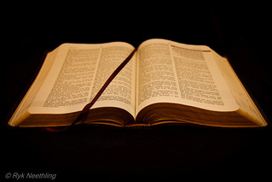
Daniel and His Friends selected to serve the king
Vs 3-4

Slide 4
The king attempts to manipulate Daniel and his friends
Vs 5

Slide 5
Daniels and his friends given new names
Vs 6-7

Slide 6
Daniel refuses to defile himself with the king’s goods
Vs 8-9

Slide 7
The fear and response of the chief of the eunuchs
Vs 10

Slide 8
The request and challenge made to the steward
Vs 11-13

Slide 9
The results of the challenge
Vs 15-16

Slide 10
The blessings from God given to Daniel and his friends
Vs 17-20

Slide 11
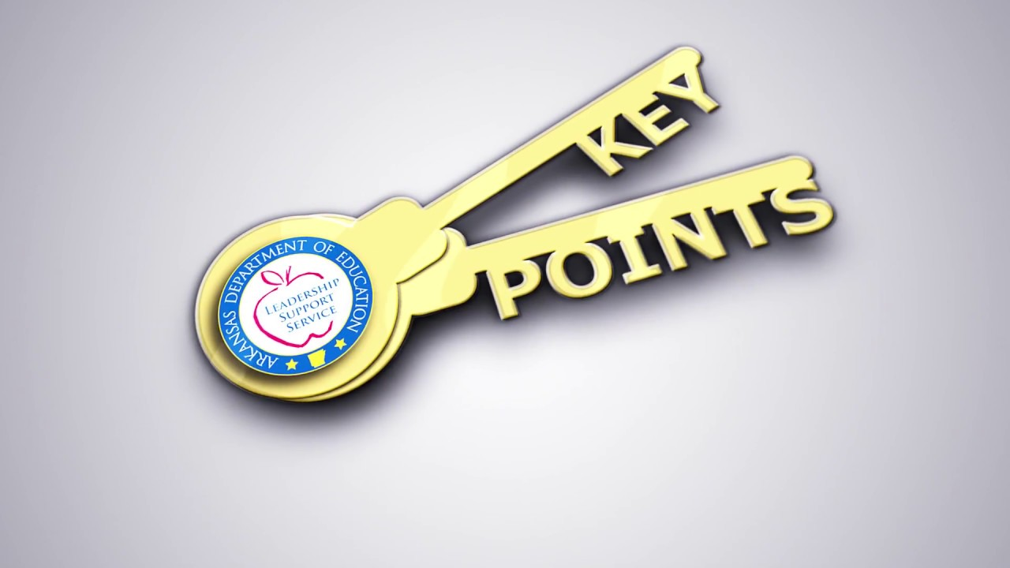
Daniel remembered who he belonged to and where he came from
Daniel chose not to accept the king’s gifts but instead focus on and not forget his God
Daniel is rewarded and protected by God

Slide 12
Chapter 2: Nebuchadnezzar’s Dream

Slide 13
The ing’s disturbing dream
Vs 1-3

Slide 14
The Chaldean’s tell the king they will interpret for him
Vs 4

Slide 15
The offer and warning from the king
Vs 5-6

Slide 16
The king demands he be told the dream before its interpretation
Vs 8-9

Slide 17
The Chaldean’s response
Vs 10-11

Slide 18
The anger of the king and his actions
Vs 12-13

Slide 19
Daniel receives news of the king’s orders
Vs 14-15

Slide 20
Daniel asks the king for time to interpret the dream
Vs 16

Slide 21
Daniel tells his friends he is going to interpret the dream and they should pray God spare their lives
Vs 17-18

Slide 22
Daniel praises God and thanks him for revealing the dream and its interpretation
Vs 19-23

Slide 23
Daniel reveals the dream to the king advising no man could have
Vs 27-28

Slide 24
Daniel reveals the interpretation of the dream
Vs 36-45

Slide 25
The king honors the God of Daniel for revealing his dream and promotes Daniel
Vs 47-48

Slide 26
Daniel petitions the king on behalf of his friends
Vs 49

Slide 27
Daniel allows God to work through him to answer the king
Daniel remembers and seeks benefits for his friends as well

Slide 28
Chapter 3: Daniel’s Faithful Friends

Slide 29
Daniel chooses faithful friends

