Slide 1
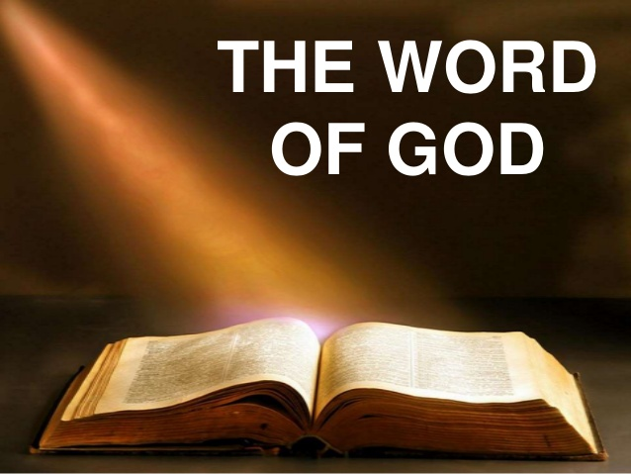
How to use the Word of God
What every Christian
must know

Slide 2
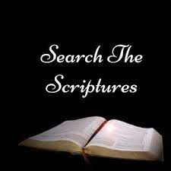
Search/Examine the Word
Jn 5:39 You study the scriptures thoroughly because you think in them you possess eternal life, and it is these same scriptures that testify about me,

Slide 3
Search/Examine the Word
Rom 15:4 For everything that was written in former times was written for our instruction, so that through endurance and through encouragement of the scriptures we may have hope.

Slide 4
Search/Examine the Word
Acts 17:11 These Jews were more open-minded than those in Thessalonica, for they eagerly received the message, examining the scriptures carefully every day to see if these things were so.

Slide 5
Search/Examine the Word
Eph 4:14 So we are no longer to be children, tossed back and forth by waves and carried about by every wind of teaching by the trickery of people who craftily carry out their deceitful schemes.

Slide 6
Search/Examine the Word
2 Tim 2:15 Make every effort to present yourself before God as a proven worker who does not need to be ashamed, teaching the message of truth accurately.

Slide 7
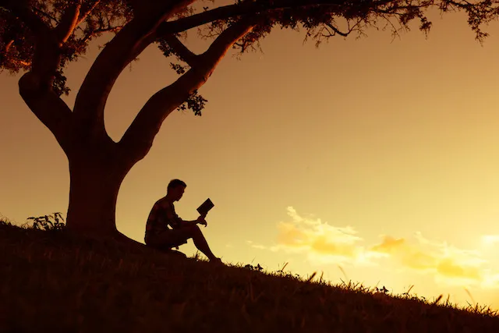
Meditate on the Word

Slide 8
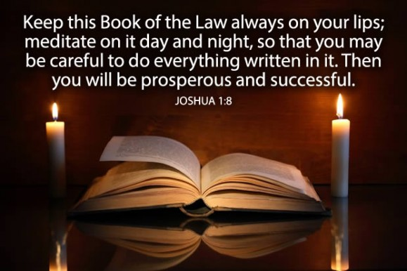
Meditate on the Word

Slide 9
Meditate on the Word

Slide 10
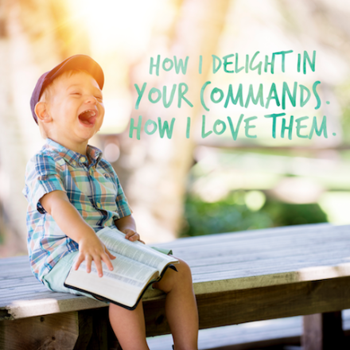
Delight in the Word
Ps 1:1-2 Blessed is the man Who walks not in the counsel of the ungodly, Nor stands in the path of sinners, Nor sits in the seat of the scornful; ² But his delight is in the law of the Lord, And in His law he ]meditates day and night.

Slide 11
Delight in the Word
Ps 119: 14-16 I rejoice in the lifestyle prescribed by your rules[ as if they were riches of all kinds. ¹⁵ I will meditate on your precepts and focus on your behavior. ¹⁶ I find delight in your statutes; I do not forget your instructions.

Slide 12
Delight in the Word
Jer 15:16 As your words came to me I drank them in, and they filled my heart with joy and happiness because I belong to you, O Lord God of Heaven’s Armies.

Slide 13
Declare the Word
Ps 96:2-3 Sing to the Lord. Praise his name. Announce every day how he delivers. ³ Tell the nations about his splendor. Tell all the nations about his amazing deeds.

Slide 14
Declare the Word
Mk 16:15-16 He said to them, “Go into all the world and preach the gospel to every creature. ¹⁶ The one who believes and is baptized will be saved, but the one who does not believe will be condemned.

Slide 15
Declare the Word
Rom 1:16-17 For I am not ashamed of the gospel, for it is God’s power for salvation to everyone who believes, to the Jew first and also to the Greek. ¹⁷ For the righteousness of God is revealed in the gospel from faith to faith, just as it is written, “The righteous by faith will live.”

Slide 16
Declare the Word
Rom 10:14-17 How are they to call on one they have not believed in? And how are they to believe in one they have not heard of? And how are they to hear without someone preaching to them? ¹⁵ And how are they to preach unless they are sent? As it is written, “How timely[ is the arrival[ of those who proclaim the good news.” ¹⁶ But not all have obeyed the good news, for Isaiah says, “Lord, who has believed our report?” ¹⁷ Consequently faith comes from what is heard, and what is heard comes through the preached word of Christ.

