Slide 1
The worship service
The Lord’s Supper

Slide 2
The Lord’s Supper: Instituted by Christ (1 Cor 11:23-25)
²³ For I received from the Lord that which I also delivered to you: that the Lord Jesus on the same night in which He was betrayed took bread; ²⁴ and when He had given thanks, He broke it and said, “Take, eat; this is My body which is broken for you; do this in remembrance of Me.” ²⁵ In the same manner He also took the cup after supper, saying, “This cup is the new covenant in My blood. This do, as often as you drink it, in remembrance of Me.”

Slide 3
The Lord’s Supper: Covenant Meal (1 Cor 11:23-25)
²³ For I received from the Lord that which I also delivered to you: that the Lord Jesus on the same night in which He was betrayed took bread; ²⁴ and when He had given thanks, He broke it and said, “Take, eat; this is My body which is broken for you; do this in remembrance of Me.” ²⁵ In the same manner He also took the cup after supper, saying, “This cup is the new covenant in My blood. This do, as often as you drink it, in remembrance of Me.”
Notes:
No doubt the agreed upon terms are that God grants us forgiveness and that we will live as new men, dead to sin and alive to God (Romans 6:1-23).
This meal, the Lord’s Supper, is our ratification and agreement to this covenant. It is a weekly reminder of the covenant to which we have submitted. It is a the reminder that our lives now belong to God and that we have separated ourselves to His service. It is also our reminder that God has submitted to a covenant of forgiveness with us.

Slide 4
The Lord’s Supper: Covenant Meal (Jer 31:31-34)
³¹ “Behold, the days are coming, says the Lord, when I will make a new covenant with the house of Israel and with the house of Judah— ³² not according to the covenant that I made with their fathers in the day that I took them by the hand to lead them out of the land of Egypt, My covenant which they broke, though I was a husband to them, says the Lord. ³³ But this is the covenant that I will make with the house of Israel after those days, says the Lord: I will put My law in their minds, and write it on their hearts; and I will be their God, and they shall be My people. ³⁴ No more shall every man teach his neighbor, and every man his brother, saying, ‘Know the Lord,’ for they all shall know Me, from the least of them to the greatest of them, says the Lord. For I will forgive their iniquity, and their sin I will remember no more.”
Notes:
Each week we remind ourselves of our covenant with God and share a feast with our Lord.

Slide 5
The Lord’s Supper: A Communal Meal (1 Cor 11:17-18)
¹⁷ Now in giving these instructions I do not praise you, since you come together not for the better but for the worse. ¹⁸ For first of all, when you come together as a church, I hear that there are divisions among you, and in part I believe it.

Slide 6
The Lord’s Supper: A Communal Meal (1 Cor 11:17-18, 20)
¹⁷ Now in giving these instructions I do not praise you, since you come together not for the better but for the worse. ¹⁸ For first of all, when you come together as a church, I hear that there are divisions among you, and in part I believe it…²⁰ Therefore when you come together in one place, it is not to eat the Lord’s Supper.

Slide 7
The Lord’s Supper: A Communal Meal (1 Cor 11:33-34)
³³ Therefore, my brethren, when you come together to eat, wait for one another. ³⁴ But if anyone is hungry, let him eat at home, lest you come together for judgment. And the rest I will set in order when I come.
Notes:
Through the Lord’s Supper we become 1
1 Cor 10:17 :¹⁷ For we, though many, are one bread and one body; for we all partake of that one bread.

Slide 8
The Lord’s Supper is a Remembrance of His Death
The bread represents His body given for our sins
The fruit of the vine represents the new covenant in His blood

Slide 9
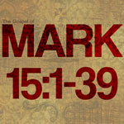

Slide 10
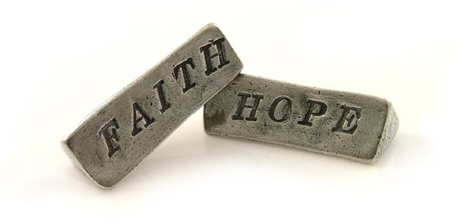
The Lord’s Supper is a Proclamation of our Faith and Hope (1 Cor 11:26)
²⁶ For as often as you eat this bread and drink this cup, you proclaim the Lord’s death till He comes.

Slide 11
Conclusion: We Must Eat & Drink to Live Forever (Jn 6:53-58)
⁵³ Then Jesus said to them, “Most assuredly, I say to you, unless you eat the flesh of the Son of Man and drink His blood, you have no life in you. ⁵⁴ Whoever eats My flesh and drinks My blood has eternal life, and I will raise him up at the last day. ⁵⁵ For My flesh is food indeed, and My blood is drink indeed. ⁵⁶ He who eats My flesh and drinks My blood abides in Me, and I in him. ⁵⁷ As the living Father sent Me, and I live because of the Father, so he who feeds on Me will live because of Me. ⁵⁸ This is the bread which came down from heaven—not as your fathers ate the manna, and are dead. He who eats this bread will live forever.”

