Slide 1
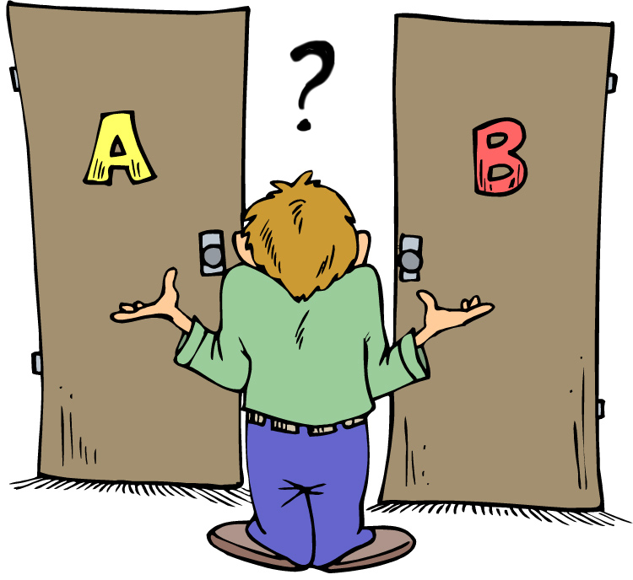
Choices
Examples from the Bible

Slide 2
The rich young ruler (Mt 19:16-22)
Treasure in Heaven
Treasure on Earth
Mt 16:21 “²¹ Jesus said to him, “If you want to be perfect, go, sell what you have and give to the poor, and you will have treasure in heaven; and come, follow Me.”
Mt 16:22 “²² But when the young man heard that saying, he went away sorrowful, for he had great possessions.

Slide 3
Pilate and the multitude (Mt 27:16-28)
Barabbas
Jesus
Mt 27:16 “¹⁶ And at that time they had a notorious prisoner called Barabbas.
Mt 27:17-18 “¹⁷ Therefore, when they had gathered together, Pilate said to them, “Whom do you want me to release to you? Barabbas, or Jesus who is called Christ?” ¹⁸ For he knew that they had handed Him over because of envy.”

Slide 4
Pilate and the multitude (Mt 27:16-28)
Barabbas
Jesus
Mt 27:21 “²¹ The governor answered and said to them, “Which of the two do you want me to release to you? They said, “Barabbas!”
Mt 27:22 “²² Pilate said to them, “What then shall I do with Jesus who is called Christ?” They all said to him, “Let Him be crucified!”

Slide 5
Felix (Acts 24:24-25)
Act now
Act later
Acts 24:24 “²⁴ And after some days, when Felix came with his wife Drusilla, who was Jewish, he sent for Paul and heard him concerning the faith in Christ."
Acts 24:25 “²⁵ Now as he reasoned about righteousness, self-control, and the judgment to come, Felix was afraid and answered, “Go away for now; when I have a convenient time I will call for you.”

Slide 6
King Agrippa (Acts 26:27-28)
Believe and change
Believe & not change
Acts 26:27 “²⁷ King Agrippa, do you believe the prophets? I know that you do believe.”
Acts 26:28 “²⁸ Then Agrippa said to Paul, “You almost persuade me to become a Christian.”

Slide 7
Your Choice (Mt 7:13-14)
Life (Narrow gate)
Destruction (wide gate)
Mt 7:14 “¹⁴ Because narrow is the gate and difficult is the way which leads to life, and there are few who find it.
Mt 7:13 “…for wide is the gate and broad is the way that leads to destruction, and there are many who go in by it.”

