Slide 1
Facts to Remember Starting the new year
Psalm 145

Slide 3
Verses 1-9

Slide 4
Verses 10-13

Slide 5
Verses 14-16

Slide 6
Verses 17-20

Slide 7
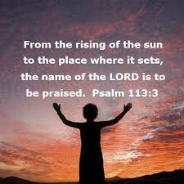
Verse 21

