Slide 2
Fear of the Lord defined
‘That indefinable mixture of reverence, fear, pleasure, joy and awe which fills our hearts when we realise who God is and what he has done for us.’ (Sinclair Ferguson)
‘God must be taken seriously. He must not be trifled with. He must be, as he actually is, the centre of everything we are, think, or aspire to do. He must be the starting point for every project, the strength we seek for every valuable endeavour, the one we earnestly desire to please and honour as our goal.’ (James Boice)

Slide 3
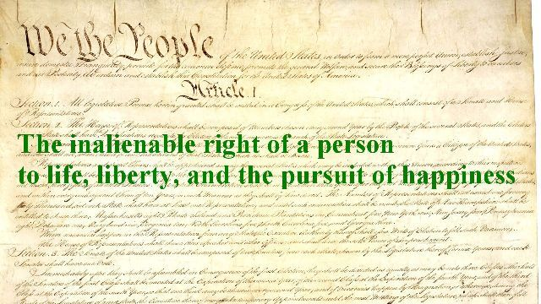
Blessed is everyone who fears the Lord, who walks in His ways
Blessed can be translated as “happy”
All mankind desires true happiness but they often look in the wrong places

Slide 4
Blessed is everyone who fears the Lord, who walks in His ways
Many look for happiness in
Lesiure
Individual pursuits
Without God
The opposite of the way happiness is found in this Psalm

Slide 5
Blessed is everyone who fears the Lord, who walks in His ways
Ps 11:10 “¹⁰ The fear of the Lord is the beginning of wisdom; A good understanding have all those who do His commandments. His praise endures forever.”
Prov 1:7 “⁷ The fear of the Lord is the beginning of knowledge, But fools despise wisdom and instruction.”

Slide 6
Blessed is everyone who fears the Lord, who walks in His ways
Deut 5:29
1 Kings 2:1-4
Ps 119: 1-8

Slide 7
When you eat of the labor of your hands, you shall be happy, and it shall be well with you
Haggai 1:5-6 “⁵ Now therefore, thus says the Lord of hosts: “Consider your ways!
⁶ “You have sown much, and bring in little; You eat, but do not have enough; You drink, but you are not filled with drink; You clothe yourselves, but no one is warm; And he who earns wages, Earns wages to put into a bag with holes.”
The opposite of what this verse speaks of

Slide 8
When you eat of the labor of your hands, you shall be happy, and it shall be well with you
Eccl 2:24
Eccl 3:9-13
Eccl 5:18-20

Slide 9
Your wife shall be like a fruitful vine in the very heart of your house
Gen 1:28
Prov 31
Prov 18:22

Slide 10
Your children like olive plants all around your table
Ps 127:3-5
Prov 22:6
Eph 6:1-4

Slide 11
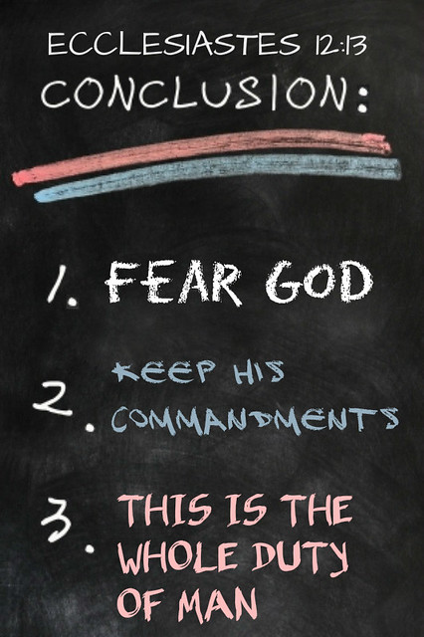
Behold, thus shall the man be blessed who fears the Lord

