Slide 3
Abraham waited 25 years
The first 4 verses reveal God’s promise to Abram regarding a homeland for his offspring
Abram was 75 years old when he first received the promise

Slide 5
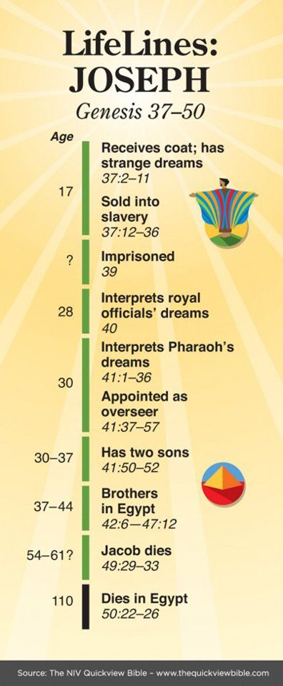
Joseph waited 13 years

Slide 6
Jacob waited 20 years to be free of Laban
Gen 31:41-42 “⁴¹ Thus I have been in your house twenty years; I served you fourteen years for your two daughters, and six years for your flock, and you have changed my wages ten times.
⁴² Unless the God of my father, the God of Abraham and the Fear of Isaac, had been with me, surely now you would have sent me away empty-handed. God has seen my affliction and the labor of my hands, and rebuked you last night.”

Slide 7
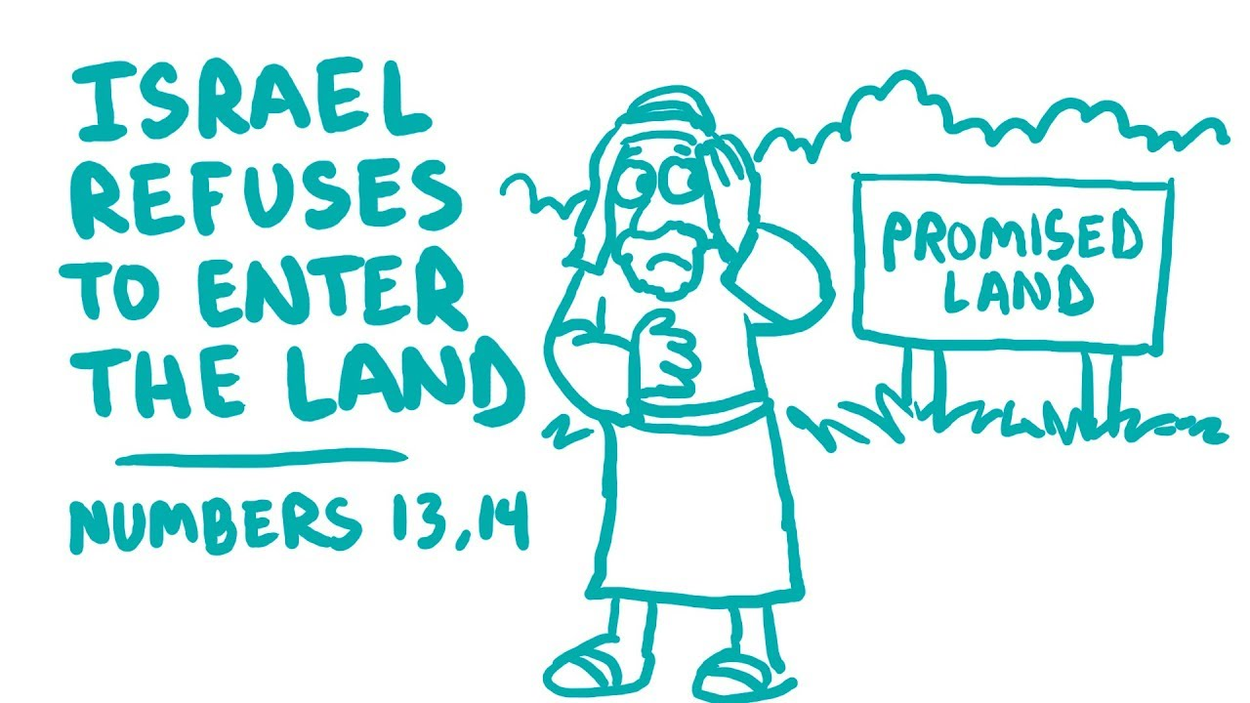
Joshua and Caleb waited forty years
All those 20 and over would perish in the wilderness except Joshua and Caleb (Num 14:28-30)
All those under 20 would toil in the wilderness 40 years (one year for each day the spies spied out the land (Num 14:31-34)
Joshua and Caleb enter the promised land (Josh 14)

Slide 8
Habakkuk learned to wait

