Slide 1
Remember His Words
Luke 24:1-12
focus verse 8

Slide 2
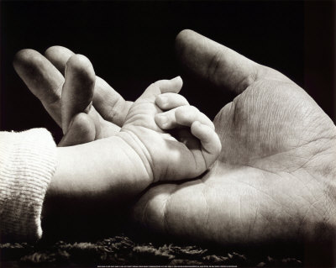
God & Christ’s Love & Care
Mt 6:25-35; Lk 12:6-7; Lk 15:1-10; Jn 3:16
Emphasized by other writers in the Bible
Rom 5:8; Gal 2:20; Eph 2:4-5; 1 Pet 5:6-7; 1 Jn 4:9-11
Notes:
Mt 6:25-34: D not worry
Lk 12:6-7: greater value than sparrow… hairs of your head are all numbered
Lk 15:1-10 Lost sheep and lost coin (read this passage)
Gal 2:20 The son of God who loved me and gave Himself for me
Eph 2:4-5 The great with which God loved us
1 Pet 5:6-7 Cast all your cares upon Him…He cares for you
1 Jn 4:9-11 God loved us and sent His son to be the propitiation for our sins

Slide 3
Words about prayer
Instruction on how to pray – Mt 6:5-8
The model prayer (Adoration, confession & petition)
Mt 6:9-12
The prayer in the garden
Mt 26:36-46
Other writers’ thoughts on prayer
1 Thes 5:17; 1 Tim 2:1-2; Ja 5:13-16
Notes:
1 Thes 5:17 “Pray without ceasing”
1 Tim 2:1-2 pray for all men
Jam 5:13-16 (turn and read)

Slide 4
Words about Heaven
Heaven is God’s dwelling place
Mt 5:34 & 45; Mt 6:9; Mt 18:10 & 14; Mk 11:25-26
Other writers’ thoughts
Deut 26:15; Neh 9:27; Rom 1:18; Heb 8:1
Heaven will be eternal
Mt 25:46 & Jn 10:28
Other writers’ thoughts
Ps 23:6 & 2 Pet 1:11
Notes:
Mt 5:34: Heaven is God’s throne
Mt 5:45: Sons of your Father in Heaven
Mt 6:9: Pray our Father in Heaven
Mt 18:10: The face of my Father who is in Heaven
Mt 18:14: The will of your Father who is in Heaven
Mk 11:25-26: Your Father in Heaven and forgiveness of trespasses
Deut 25:16: Look down from Your habitation, from Heaven
Neh 9:27: When they cried to You, You heard from Heaven
Rom 1:18 “The wrath of God is revealed from Heaven”
Heb 8:1 the throne of the Majesty in the heavens
Mt 25:46 “⁴⁶ And these will go away into everlasting punishment, but the righteous into eternal life.”
Jn 10:28 “²⁸ And I give them eternal life, and they shall never perish; neither shall anyone snatch them out of My hand.”
Ps 23:6 “⁶ Surely goodness and mercy shall follow me All the days of my life; And I will dwell in the house of the Lord Forever.”
2 Pet 1:11 “¹¹ for so an entrance will be supplied to you abundantly into the everlasting kingdom of our Lord and Savior Jesus Christ.”

Slide 6
Remember His Words part 2
Luke 24:1-12
focus verse 8

Slide 7
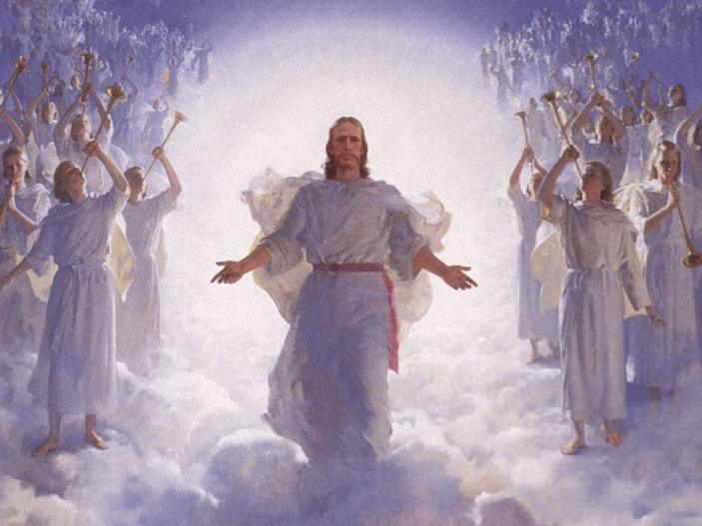
More Words about Heaven
Heaven as the future home of the saints
Mt 25:34 & Jn 14:2
Heaven described as paradise
Lk 23:43 & Rev 2:7
Other writers’ thoughts
2 Cor 12:2-4

Slide 8
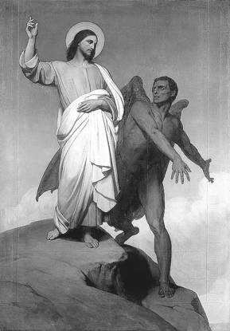
Words about Hell
Descriptions of Hell
Weeping & gnashing of teeth – Mt 25:30
Outer darkness – Mt 22:13
Torments – Lk 16:23
Fire is not quenched – Mk 9:43
Other writers’ thoughts
Sorrow – 2 Sam 22:6
Everlasting destruction – 2 Thes 1:8-9
No rest – Rev 14:11
A lake of fire – Rev 20:14

Slide 9
Preparation & Eternity
Building one’s house on sand or rock
Mt 7:24-27
Parable of the 10 virgins – Mt 25:1-13
A simple statement – Mt 24:44
A horrible picture – Mt 24:35-42
Other writers’ thoughts
Amos 4:12; Prov 27:12; 1 The 5:1-10; 2 Pet 3:9-12

Slide 10
Remember His Words
He has made provisions for this life and the life to come
He has described both destinies
He invites you to spend eternity with Him
He has left the decisions with you…
What is your response?

