Slide 1
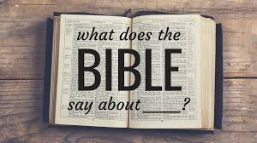
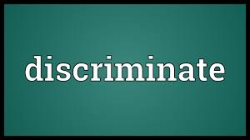

Slide 2
God demands discrimination
The primary meaning of the word discriminate is
To have good taste or judgment
To make a distinction
The bible uses the term “discern” synonymously with “discriminate”
Discriminate comes from the Greek word “diakrino”
To separate, discriminate, then to learn by discriminating, to determine, to decide

Slide 3
God demands discrimination between the sexes

Slide 4
God demands discrimination between the sexes

Slide 5
God demands discrimination between the sexes

Slide 6
God demands discrimination between the sexes

Slide 7
God demands discrimination during the Lord’s Supper

Slide 8
God demands discrimination during the Lord’s Supper

Slide 9
God demands discrimination between the holy and the profane

Slide 10
God demands discrimination between the holy and the profane

Slide 11
God demands discrimination between the holy and the profane

Slide 12
God demands discrimination between the holy and the profane

Slide 13
God demands discrimination between the holy and the profane

