Slide 1
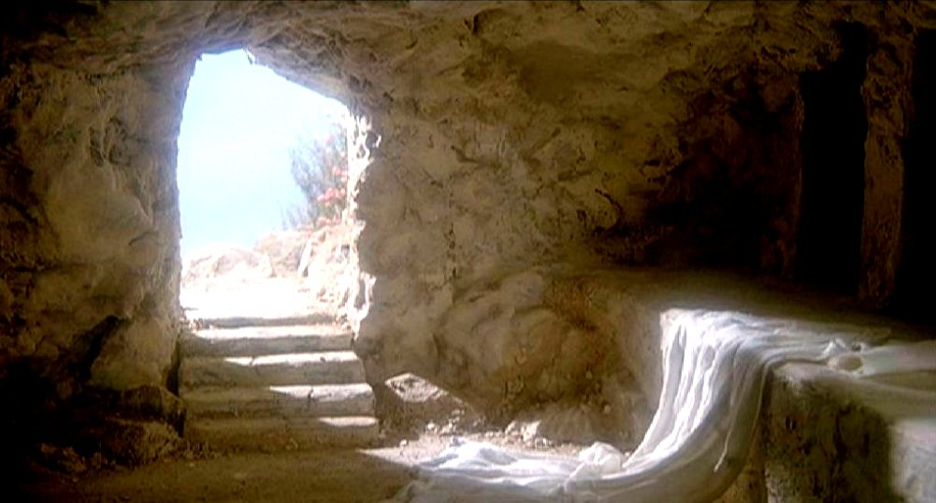
Victory Over Death

Slide 2
Victory Over Death
“And I will put enmity Between you and the woman, And between your seed and her Seed; He shall bruise your head, And you shall bruise His heel.”
Genesis 3:15

Slide 3
Victory Over Death
Death
Burial
Resurrection

Slide 4
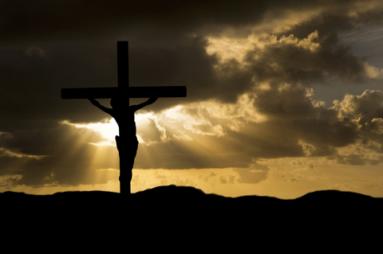
Necessity of the Pure Sacrifice
Matthew 27:51-54
Victory Over Death

Slide 5
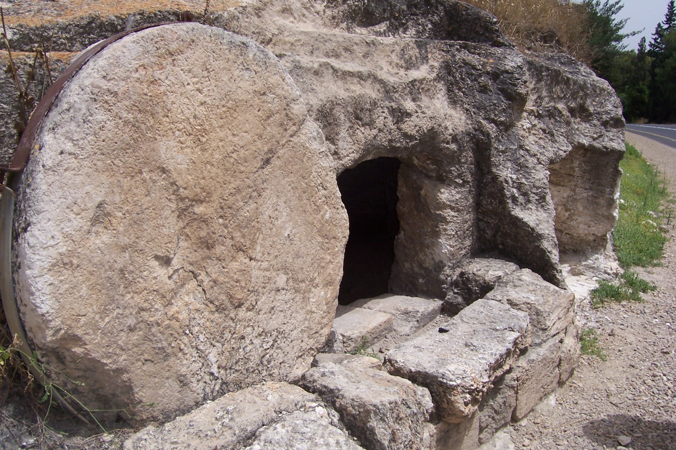
Christ’s
Burial
Matt. 27:62-66
Victory Over Death

Slide 6
Resurrections Throughout the Bible
Victory Over Death

Slide 7
Biblical Accounts of People Raised from the Dead
 | Event Details | Scripture References
1 | Elijah raised the son of the Zarephath widow from the dead | 1 Kings 17:17-22
2 | Elisha raised the son of the Shunamite woman from the dead | 2 Kings 4:32-35
3 | A man raised from the dead when his body touched Elisha's bones | 2 Kings 13:20-21
4 | Jesus raised the son of the widow of Nain from the dead | Luke 7:11-15
5 | Jesus raised the daughter of Jairus from the dead | Luke 8:41-42; 49-55
6 | Jesus raised Lazarus from the dead | John 11:1-44
7 | Peter raised Dorcas from the dead | Acts 9:36-41
8 | Eutychus was raised from the dead by Paul | Acts 20:9-10
9 | Many saints rose from the dead at the death of Jesus | Matthew 27:50-53
10 | Jesus rose from the dead | Mat. 28:5-8; Mark 16:6; Luke 24:5-6

Slide 8
Christ’s Resurrection
Matthew 28
Victory Over Death

Slide 9
Appearances After His Resurrection
Order | Time | To Whom | Place | Scripture
1 | Early Sunday morning | Mary Magdalene | Near the tomb at Jerusalem | Mark 16:9 John 20:11-18
2 | Sunday morning | Women returning from the tomb | Near Jerusalem | Mat. 28:9-10
3 | Sunday | Simon Peter alone | Near Jerusalem | Luke 24:34
4 | Sunday afternoon | Two disciples going to Emmaus | Between Jerusalem & Emmaus, Jerusalem | Luke 24:13-31
5 | Sunday evening | Apostles, except Thomas | Jerusalem | John 20:19-25
6 | Sunday evening next week | Apostles, Thomas being present | Jerusalem | John 20:26-29
7 | Unknown | Seven disciples fishing | Sea of Galilee | John 21:1-13
8 | Unknown | Eleven disciples on mountain | Galilee | Mat. 28:16-20
9 | Unknown | About 500 brethren at once | Galilee | 1 Cor. 15:6
10 | Unknown | James, and then all the apostles | Probably Jerusalem | 1 Cor. 15:7
11 | Unknown | All the apostles at ascension | Mount of Olives near Bethany | Luke 24:50-51 Acts 1:16-12

Slide 10
Christ’s Resurrection
“And as they went to tell His disciples, behold, Jesus met them, saying, “Rejoice!” So they came and held Him by the feet and worshiped Him. Then Jesus said to them, “Do not be afraid. Go and tell My brethren to go to Galilee, and there they will see Me.”
Matthew 28:9-10
Victory Over Death

Slide 11
Christ’s Resurrection
“Moreover, brethren, I declare to you the gospel which I preached to you, which also you received and in which you stand, by which also you are saved, if you hold fast that word which I preached to you—unless you believed in vain...
1 Corinthians 15:1-4
Victory Over Death

Slide 12
Christ’s Resurrection
…For I delivered to you first of all that which I also received: that Christ died for our sins according to the Scriptures, and that He was buried, and that He rose again the third day according to the Scriptures,”
1 Corinthians 15:1-4
Victory Over Death

Slide 13
Christ’s Resurrection
“But now Christ is risen from the dead, and has become the firstfruits of those who have fallen asleep.”
1 Corinthians 15:20
Victory Over Death

Slide 14
Christ’s Resurrection
“O Death, where is your sting? O Hades, where is your victory?” The sting of death is sin, and the strength of sin is the law. But thanks be to God, who gives us the victory through our Lord Jesus Christ.
Therefore, my beloved brethren, be steadfast, immovable, always abounding in the work of the Lord, knowing that your labor is not in vain in the Lord”
1 Corinthians 15:55-58
Victory Over Death

Slide 15
Christ’s Resurrection
Christ Overcame Death through the Resurrection
Victory Over Death

Slide 16
Christ’s Resurrection
“And truly Jesus did many other signs in the presence of His disciples, which are not written in this book; but these are written that you may believe that Jesus is the Christ, the Son of God, and that believing you may have life in His name.”
John 20:30-31
Victory Over Death

Slide 17
Victory Over Death

