Slide 1
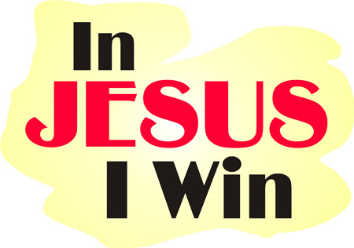
Victories in Jesus
Isaiah 25:8-9 (cf. Rev 21:4)
Notes:
Rom 8:37 “³⁷ No, in all these things we have complete victory^{[a]} through him^{[b]} who loved us! “
1 cor 15:57 “⁵⁷ But thanks be to God, who gives us the victory through our Lord Jesus Christ!”

Slide 2
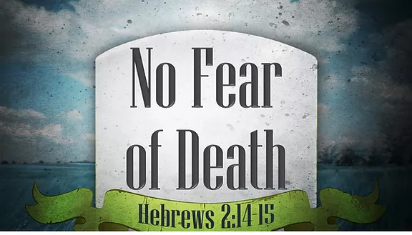
Victory over the fear of death and the grave
The universal truth of death (Can lead to fear)
Heb 9:27 “²⁷ And as it is appointed for men to die once, but after this the judgment,

Slide 3
Victory over the fear of death and the grave
Christ has defeated death for us
⁵³ For this corruptible must put on incorruption, and this mortal must put on immortality. ⁵⁴ So when this corruptible has put on incorruption, and this mortal has put on immortality, then shall be brought to pass the saying that is written: “Death is swallowed up in victory.”
⁵⁵ “O Death, where is your sting? O Hades, where is your victory?”
⁵⁶ The sting of death is sin, and the strength of sin is the law. ⁵⁷ But thanks be to God, who gives us the victory through our Lord Jesus Christ.
Notes:
¹⁴ Inasmuch then as the children have partaken of flesh and blood, He Himself likewise shared in the same, that through death He might destroy him who had the power of death, that is, the devil, ¹⁵ and release those who through fear of death were all their lifetime subject to bondage.

Slide 4
Victory over the fear of death and the grave
Christ has defeated death for us
Rom 6:4-9 “⁴ Therefore we were buried with Him through baptism into death, that just as Christ was raised from the dead by the glory of the Father, even so we also should walk in newness of life.
⁵ For if we have been united together in the likeness of His death, certainly we also shall be in the likeness of His resurrection, ⁶ knowing this, that our old man was crucified with Him, that the body of sin might be done away with, that we should no longer be slaves of sin. ⁷ For he who has died has been freed from sin. ⁸ Now if we died with Christ, we believe that we shall also live with Him, ⁹ knowing that Christ, having been raised from the dead, dies no more. Death no longer has dominion over Him.

Slide 5
Victory over the fear of death and the grave
God’s children need not fear death
1 Thes 4:13-18 “¹³ But I do not want you to be ignorant, brethren, concerning those who have fallen asleep, lest you sorrow as others who have no hope. ¹⁴ For if we believe that Jesus died and rose again, even so God will bring with Him those who sleep in Jesus.
¹⁵ For this we say to you by the word of the Lord, that we who are alive and remain until the coming of the Lord will by no means precede those who are asleep.

Slide 6
Victory over the fear of death and the grave
God’s children need not fear death
1 Thes 4:13-18 “¹⁶ For the Lord Himself will descend from heaven with a shout, with the voice of an archangel, and with the trumpet of God. And the dead in Christ will rise first. ¹⁷ Then we who are alive and remain shall be caught up together with them in the clouds to meet the Lord in the air. And thus we shall always be with the Lord. ¹⁸ Therefore comfort one another with these words.

Slide 7
Victory over heartache and pain
Psalm 34:18 “¹⁸ The Lord is near to those who have a broken heart, And saves such as ^{[a]}have a contrite spirit
Psalm 147:3 “³ He heals the brokenhearted And binds up their wounds.
Is 57:15 “⁵ For thus says the High and Lofty One Who inhabits eternity, whose name is Holy: “I dwell in the high and holy place, With him who has a contrite and humble spirit, To revive the spirit of the humble, And to revive the heart of the contrite ones.

Slide 8
Victory over heartache and pain
Rev 21:4 “⁴ And God will wipe away every tear from their eyes; there shall be no more death, nor sorrow, nor crying. There shall be no more pain, for the former things have passed away.”

Slide 9
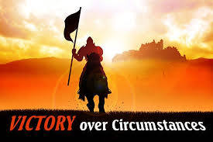
Victory over Trials and Hardships
Trials are a part of life
1 Pet 4:12-14 “¹² Beloved, do not think it strange concerning the fiery trial which is to try you, as though some strange thing happened to you; ¹³ but rejoice to the extent that you partake of Christ’s sufferings, that when His glory is revealed, you may also be glad with exceeding joy. ¹⁴ If you are reproached for the name of Christ, blessed are you, for the Spirit of glory and of God rests upon you. On their part He is blasphemed, but on your part He is glorified.
Notes:
Jn 16:33 “³³ These things I have spoken to you, that in Me you may have peace. In the world you]will have tribulation; but be of good cheer, I have overcome the world.”

Slide 10
Victory over Trials and Hardships
Trials are a part of life
Jam 1:2-4 “² My brethren, count it all joy when you fall into various trials, ³ knowing that the testing of your faith produces patience. ⁴ But let patience have its perfect work, that you may be perfect and complete, lacking nothing.
Jam 5:10-11 “¹⁰ My brethren, take the prophets, who spoke in the name of the Lord, as an example of suffering and patience. ¹¹ Indeed we count them blessed who endure. You have heard of the perseverance of Job and seen the end intended by the Lord—that the Lord is very compassionate and merciful.

Slide 11
Victory over Trials and Hardships
What to remember in times of trial
Rom 8:18 “¹⁸ For I consider that the sufferings of this present time are not worthy to be compared with the glory which shall be revealed in us
Rom 8:28 “²⁸ And we know that all things work together for good to those who love God, to those who are the called according to His purpose.
Jam 1:12 “¹² Blessed is the man who endures temptation; for when he has been approved, he will receive the crown of life which the Lord has promised to those who love Him.

Slide 12
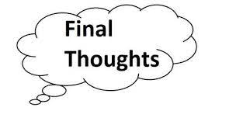
Final Thoughts
Rom 8:37 “³⁷ No, in all these things we have complete victory through him who loved us!
1 Cor 15:57 “⁵⁷ But thanks be to God, who gives us the victory through our Lord Jesus Christ.

