Slide 2
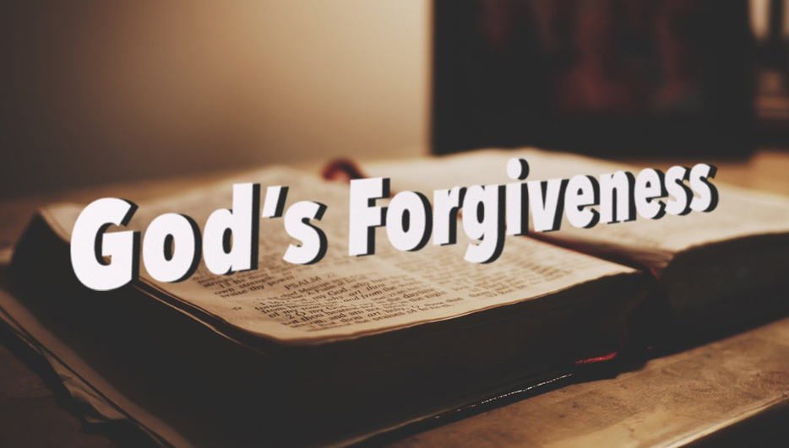
Forgiving
Psalm 32:5 “⁵ I acknowledged my sin to You, And my iniquity I have not hidden. I said, “I will confess my transgressions to the Lord,” And You forgave the iniquity of my sin. Selah”
Ps 86:5 “⁵ For You, Lord, are good, and ready to forgive, And abundant in mercy to all those who call upon You.”
Prov 28:13 “¹³ He who covers his sins will not prosper, But whoever confesses and forsakes them will have mercy.”

Slide 3
Forgiving
Eph 4:32 “³² And be kind to one another, tenderhearted, forgiving one another, even as God in Christ forgave you.”
1 Jn 1:9 “⁹ If we confess our sins, He is faithful and just to forgive us our sins and to cleanse us from all unrighteousness.”
1 Jn 2:12 “¹² I write to you, little children, Because your sins are forgiven you for His name’s sake.”

Slide 4
All Powerful, knowing, and Present
Jer 32:17 “¹⁷ ‘Ah, Lord God! Behold, You have made the heavens and the earth by Your great power and outstretched arm. There is nothing too hard for You.”
Job 42:2 “² “I know that You can do everything, And that no purpose of Yours can be withheld from You.”
PS 147:5 “⁵ Great is our Lord, and mighty in power; His understanding is infinite.”

Slide 5
All Powerful, knowing, and Present
Mt 19:26 “²⁶ But Jesus looked at them and said to them, “With men this is impossible, but with God all things are possible.”
Rev 4:11 “¹¹ “You are worthy, O Lord, To receive glory and honor and power; For You created all things, And by Your will they exist and were created.”
Rev 19:6b “Alleluia! For the Lord God Omnipotent reigns!”

Slide 6
All Powerful, knowing, and Present
Job 37:16 “¹⁶ Do you know how the clouds are balanced, Those wondrous works of Him who is perfect in knowledge?”
Ps 139:4 “⁴ For there is not a word on my tongue, But behold, O Lord, You know it altogether.”
Ps 147:5b “His understanding is infinite.”

Slide 7
All Powerful, knowing, and Present
Mt 6:8 “⁸ “Therefore do not be like them. For your Father knows the things you have need of before you ask Him.”
Rom 11:33 “³³ Oh, the depth of the riches both of the wisdom and knowledge of God! How unsearchable are His judgments and His ways past finding out!”
1 Jn 3:19-20 “¹⁹ And by this we]know that we are of the truth, and shall assure our hearts before Him. ²⁰ For if our heart condemns us, God is greater than our heart, and knows all things.”

Slide 8
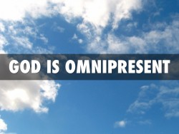
All Powerful, knowing, and Present
Ps 139:7-10 “⁷ Where can I go from Your Spirit? Or where can I flee from Your presence? ⁸ If I ascend into heaven, You are there; If I make my bed in hell, behold, You are there. ⁹ If I take the wings of the morning, And dwell in the uttermost parts of the sea, ¹⁰ Even there Your hand shall lead me, And Your right hand shall hold me.”
Notes:
Wherever you go, God is

Slide 9
Truthful
Num 23:19 “¹⁹ “God is not a man, that He should lie, Nor a son of man, that He should repent. Has He said, and will He not do? Or has He spoken, and will He not make it good?”
1 Sam 15:29 “²⁹ And also the Strength of Israel will not lie nor relent. For He is not a man, that He should relent.”
Notes:
Wherever you go, God is

Slide 10
Truthful
Tit 1:2 “² in hope of eternal life which God, who cannot lie, promised before time began,”
Heb 6:17-18, " ¹⁷ Thus God, determining to show more abundantly to the heirs of promise the immutability of His counsel, confirmed it by an oath, ¹⁸ that by two immutable things, in which it is impossible for God to lie, we might have strong consolation, who have fled for refuge to lay hold of the hope set before us.”
Notes:
Wherever you go, God is

Slide 11
Holy
Lev 11:44 “⁴⁴ For I am the Lord your God. You shall therefore consecrate yourselves, and you shall be holy; for I am holy. Neither shall you defile yourselves with any creeping thing that creeps on the earth.”
1 Sam 2:2 “² “No one is holy like the Lord, For there is none besides You, Nor is there any rock like our God.”
Is 6:3 “³ And one cried to another and said: “Holy, holy, holy is the Lord of hosts; The whole earth is full of His glory!”
Notes:
Wherever you go, God is

Slide 12
Holy
Heb 12:14 “¹⁴ Pursue peace with all people, and holiness, without which no one will see the Lord:”
1 Pet 1:15-16 “¹⁵ but as He who called you is holy, you also be holy in all your conduct, ¹⁶ because it is written, “Be holy, for I am holy.”
Rev 4:8 “⁸ The four living creatures, each having six wings, were full of eyes around and within. And they do not rest day or night, saying: “Holy, holy, holy, Lord God Almighty, Who was and is and is to come!”
Notes:
Wherever you go, God is

Slide 13
Eternal
Deut 33:27a “²⁷ The eternal God is your refuge,…”
Job 36:26 “²⁶ “Behold, God is great, and we do not know Him; Nor can the number of His years be discovered.”
Ps 90:2 “² Before the mountains were brought forth, Or ever You had formed the earth and the world, Even from everlasting to everlasting, You are God.”
Notes:
Wherever you go, God is

Slide 14
Eternal
Rom 1:20 “²⁰ For since the creation of the world His invisible attributes are clearly seen, being understood by the things that are made, even His eternal power and Godhead, so that they are without excuse,”
1 Tim 1:17 “¹⁷ Now to the King eternal, immortal, invisible, to God who alone is wise, be honor and glory forever and ever. Amen.
Rev 4:11 “¹ “You are worthy, [O Lord, To receive glory and honor and power; For You created all things, And by Your will they exist and were created.”
Notes:
Wherever you go, God is

Slide 15
Ready
Notes:
Wherever you go, God is

