Slide 1
Make yourself ready

Slide 2
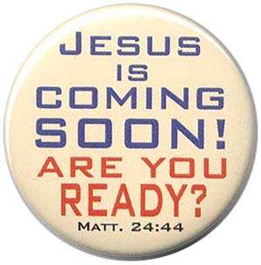
Revelation 3
¹¹ Behold, I am coming quickly! Hold fast what you have, that no one may take your crown.
Notes:
⁴⁴ Therefore you also be ready, for the Son of Man is coming at an hour you do not expect.

Slide 3
Revelation 22
⁶ Then he said to me, “These words are faithful and true.” And the Lord God of the holy prophets sent His angel to show His servants the things which must shortly take place.
⁷ “Behold, I am coming quickly! Blessed is he who keeps the words of the prophecy of this book.”

Slide 4
Revelation 22
¹² And behold, I am coming quickly, and My reward is with Me, to give to every one according to his work.

Slide 5
Revelation 22
²⁰ He who testifies to these things says, “Surely I am coming quickly….”

Slide 6
What is meant by quickly?
The Greek word tachu, which is translated “soon” or “quickly,” means “without unnecessary delay.” It does not mean “immediately.” The same word is used in other places in the New Testament, but, interestingly, it is used most often by Jesus in the book of Revelation (Revelation 2:16; 3:11; 11:14; 22:7, 12, and 20). The meaning seems to be that events have been set in motion that will usher in His arrival without any unnecessary delay. Everything is moving along according to God’s timetable.
(WWW.gotquestions .org)

Slide 7
What is meant by quickly?
Strong's Exhaustive Concordance
lightly, quickly. Neuter singular of tachus (as adverb); shortly, i.e. Without delay, soon, or (by surprise) suddenly, or (by implication, of ease) readily -- lightly, quickly.

Slide 8
What is meant by quickly (the how, not the when)
Mt 24:36-40
³⁶ “But of that day and hour no one knows, not even the angels of heaven, but My Father only. ³⁷ But as the days of Noah were, so also will the coming of the Son of Man be. ³⁸ For as in the days before the flood, they were eating and drinking, marrying and giving in marriage, until the day that Noah entered the ark, ³⁹ and did not know until the flood came and took them all away, so also will the coming of the Son of Man be.

Slide 9
What is meant by quickly (the how, not the when)
1 Thes 5:1-6
5 But concerning the times and the seasons, brethren, you have no need that I should write to you. ² For you yourselves know perfectly that the day of the Lord so comes as a thief in the night. ³ For when they say, “Peace and safety!” then sudden destruction comes upon them, as labor pains upon a pregnant woman. And they shall not escape. ⁴ But you, brethren, are not in darkness, so that this Day should overtake you as a thief. ⁵ You are all sons of light and sons of the day. We are not of the night nor of darkness. ⁶ Therefore let us not sleep, as others do, but let us watch and be sober.

Slide 10
John 3
3 There was a man of the Pharisees named Nicodemus, a ruler of the Jews. ² This man came to Jesus by night and said to Him, “Rabbi, we know that You are a teacher come from God; for no one can do these signs that You do unless God is with him.” ³ Jesus answered and said to him, “Most assuredly, I say to you, unless one is born again, he cannot see the kingdom of God.”
Notes:
If you want to receive the reward of Heaven, you must be born again

Slide 11
John 3
⁷ Do not marvel that I said to you, ‘You must be born again.’
“must” rules out any other options
Being born again begins our preparation
Notes:
If you want to receive the reward of Heaven, you must be born again

Slide 12
Jesus has told us two things…
You must be born again
Behold I come quickly
Notes:
If you want to receive the reward of Heaven, you must be born again

Slide 13
What is meant by born again ?
⁴ Nicodemus said to Him, “How can a man be born when he is old? Can he enter a second time into his mother’s womb and be born?” Jesus answered, “Most assuredly, I say to you, unless one is born of water and the Spirit, he cannot enter the kingdom of God. ⁶ That which is born of the flesh is flesh, and that which is born of the Spirit is spirit.

Slide 14
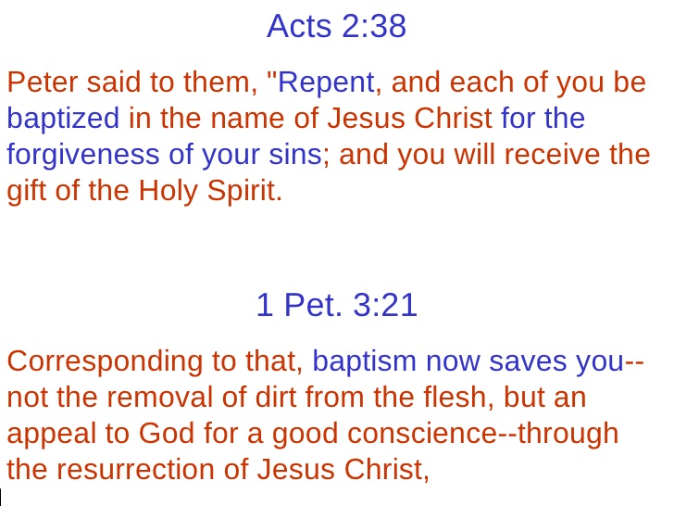
Why remission of sins?
Romans 3:23
²³ for all have sinned and fall short of the glory of God,
Rom 6:23
²³ For the wages of sin is death, but the gift of God is eternal life in Christ Jesus our Lord.
Notes:
Simply put without remission of sins we cannot have a home in Heaven

Slide 15
Make yourself ready

