Slide 2
Thoughts on integrity

Slide 3
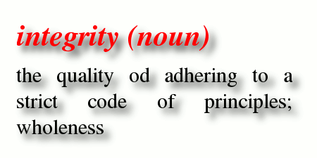

Slide 5
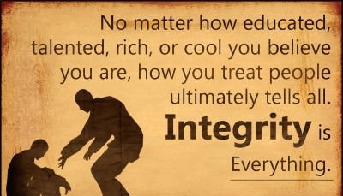

Slide 6
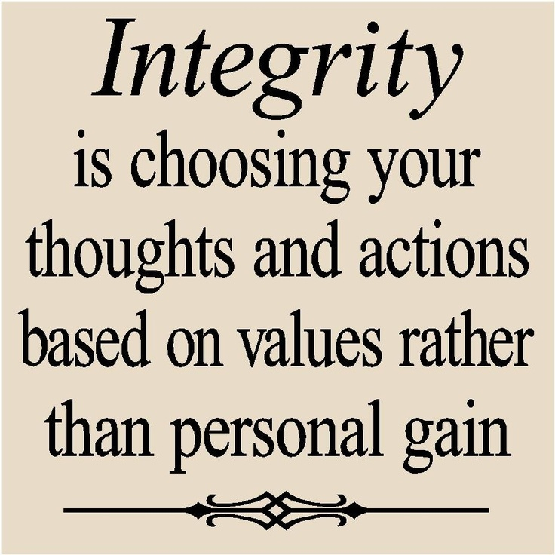

Slide 7
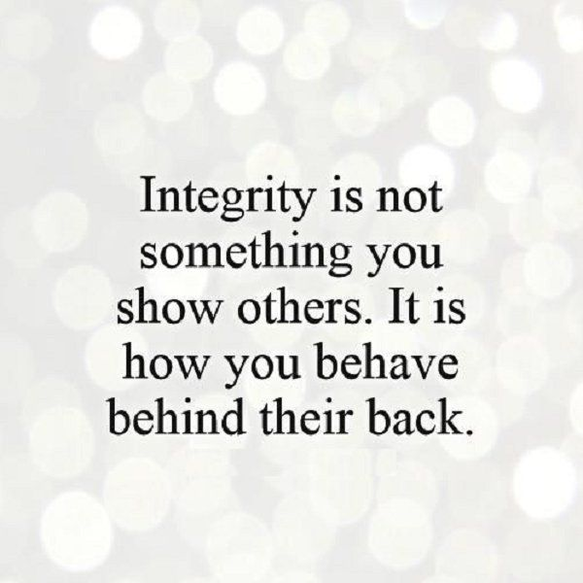

Slide 8
Integrity is an inner quality
Job Maintains His Integrity
27 Moreover Job continued his discourse, and said: ² “As God lives, who has taken away my justice, And the Almighty, who has made my soul bitter, ³ As long as my breath is in me, And the breath of God in my nostrils, ⁴ My lips will not speak wickedness, Nor my tongue utter deceit.⁵ Far be it from me That I should say you are right; Till I die I will not put away my integrity from me.

Slide 9
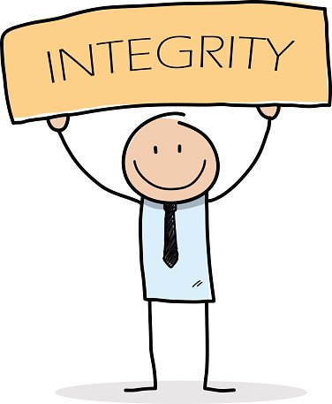
A combination of qualities
Truthfulness-speech
Honesty-Actions
Sincerity-attitude and spirit

Slide 10
Affects how we live (Prov 11:1)
Guides how we live
Guides specific decisions we make
Guides in all areas of life

Slide 11
Priceless (Prov 19:1)
Greater in value than all we have
It paints everything when it is present
It taints everything when it is absent

Slide 12
Affects our families (Prov 20:7)
One is righteous when one walks integrity
One’s children a blessed when one walks in integrity

Slide 13
Makes one whole
Lack of any aspect of character creates a hole in the composition of man
Integrity involves the idea of “whole, complete, entire”
A person without integrity is a person lacking

Slide 14
Requires work
Integrity may not come naturally
There are obstacles to integrity: self-preservation, self-provision, and self promotion
Integrity grows in relation to our time in the Word

