Slide 1
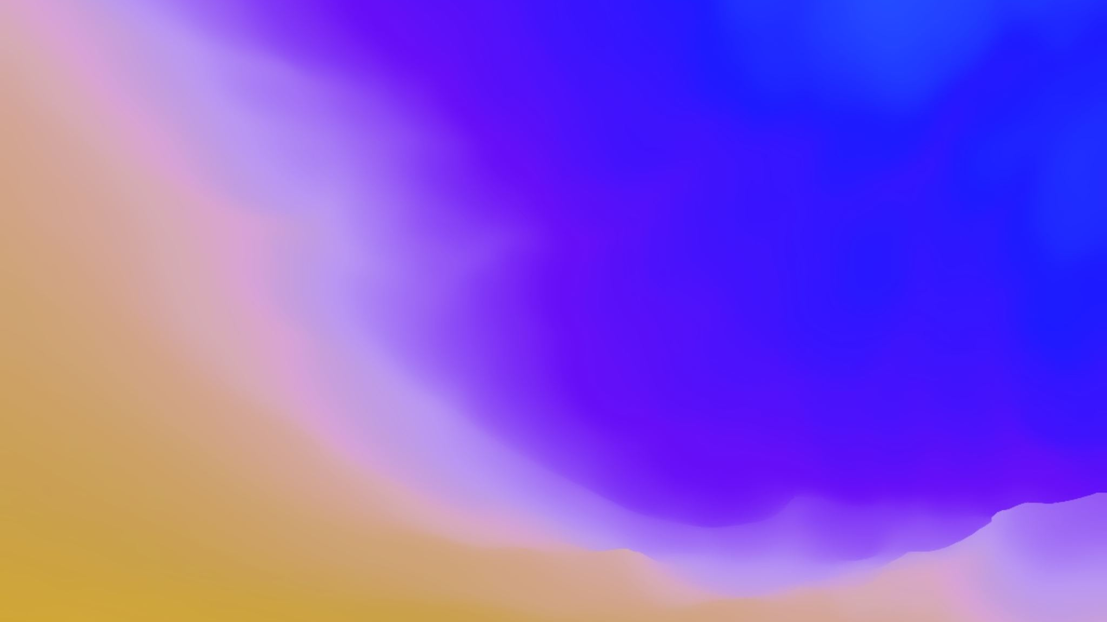
Elijah: “A Man With A Nature Like Ours”
James 5:17; I Kings 19:1-4

Slide 2
Introduction: 1 Kings 19:1-4
1 Kings 19:1-4 New King James Version
19 And Ahab told Jezebel all that Elijah had done, also how he had executed all the prophets with the sword. ² Then Jezebel sent a messenger to Elijah, saying, “So let the gods do to me, and more also, if I do not make your life as the life of one of them by tomorrow about this time.” ³ And when he saw that, he arose and ran for his life, and went to Beersheba, which belongs to Judah, and left his servant there. ⁴ But he himself went a day’s journey into the wilderness, and came and sat down under a broom tree. And he prayed that he might die, and said, “It is enough! Now, Lord, take my life, for I am no better than my fathers!”

Slide 3
What has happened to this great man of God who saw Him miraculously
Stop the rain and start it again at his request (1 Kings 17:1, 7)
Feed him with ravens (1 Kings 17:1-6)
Multiply meal and oil for him and a widow’s family (1 King 17:8-16)
Raise the widow’s dead son (1 Kings 17:17-24)
Send fire when he prayed for it (1 Kings 18:20-40)

Slide 4
What changed the thinking of this great man of God
If God could perform all these miracles why would there be a need to flee Jezebel
Surely God could protect him
Why flee and wish for death upon himself
What has happened in a span that can’t have been more than 24 hours

Slide 5
Let’s consider the actions of Elijah and try to answer the previous questions
He cut himself off from those close to him (3)
These feelings were clearly irrational (18)

Slide 6
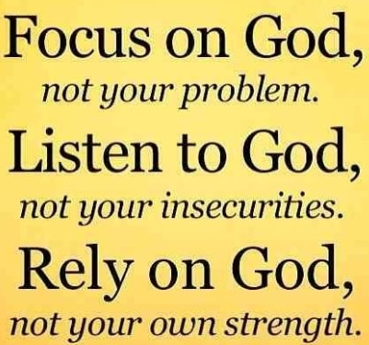
Let’s consider the actions of Elijah and try to answer the previous questions
He took his focus off God and placed it on himself (3)
Notes:
Mt 14:28-31 Peter walking on the water to his focus of Jesus
Heb 12:1-2 “looking unto Jesus the author and finisher of our faith

Slide 7
Let’s consider the actions of Elijah and try to answer the previous questions
He gave up… decided things were too rough (4)
Notes:
If he really wanted to die he could have just stayed put and allowed Jezebel to take care of it (irrational thought)

Slide 9
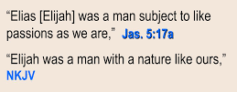
Conclusion: It could happen to you

