Slide 1
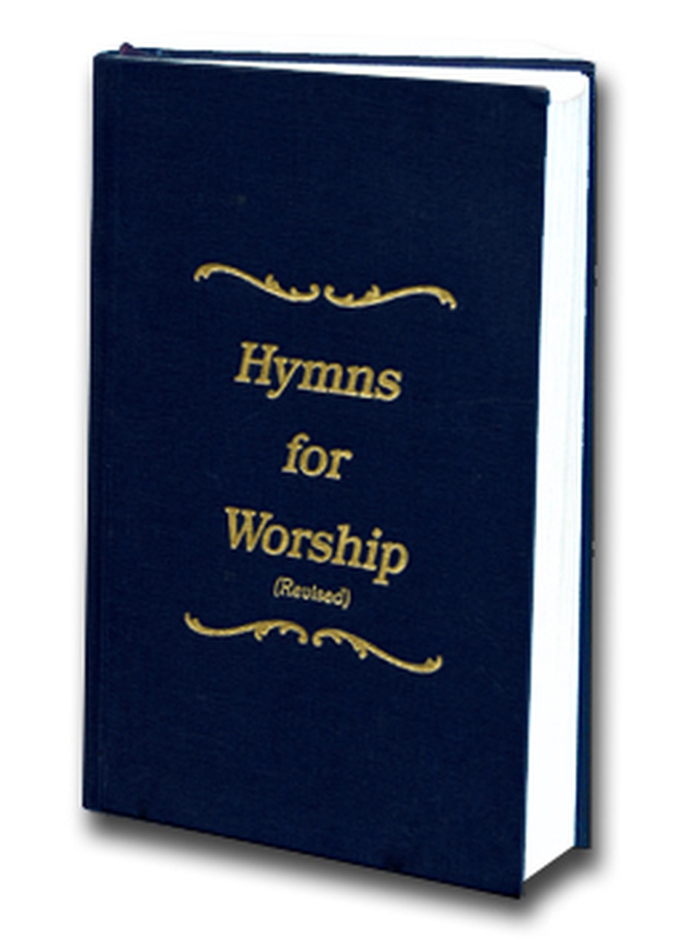
He Loves Me
Song #696

Slide 2
Why did the Savior heaven leave and come to earth below where men His grace would not receive?
John 3:13 New King James Version
¹³ No one has ascended to heaven but He who came down from heaven, that is, the Son of Man who is in heaven.

Slide 3
Why did the Savior heaven leave and come to earth below where men His grace would not receive?
John 6:38 New King James Version
³⁸ For I have come down from heaven, not to do My own will, but the will of Him who sent Me.

Slide 4
Why did the Savior heaven leave and come to earth below where men His grace would not receive?
Philippians 2:5-8 New King James Version
⁵ Let this mind be in you which was also in Christ Jesus, ⁶ who, being in the form of God, did not consider it robbery to be equal with God, ⁷ but made Himself of no reputation, taking the form of a bondservant, and coming in the likeness of men. ⁸ And being found in appearance as a man, He humbled Himself and became obedient to the point of death, even the death of the cross.

Slide 5
Why did the Savior heaven leave and come to earth below where men His grace would not receive?
1 John 4:2 New King James Version
² By this you know the Spirit of God: Every spirit that confesses that Jesus Christ has come in the flesh is of God,
he cross.

Slide 6
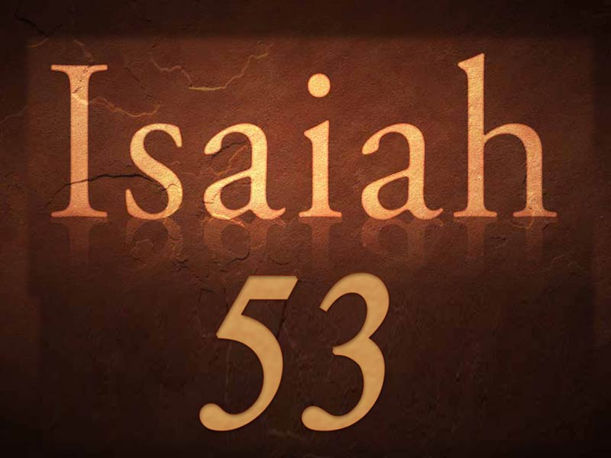
Why did the Savior heaven leave and come to earth below where men His grace would not receive?

Slide 7
Why did the Savior heaven leave and come to earth below where men His grace would not receive?
Psalm 118:22 New King James Version
²² The stone which the builders rejected Has become the chief cornerstone.
Ephesians 2:20 New King James Version
²⁰ having been built on the foundation of the apostles and prophets, Jesus Christ Himself being the chief cornerstone,

Slide 8
Why did the Savior heaven leave and come to earth below where men His grace would not receive?
Because He loves me so!

Slide 9
Why did the Savior mark the way and why temptation know? Why teach and toil and plead and pray?
1 Peter 2:21 New King James Version
²¹ For to this you were called, because Christ also suffered for us, leaving us an example, that you should follow His steps:

Slide 10
Why did the Savior mark the way and why temptation know? Why teach and toil and plead and pray?
1 Corinthians 11:1 New King James Version
11 Imitate me, just as I also imitate Christ.

Slide 11
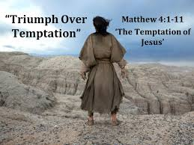
Why did the Savior mark the way and why temptation know? Why teach and toil and plead and pray?
1 Corinthians 11:1 New King James Version
11 Imitate me, just as I also imitate Christ.

Slide 12
Why did the Savior mark the way and why temptation know? Why teach and toil and plead and pray?
Hebrews 4:14-15 New King James Version
¹⁴ Seeing then that we have a great High Priest who has passed through the heavens, Jesus the Son of God, let us hold fast our confession. ¹⁵ For we do not have a High Priest who cannot sympathize with our weaknesses, but was in all points tempted as we are, yet without sin.

Slide 13
Why did the Savior mark the way and why temptation know? Why teach and toil and plead and pray?
Matthew 7:28-29 New King James Version
²⁸ And so it was, when Jesus had ended these sayings, that the people were astonished at His teaching, ²⁹ for He taught them as one having authority, and not as the scribes.

Slide 14
Why did the Savior mark the way and why temptation know? Why teach and toil and plead and pray?
Mark 6:34 New King James Version
³⁴ And Jesus, when He came out, saw a great multitude and was moved with compassion for them, because they were like sheep not having a shepherd. So He began to teach them many things.

Slide 15
Why did the Savior mark the way and why temptation know? Why teach and toil and plead and pray?
Luke 5:3 New King James Version
³ Then He got into one of the boats, which was Simon’s, and asked him to put out a little from the land. And He sat down and taught the multitudes from the boat.

Slide 16
Why did the Savior mark the way and why temptation know? Why teach and toil and plead and pray?
Matthew 14:23 New King James Version
²³ And when He had sent the multitudes away, He went up on the mountain by Himself to pray. Now when evening came, He was alone there.

Slide 17
Why did the Savior mark the way and why temptation know? Why teach and toil and plead and pray?
Luke 6:12 New King James Version
¹² Now it came to pass in those days that He went out to the mountain to pray, and continued all night in prayer to God.

Slide 18
Why did the Savior mark the way and why temptation know? Why teach and toil and plead and pray?
Mark 1:35 New King James Version
³⁵ Now in the morning, having risen a long while before daylight, He went out and departed to a ^{[a]}solitary place; and there He prayed.

Slide 19
Why did the Savior mark the way and why temptation know? Why teach and toil and plead and pray?
Because He loves me so!

Slide 20
Why feel the garden’s dreadful dross? Why through His Trials go? Why suffer death upon the cross?

Slide 21
Why feel the garden’s dreadful dross? Why through His Trials go? Why suffer death upon the cross?

Slide 22
Why feel the garden’s dreadful dross? Why through His Trials go? Why suffer death upon the cross?
Because He loves me so!

Slide 23
Conclusion
He loves me! He loves me! He loves me this I know! He gave Himself to die for me because He loves me so!

