Slide 1
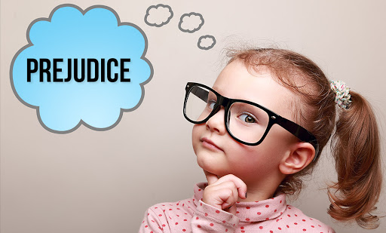

Slide 2
Prejudice Defined (Webster’s Dictionary)
(1) : preconceived judgment or opinion
(2) : an adverse opinion or leaning formed without just grounds or before sufficient knowledge
b : an instance of such judgment or opinion
c : an irrational attitude of hostility directed against an individual, a group, a race, or their supposed characteristics

Slide 3
Discrimination Defined (Dictionary.com & Wikipedia)
An act or instance of discriminating, or of making a distinction
treatment or consideration of, or making a distinction in favor of or against, a person or thing based on the group, class, or category to which that person or thing belongs rather than on individual merit: racial and religious intolerance and discrimination
Discrimination is the act of making distinctions between human beings based on the groups, classes, or other categories to which they are perceived to belong

Slide 4
Racism Defined (Dictionary.com & Wikipedia)
A belief or doctrine that inherent differences among the various human racial groups determine cultural or individual achievement, usually involving the idea that one's own race is superior and has the right to dominate others or that a particular racial group is inferior to the others
Hatred or intolerance of another race or other races
Racism is the belief that groups of humans possess different behavioral traits corresponding to physical appearance and can be divided based on the superiority of one race over another

Slide 9
In the past 150 years many groups and peoples have been persecuted due to a variety of prejudices
Slavery in America
Darwin’s theory of evolution
The full title of his famous work: “The Origin of Species by Means of Natural Selection, or, The Preservation of Favoured Races in the Struggle for Life”
Hitler’s idea of the blonde-haired blue-eyed superior Aryan race
Those he considered inferior included Jews, Poles, and slaves

Slide 10
Key Scriptures
Gen 1:26 “²⁶ Then God said, “Let Us make man in Our image, according to Our likeness; let them have dominion over the fish of the sea, over the birds of the air, and over the cattle, over all the earth and over every creeping thing that creeps on the earth.”
Gen 1:27 “²⁷ So God created man in His own image; in the image of God He created him; male and female He created them.”

Slide 11
Key Scriptures
Deut 10:17 “¹⁷ For the Lord your God is God of gods and Lord of lords, the great God, mighty and awesome, who shows no partiality nor takes a bribe.”

Slide 12
Key Scriptures

Slide 13
Key Scriptures

Slide 14
Key Scriptures

Slide 15
Key Scriptures

Slide 16
Concluding Scriptures

Slide 18
Who were the Samaritans?
A people who occupied the country formerly belonging to the tribe of Ephraim and the half-tribe of Manasseh
In 721 B.C., the northern kingdom of Israel fell to the Assyrians. Many of the people of Israel were led off to Assyria as captives, but some remained in the land and intermarried with foreigners planted there by the Assyrians
These half-Jewish, half-Gentile people became known as the Samaritans.

Slide 19
Why did the Jews of Jesus’ time still hate the Samaritans
They created for themselves their own religion that the Jews considered to be heresy
They established a temple on Mt. Gerizim as their center of worship claiming this is the place Moses had originally intended them to worship
They saw themselves as true descendants of Israel and preservers of the “True religion” and the Jerusalem temple and Levitical priesthood illegitimate

Slide 20
Why did the Jews of Jesus’ time still hate the Samaritans
They opposed the Jews attempt to rebuild the temple in Jerusalem
This lead to greater ill-will toward the Jews as they lived in the land in opposition to one another
The Jews saw the Samaritans as nothing more than “Half-breeds” who defiled true religion

Slide 21
Jesus and the Samaritans

Slide 22
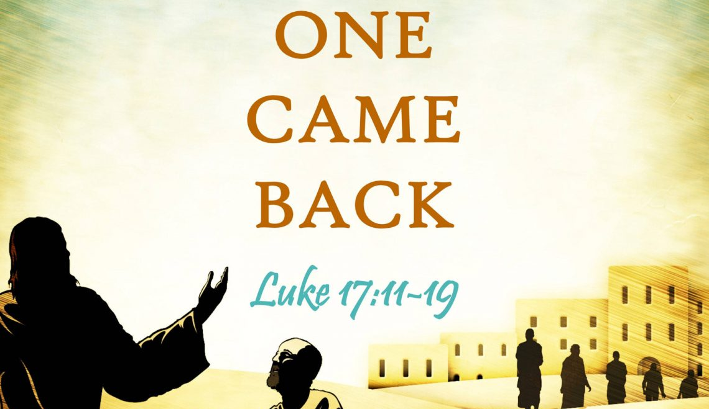
Jesus and the Samaritans

Slide 23
Jesus and the Samaritans

Slide 24
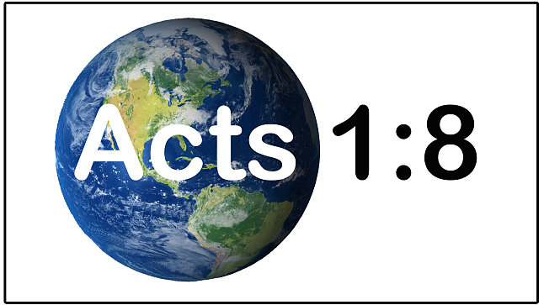
Jesus and the Samaritans

Slide 25
Philip and the Samaritans

