Slide 1
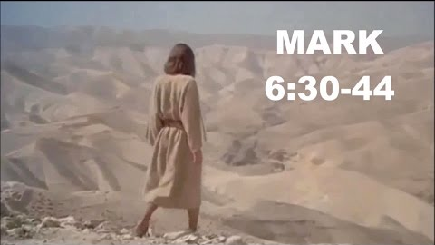

Slide 2
Possible reactions to people in need
Notes:
You see the need but do not care
Absence of emotuon

Slide 3
Possible reactions to people in need
Notes:
I know how you feel vs empathy I feel how you feel

Slide 4
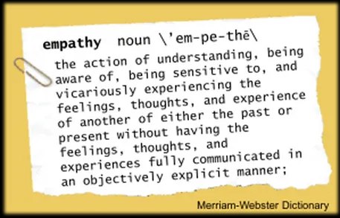
Possible reactions to people in need

Slide 5
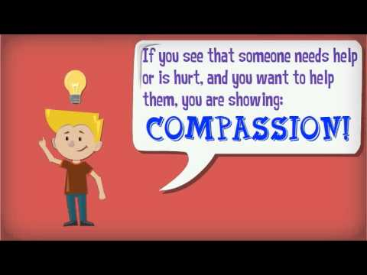
Possible reactions to people in need
To be moved inwardly; to yearn with tender mercy, affection, pity and empathy
It refers to the deepest possible feelings
The phrase moved with compassion means to be “moved in the inner organs… has the same idea as the expression “from the bottom of my heart”
Notes:
Definitions found n Pocketbible app

Slide 6
His Compassion for the Apostles Mk 6:30-32
³⁰ Then the apostles gathered to Jesus and told Him all things, both what they had done and what they had taught.
³¹ And He said to them, “Come aside by yourselves to a deserted place and rest a while.” For there were many coming and going, and they did not even have time to eat.
³² So they departed to a deserted place in the boat by themselves.

Slide 7
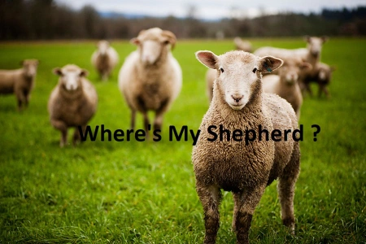
His Compassion for the Multitude Mk 6:33-34
³³ But [the multitudes saw them departing, and many knew Him and ran there on foot from all the cities. They arrived before them and came together to Him.
³⁴ And Jesus, when He came out, saw a great multitude and was moved with compassion for them, because they were like sheep not having a shepherd. So He began to teach them many things.

Slide 8
His Compassion for the Multitude Mk 6:33-34
Sheep without a shepherd cannot find their way
Without a heavenly shepherd the lost would not be able to find their way to God
Lk 15:3-7

Slide 9
His Compassion for the Multitude Mk 6:33-34
Sheep without a shepherd are defenseless
Without a heavenly shepherd the lost would not be able to avoid the wrath of God
Jn 10:27-30

Slide 10
His Compassion for the Multitude Mk 6:33-34
Sheep without a shepherd are dumb
Without a heavenly shepherd the lost do not even know they are lost
Acts 17:16-34
Notes:
Paul at the areopagus deals with the idea of ignorance and the one true God and the day of judgment

Slide 11
His Compassion for You

