Slide 1
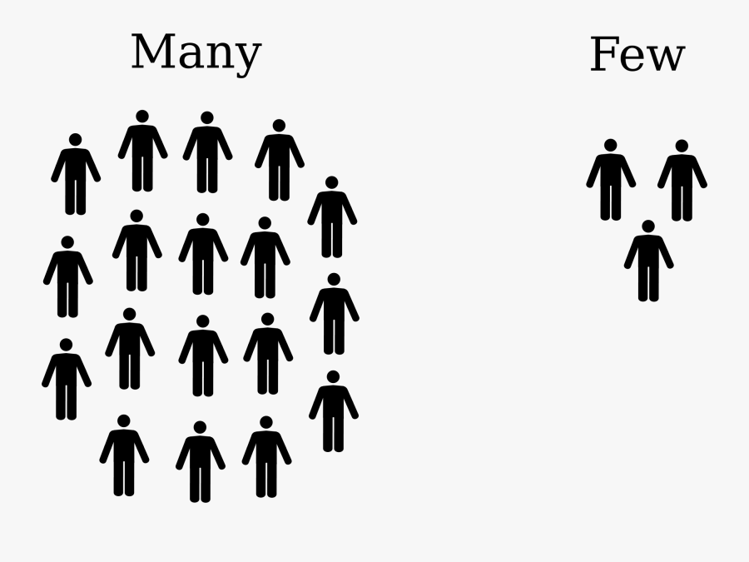
Thoughts on “few”

Slide 4
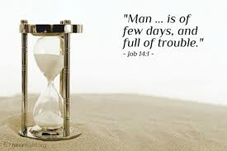
Few is the number of days to prepare for the end of this life and the start of the next
Ps 39:4-5 “⁴ “Lord, make me to know my end, and what is the measure of my days, That I may know how frail I am. Indeed, You have made my days as handbreadths, And my age is as nothing before You; Certainly every man at his best state is but vapor. Selah”

Slide 5
Few is the number of days to prepare for the end of this life and the start of the next

Slide 6
Few is the number of days to prepare for the end of this life and the start of the next
Ps 90:10-12 “¹⁰ The days of our lives are seventy years; And if by reason of strength they are eighty years, Yet their boast is only labor and sorrow; For it is soon cut off, and we fly away. ¹¹ Who knows the power of Your anger? For as the fear of You, so is Your wrath. ¹² So teach us to number our days, That we may gain a heart of wisdom”

Slide 7
Few is the number of days to prepare for the end of this life and the start of the next
Eph 5:15-17 “¹⁵ See then that you walk circumspectly, not as fools but as wise, ¹⁶ redeeming the time, because the days are evil. ¹⁷ Therefore do not be unwise, but understand what the will of the Lord is.”

Slide 8
Few is the number of laborers working the harvest
Mt 9:37-38 “³⁷ Then He said to His disciples, “The harvest truly is plentiful, but the laborers are few. ³⁸ Therefore pray the Lord of the harvest to send out laborers into His harvest.”

Slide 9
Few is the number of laborers working the harvest

Slide 10
Few is the number of people who will be saved

Slide 12
Few is the number you want to be a part of on judgment day

