Slide 1
4:1-20 (Pt 1)

Slide 2
Mk 4:1 “4 And again He began to teach by the sea. And a great multitude was gathered to Him, so that He got into a boat and sat in it on the sea; and the whole multitude was on the land facing the sea.
Once again, we see great crowds gathering to hear the teachings of Jesus
Jesus takes a boat out into the sea (something He prepared for in 3:9 as well)
Being out in the sea allowed for Him to be slightly apart from the crowd so that all could see Him
Everyone could look in one direction to see Him

Slide 3
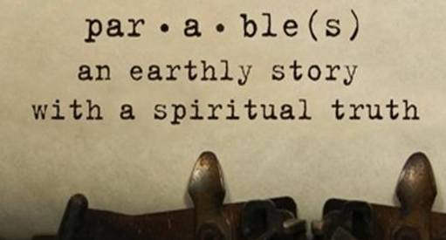
Mark 4:2 “² Then He taught them many things by parables, and said to them in His teaching:
Parable: comes from the idea of “to set along side”
Jesus used parables to set a spiritual truth alongside a physical truth that would be commonly understood

Slide 4
Mark 4:3 “³ “Listen! Behold, a sower went out to sow.
Jesus starts His teaching by telling his audience to “Listen!” He wants the people to pay attention to what is about to be said
Jesus then uses a very simple message that they would understand to begin His teaching
There is nothing stated here that the people were not familiar with or could not understand

Slide 5
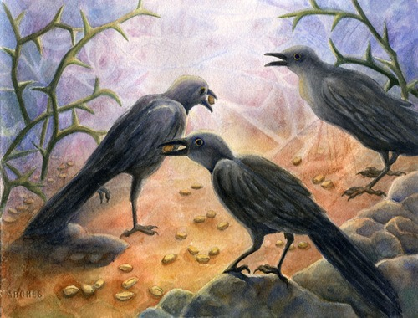
Mk 4:4 “⁴ And it happened, as he sowed, that some seed fell by the wayside; and the bird [of the air came and devoured it.
“The wayside” a road near the edge of a field or a path that ran through the field…either way the ground would be hard due to constant foot traffic

Slide 6
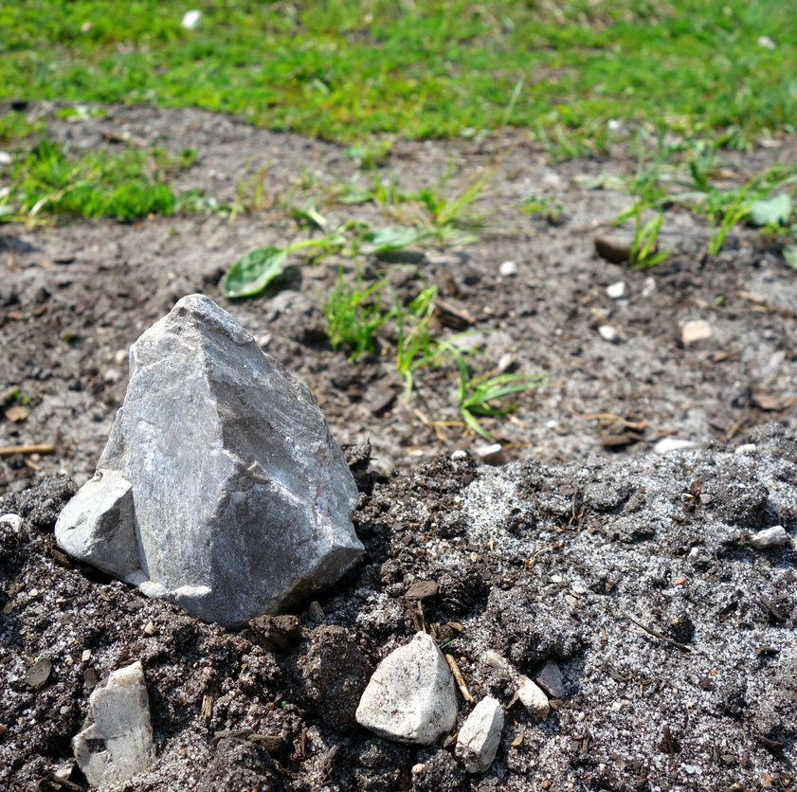
Mk 4:5-6 “⁵ Some fell on stony ground, where it did not have much earth; and immediately it sprang up because it had no depth of earth. ⁶ But when the sun was up it was scorched, and because it had no root it withered away.
Stony places are common in Palestine
Often there will be an outcropping of limestone rock covered by a thin layer of topsoil… the topsoil appears ready to be sown but because there is no depth of soil, as the sun beats down on the plant it withers and dies without producing any fruit

Slide 7
Mk 4:7 “⁷ And some seed fell among thorns; and the thorns grew up and choked it, and it yielded no crop.

Slide 8
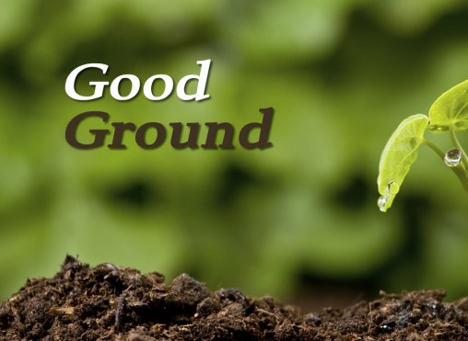
Mk 4:8 “⁸ But other seed fell on good ground and yielded a crop that sprang up, increased and produced: some thirtyfold, some sixty, and some a hundred.”
Ground that has been worked and prepared
The seed germinated within the soil and plant began to grow
When the plant reached maturity it bore fruit for the sower

Slide 9
A look at the seed and soil
The seed all came from the same place
The ground which received the seed is what varied
The emphasis of this story should be on the soil that receives the seed

Slide 10
Mark 4:9 “⁹ And He said to them, “He who has ears to hear, let him hear!”
This statement serves as a nice bookend to the statement made back in verse 3 where he tells the people to listen
Listening involves an effort to catch the words that are spoken…to hear is to analyze and truly understand what was said
Observe and take notice of what has been said

