Slide 1
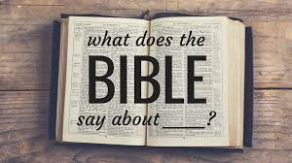
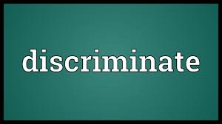

Slide 2
God demands discrimination
The primary meaning of the word discriminate is
To have good taste or judgment
To make a distinction
The bible uses the term “discern” synonymously with “discriminate”
Discriminate comes from the Greek word “diakrino”
To separate, discriminate, then to learn by discriminating, to determine, to decide

Slide 3
God demands discrimination between the church of the NT and all others

Slide 4
God demands discrimination between the church of the NT and all others
It’s establishment
It’s terms of entrance
It’s worship
It’s organization
It’s mission/work

Slide 5
God demands discrimination between matters of faith and matters of opinion
Baptism
Mk 16:16,
Jn 3:5,
1pet 3:21
Evangelism
mt 28:18-20
Care for widows and orphans
Jam 1:27

Slide 6
God demands discrimination between matters of faith and matters of opinion
Assembling with the saints
Heb 10:24-25
The Lord’s supper (when and what manner)
Acts 20:7
1 Cor 11:23-34

Slide 7
God demands discrimination between matters of faith and matters of opinion
Method of evangelism
What time we meet on the first of day of the week
What type of class material or song books used
Oder of our worship service

Slide 8
God demands discrimination between right and wrong

Slide 9
God demands discrimination between right and wrong

Slide 10
God demands discrimination between right and wrong

Slide 11
God demands discrimination between right and wrong

Slide 12
God demands discrimination

