Slide 1
Slide 1
Christ arose
Song #174
Notes:
These can be changed to reflect your school’s specific rules.

Slide 2
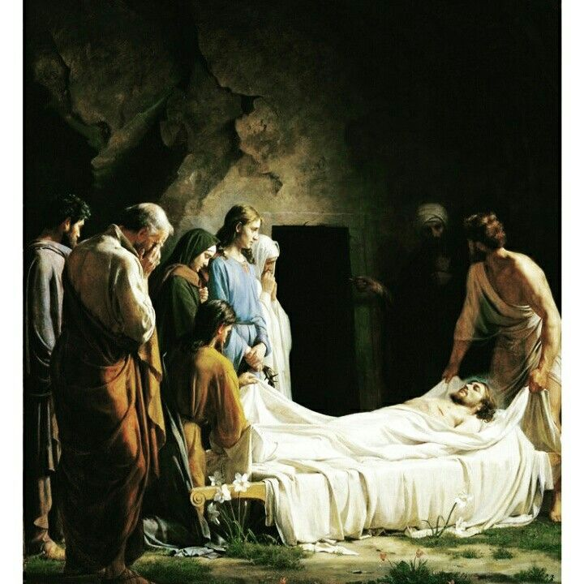
Low in the grave he lay- Jesus my savior
Mt 27: 57-61 “⁵⁷ Now when evening had come, there came a rich man from Arimathea, named Joseph, who himself had also become a disciple of Jesus. ⁵⁸ This man went to Pilate and asked for the body of Jesus. Then Pilate commanded the body to be given to him. ⁵⁹ When Joseph had taken the body, he wrapped it in a clean linen cloth, ⁶⁰ and laid it in his new tomb which he had hewn out of the rock; and he rolled a large stone against the door of the tomb, and departed. ⁶¹ And Mary Magdalene was there, and the other Mary, sitting opposite the tomb.”

Slide 3
Waiting the coming day- jesus my lord
Ps 16:9-11 “⁹ Therefore my heart is glad, and my glory rejoices; My flesh also will [rest in hope. ¹⁰ For You will not leave my soul in Sheol, Nor will You allow Your Holy One to see corruption. ¹¹ You will show me the path of life; In Your presence is fullness of joy; At Your right hand are pleasures forevermore.” (cf Act 2:24-32)
Notes:
Wait time was short as resurrection was prophesied even in the OT
Christ prophesied of His resurrection: Matt. 16.21, 17.22-23, 20.17-19

Slide 4
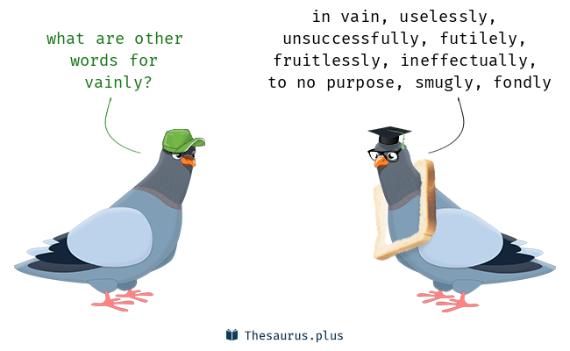
Vainly they watch his bed- jesus my savior! Vainly they seal the dead- jesus my lord
The Jewish leaders feared the disciples would steal the body so they requested a guard be set at the sealed tomb (Mt 27:62-66)
They recalled his predictions of the resurrection and wanted to cover all their bases (Mt 12:38-40)
Their preparations were in vain as Christ did eventually leave the tomb (Mt 28:11-15)

Slide 5
Death cannot keep his prey- jesus my savior! He tore the bars away- jesus my lord
After three days Christ arose just as He said he would (Mt 28:1-2)
He appeared to a number of people to prove He was alive again (Act 1:1-3; 1 Cor 15:3-8)
We are to remember this resurrection as it proves He truly is the Son of God (Rom 1:3-4; 2 Tim 2:8)

Slide 6
conclusion
Up from the grave He arose
With a mighty triumph o’er His foes
He arose a victor from the dark domain
He lives forever with His saints to reign
He arose! He arose Hallelujah Christ arose

